Slide 1



Resilience Protection of the Steinway Tube Under River Contracts# (C-34924/ E-40848/ W-32574)
CPM Scheduling Consultant: HSE CONTRACTORS INC
Baseline Schedule Presentation
Main Contractor:
Rising Sun Construction
The Metropolitan Transportation Authority Acting by the New York City Transit Authority

Slide 2
Content
Project Information
Project Description & Type of work
Constraints
Resources
S-Curve

Slide 3
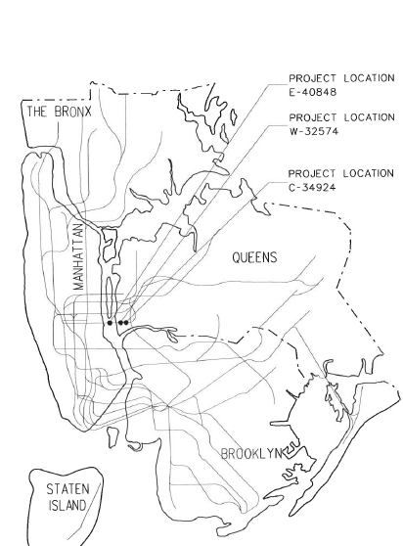
Project Information
NTP : December 19, 2022
Substantial Completion : April 17, 2025
Project Duration : 851 Calendar Days
Project value : 25,838,246$
Project location : NEW YORK

Slide 4
2. Project Description & TYPE OF WORK
Resiliency Protection of the Steinway under the river tube in the boroughs of Manhattan and queens consists of:
(Contract C-34924) Sandy mitigation: Steinway portal borough of queens.
(Contract E-40848) Pumping System Improvement in midtown Steinway tube in the borough of Manhattan and queens.
(Contract W-32574) Police radio systems: Shaft 4 BDA enclosure.
Description | Duration | Start | Finish | Budgeted Total Cost
Sandy Mitigation Steinway Work | 425 | 03-Jul-23 | 16-Mar-25 | $9,057,592.00
Pumping System Improvement Work | 288 | 21-Oct-23 | 16-Dec-24 | $8,969,018.00
Police radio and antenna equipment | 353 | 27-Jun-23 | 21-Nov-24 | $1,029,840.00

Slide 5
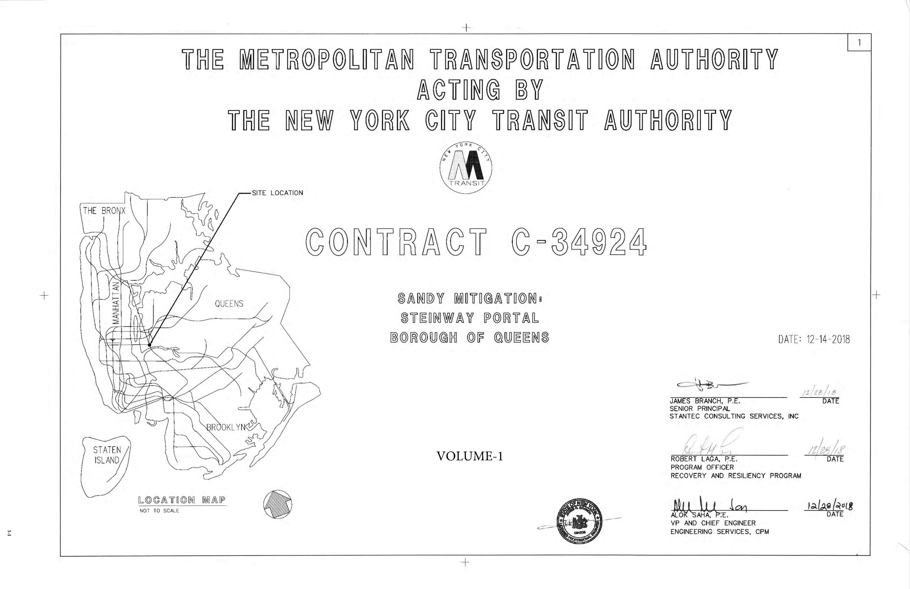
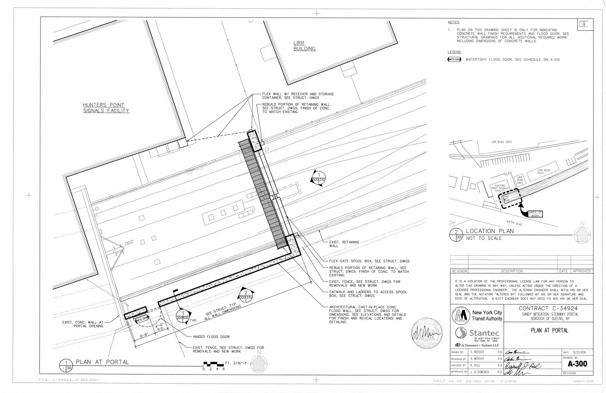
(Contract C-34924)
Sandy mitigation: Steinway portal borough of queens
Start date : 03-Jul-2023
Finish date : 16-Mar-2025
(Contract C-34924) consists of :
Concrete Flood Wall
Flood Gates Barriers
Cantilever Flood Wall
Removal of existing retaining wall at North and South elevations
Steel Catwalk
Flex Gates work
Steel Catwalk
Flex Gates work
Removal of existing retaining wall
Concrete Flood Wall
Flood Gates Barriers (WFD 006)

Slide 6
(Contract C-34924) Sandy mitigation: Steinway portal borough of queens
Type of work | Duration | Start | Finish | Budgeted Total Cost
Concrete Flood Wall | 304 | 28-Aug-23 | 13-Nov-24 | $3,295,960.00
Flood Wall | 95 | 28-Jun-24 | 13-Nov-24 | $1,005,060.00
Cantilever Flood Wall | 14 | 28-Oct-23 | 19-Nov-23 | $125,600.00
Removal of existing retaining wall | 51 | 28-Oct-23 | 14-Jan-24 | $305,000.00
Steel Catwalk | 5 | 20-Jan-24 | 28-Jan-24 | $432,650.00
Flex Gates work | 5 | 08-Mar-25 | 16-Mar-25 | $4,785,882.00

Slide 7
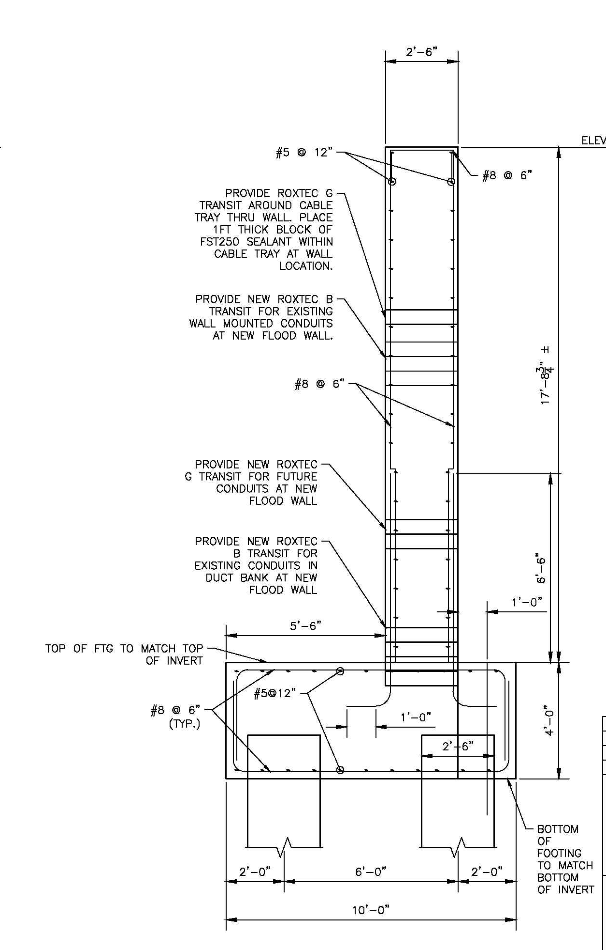
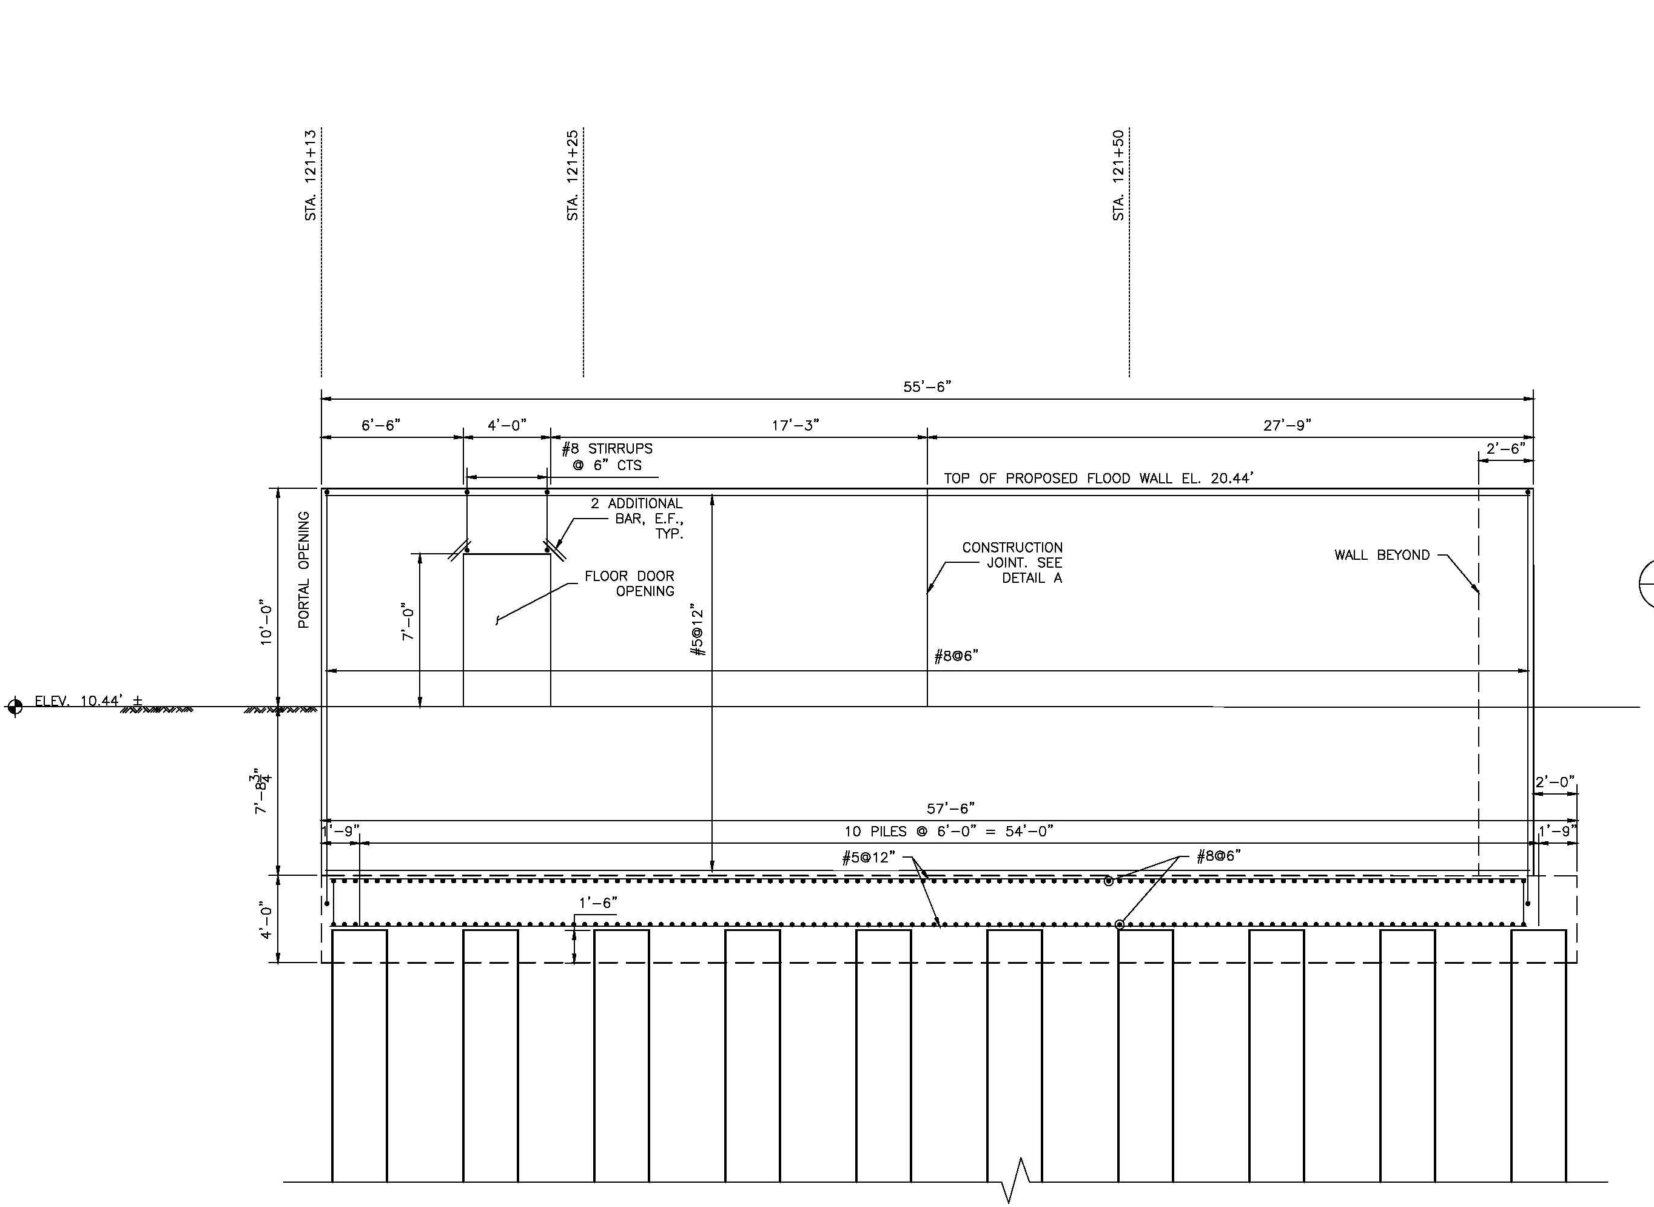
Concrete Flood Wall work
Piles starts
Pile Cap
Flood Wall
Type of work | Duration | Start | Finish | Budgeted Total Cost
Piles | 101 | 28-Aug-23 | 24-Jan-24 | $1,485,000.00
Pile Cap | 108 | 25-Jan-24 | 27-Jun-24 | $805,900.00
Flood Wall | 95 | 28-Jun-24 | 13-Nov-24 | $1,005,060.00

Slide 8
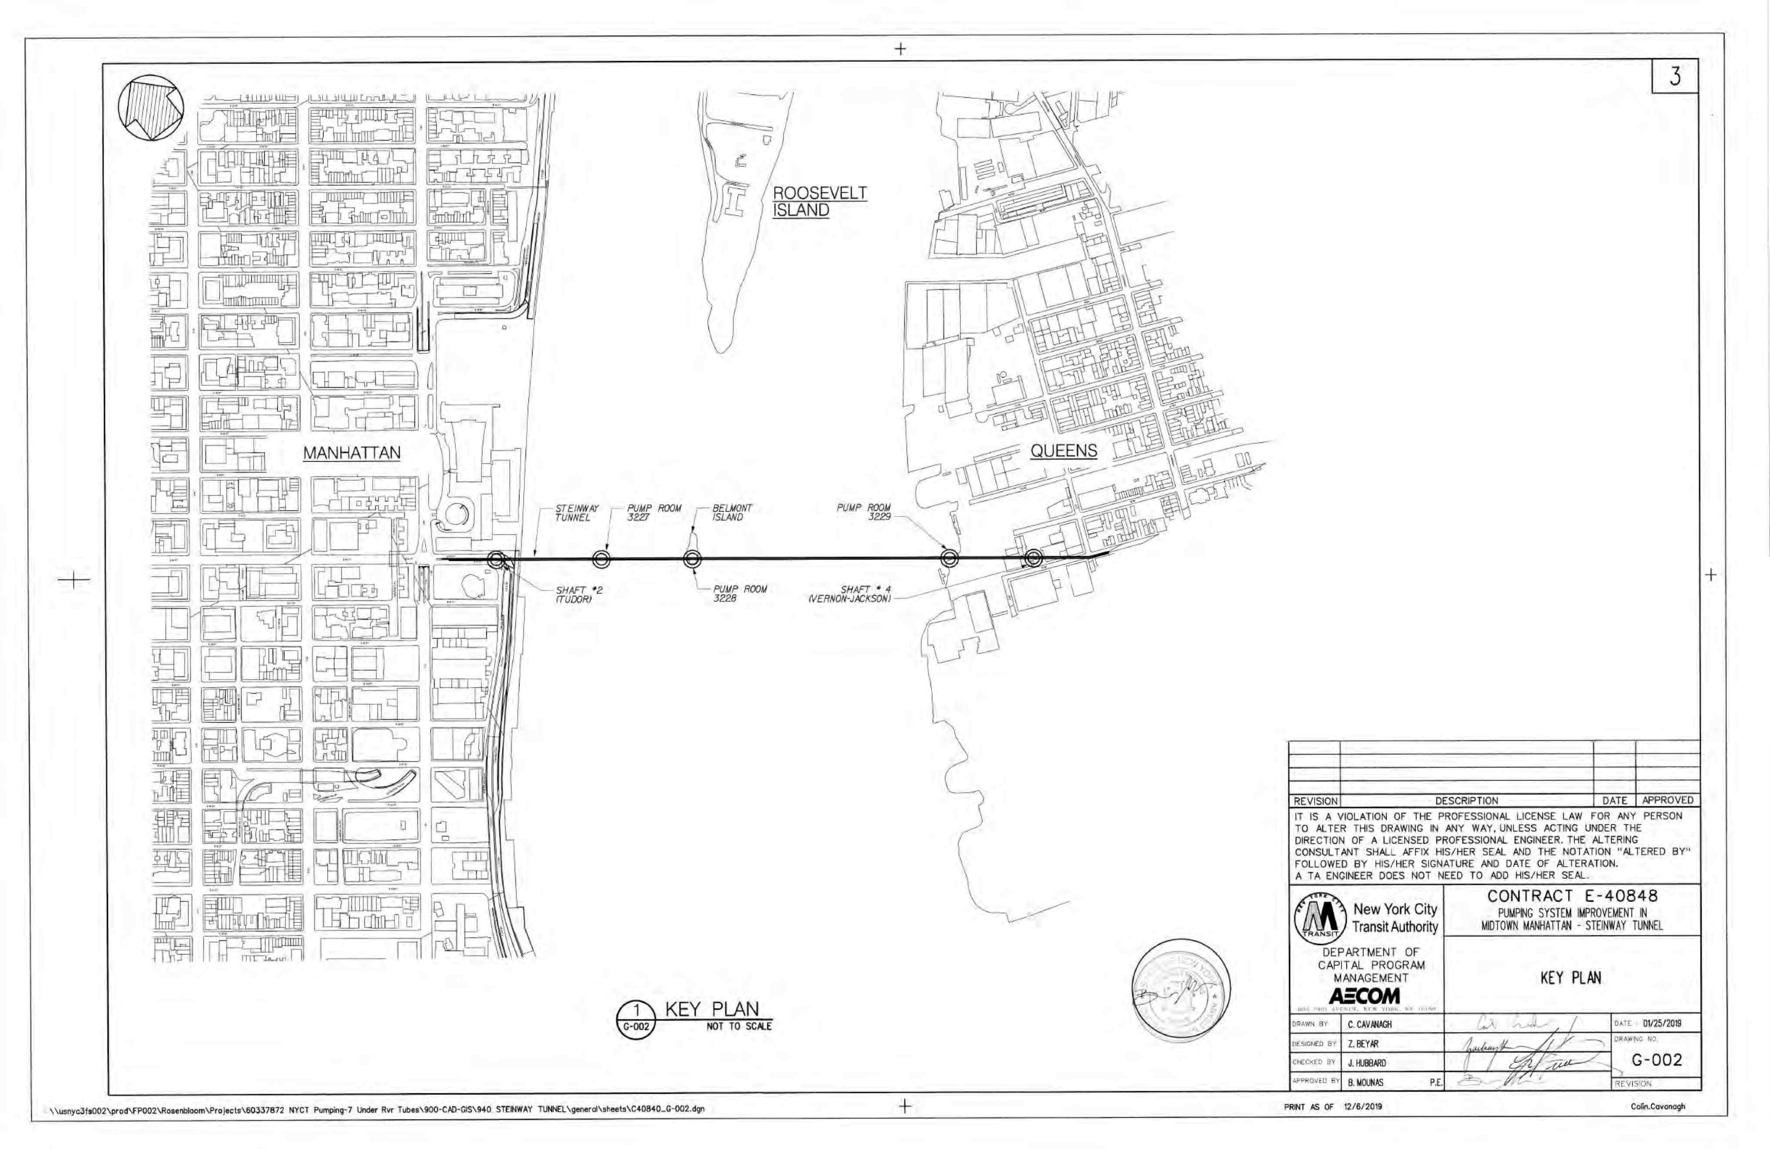
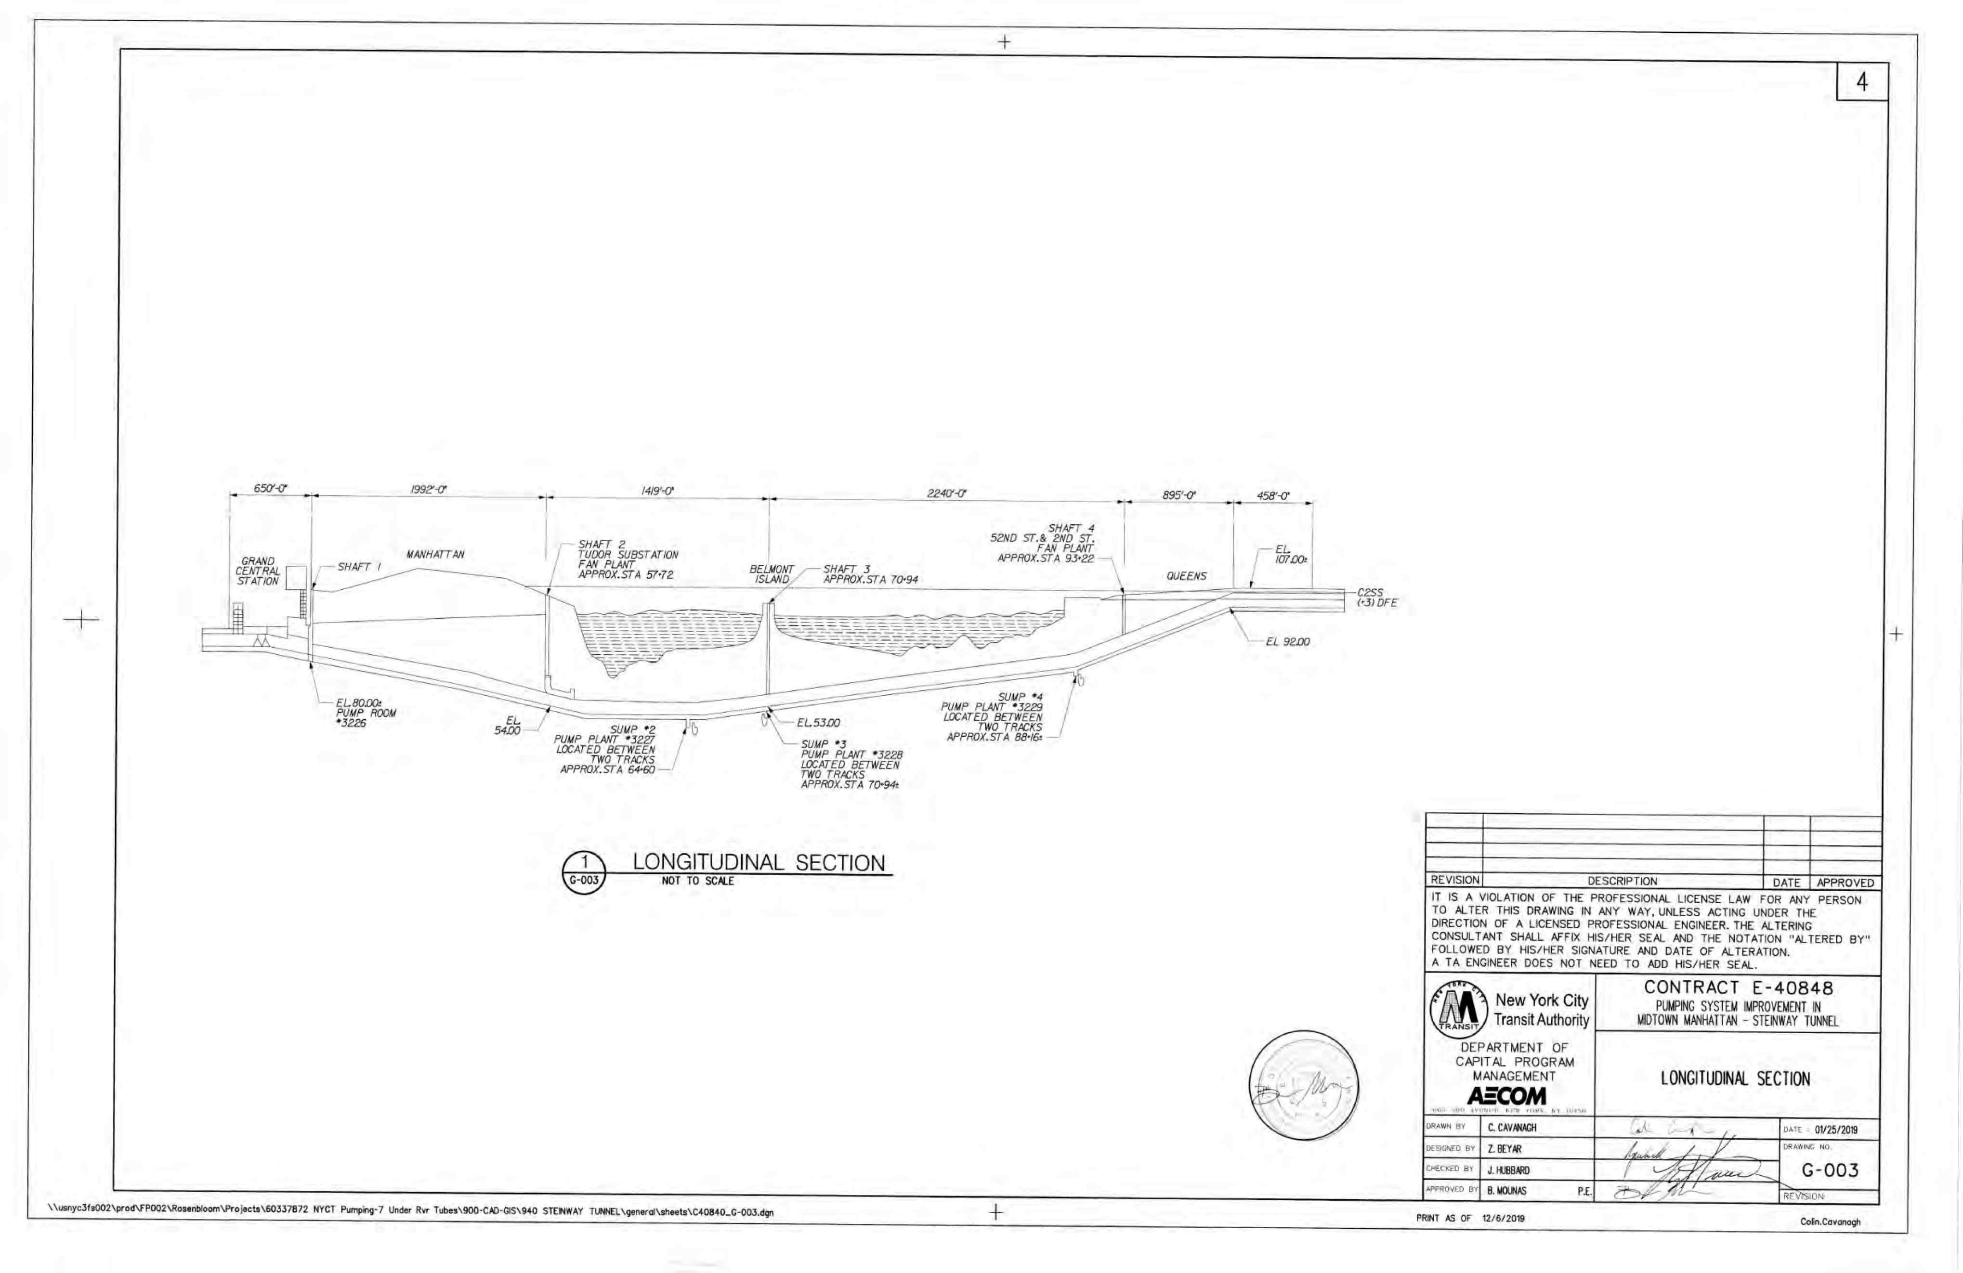
(Contract E-40848)
Pumping System Improvement in midtown Steinway tube in the borough of Manhattan and queens.
Start date : 21-Oct-2023
Finish date : 16-Dec-2024
(Contract E-40848) consists of :
Structural Work
Mechanical and Plumbing work
Electrical Work
Instrumentation and Control
Communication Work
Pump Room 3229,3228,PR 3227
C1 track Manhattan
C2 Track Queens
Shaft 4, Shaft 2.

Slide 9
Pumping System Improvement Work
Type of work | Duration | Start | Finish | Budgeted Total Cost
Structural Work | 212 | 13-Jan-24 | 17-Nov-24 | $795,760.00
Mechanical and Plumbing | 96 | 21-Oct-23 | 12-Mar-24 | $3,288,400.00
Electrical Work | 269 | 21-Oct-23 | 16-Dec-24 | $3,357,652.00
Instrumentation and Control | 19 | 19-Oct-24 | 17-Nov-24 | $962,316.00
Fire Alarm | 20 | 08-May-24 | 05-Jun-24 | $99,700.00
Communication Work | 60 | 13-Mar-24 | 17-Nov-24 | $465,190.00

Slide 10
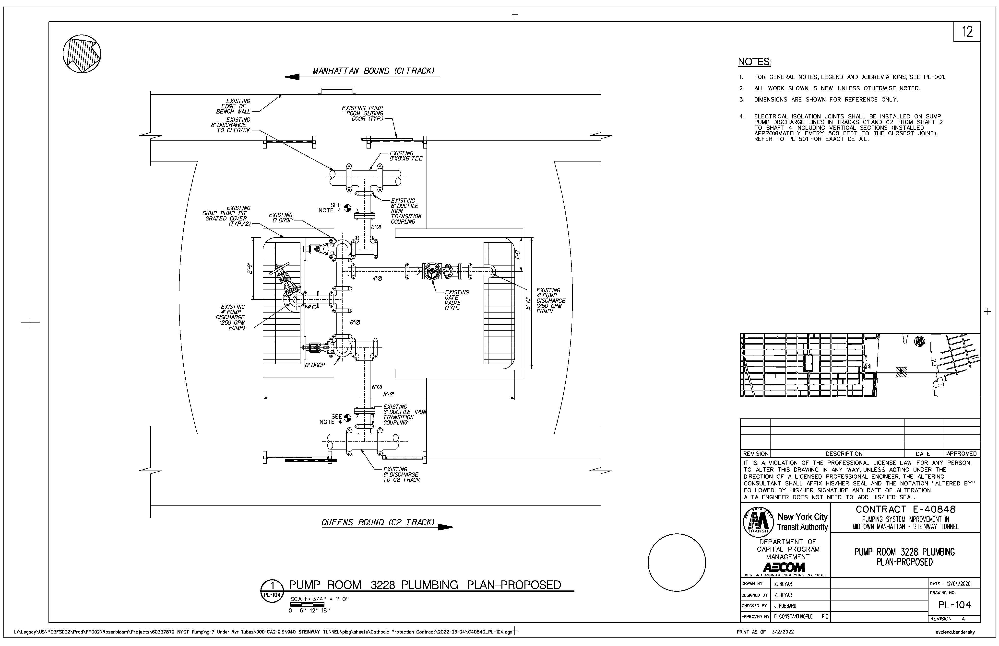
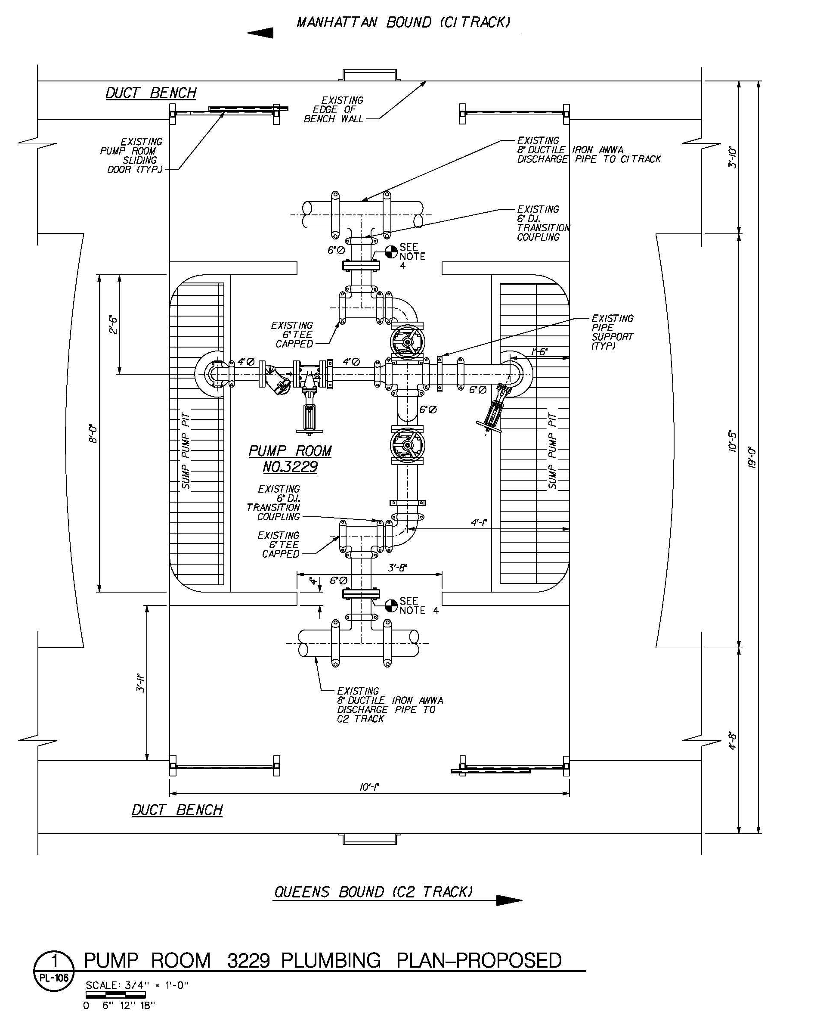
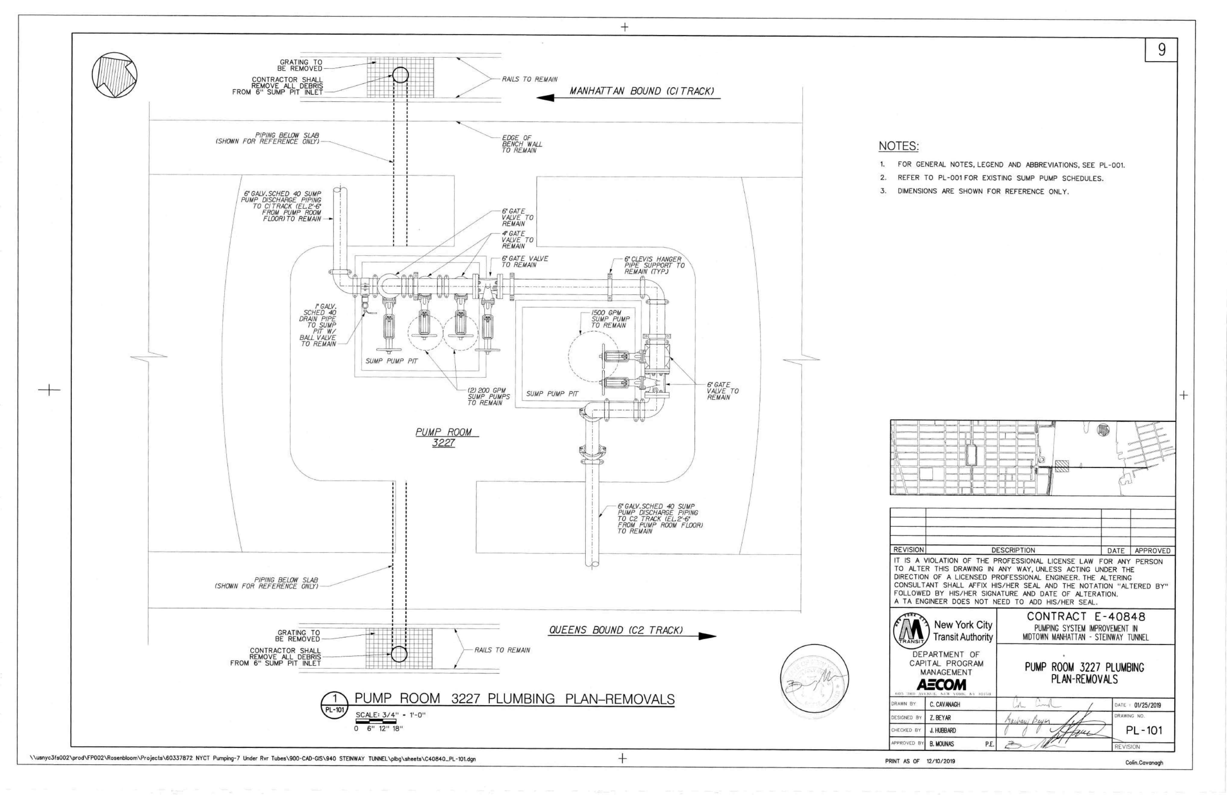
Pump Rooms (3229,3228,3227)
Pump Room (3228)
Pump Room (3229)
Pump Room (3227)

Slide 11
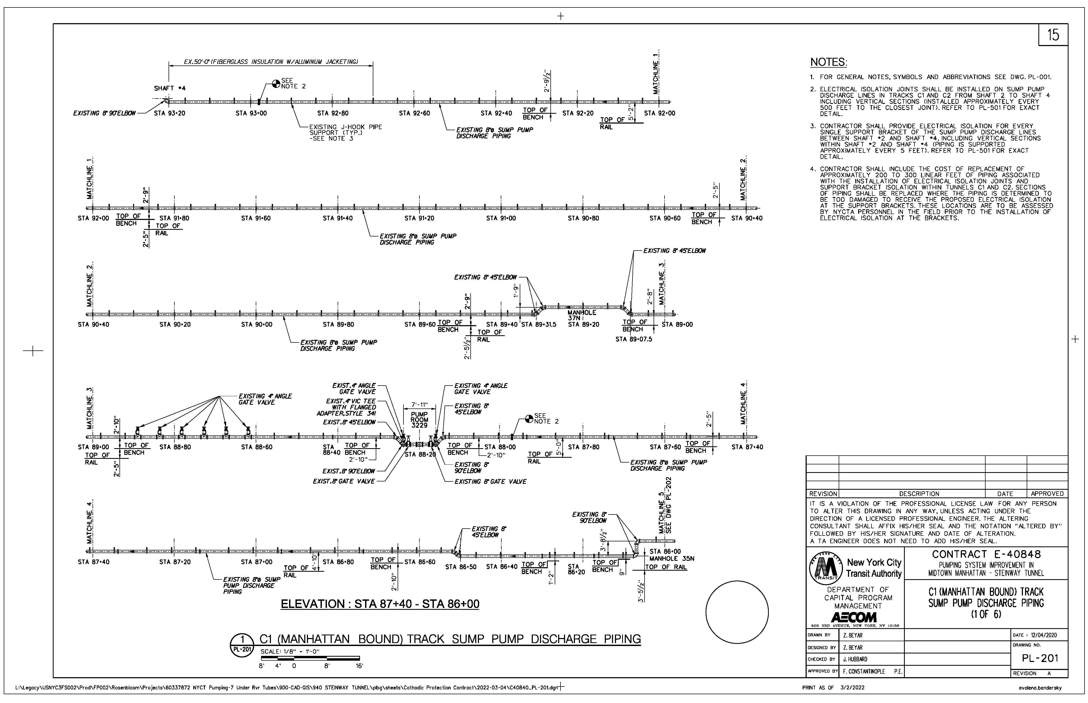
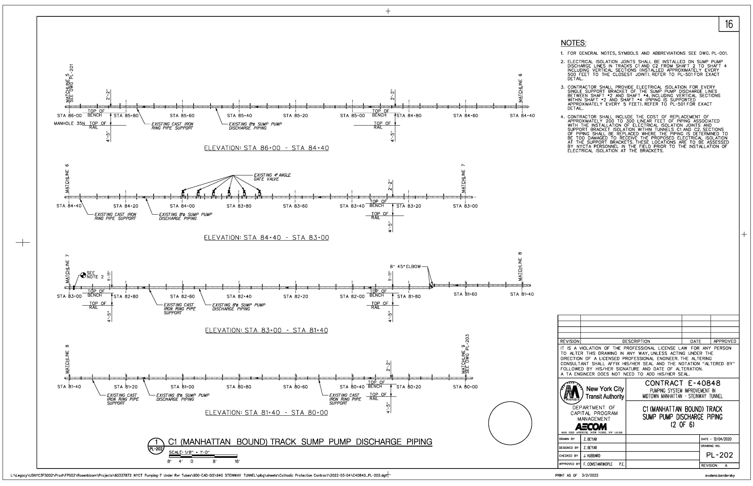
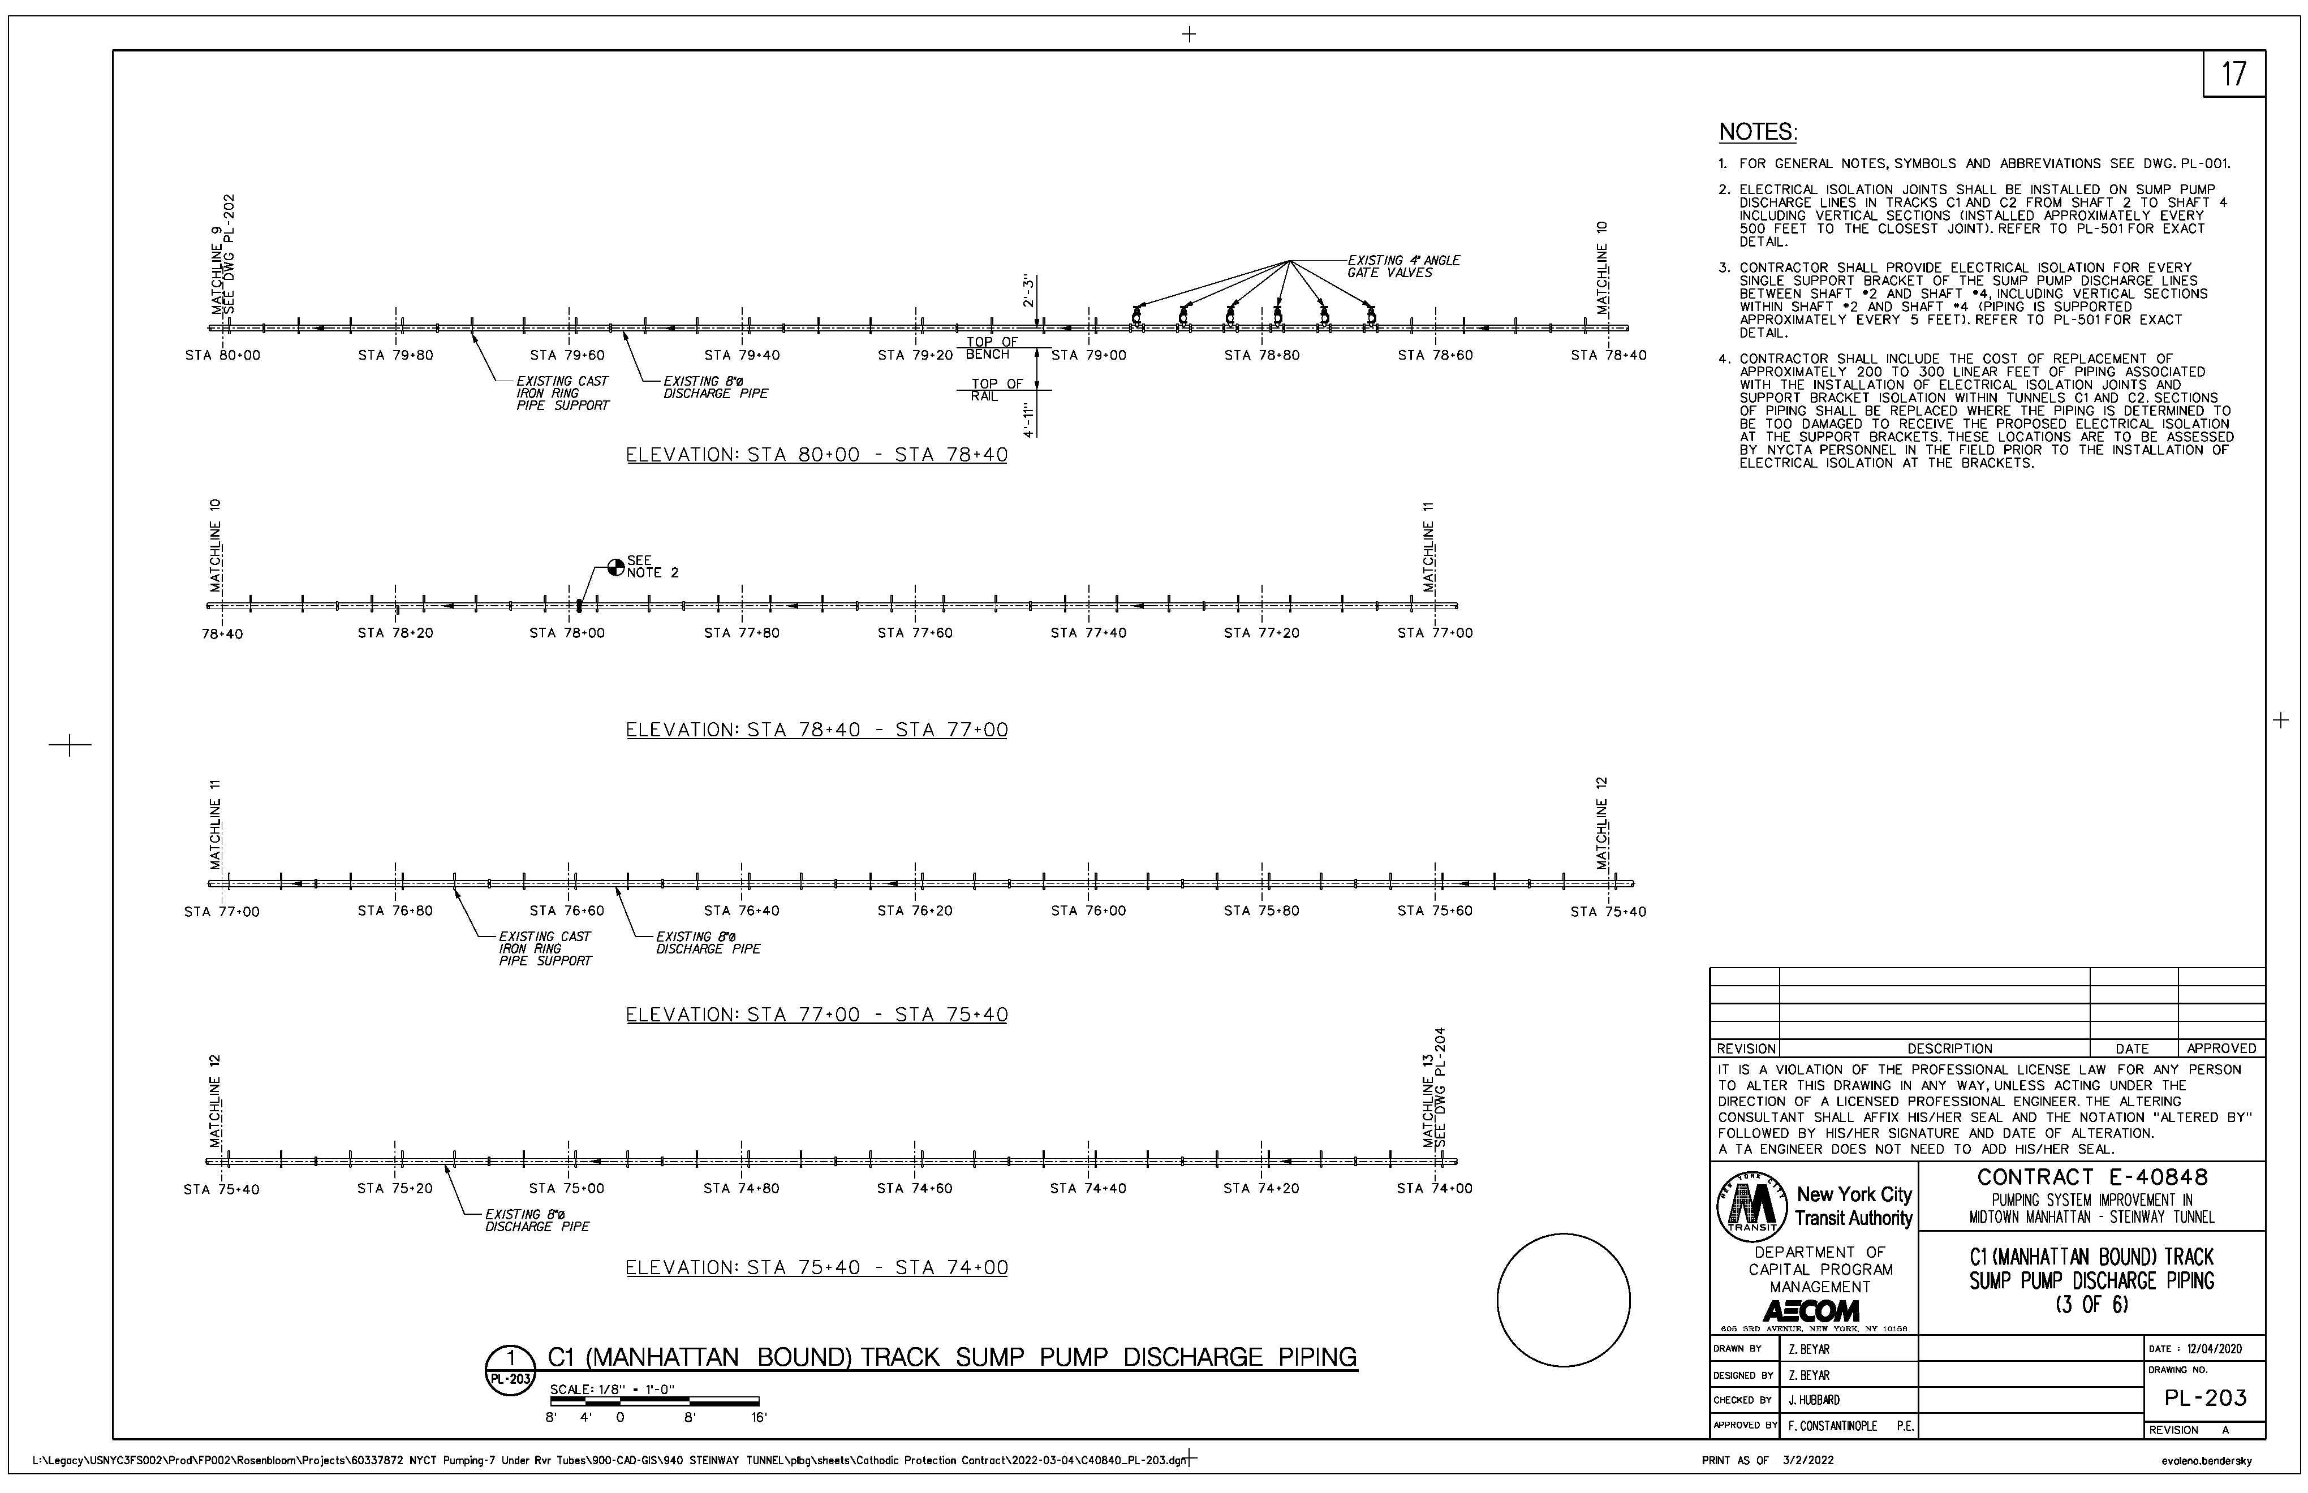
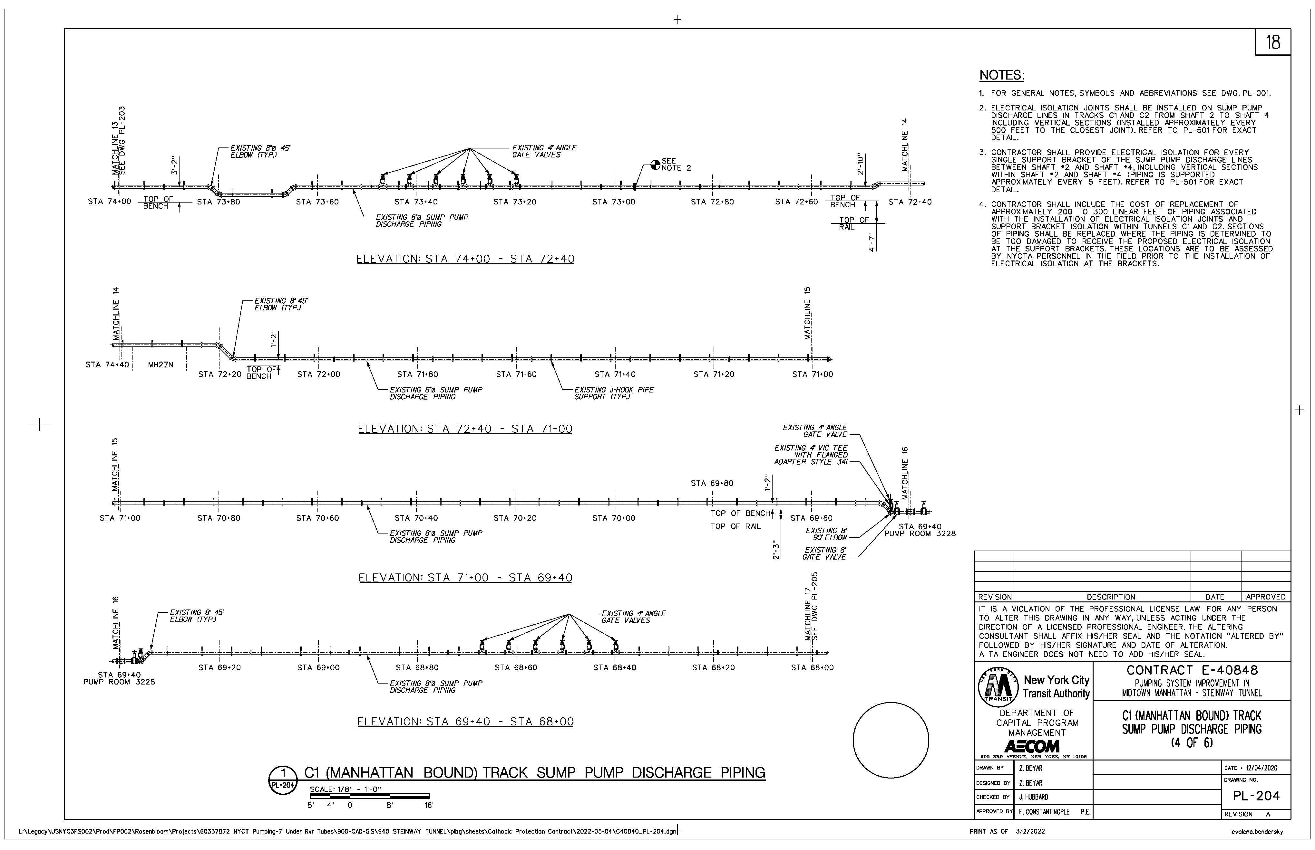
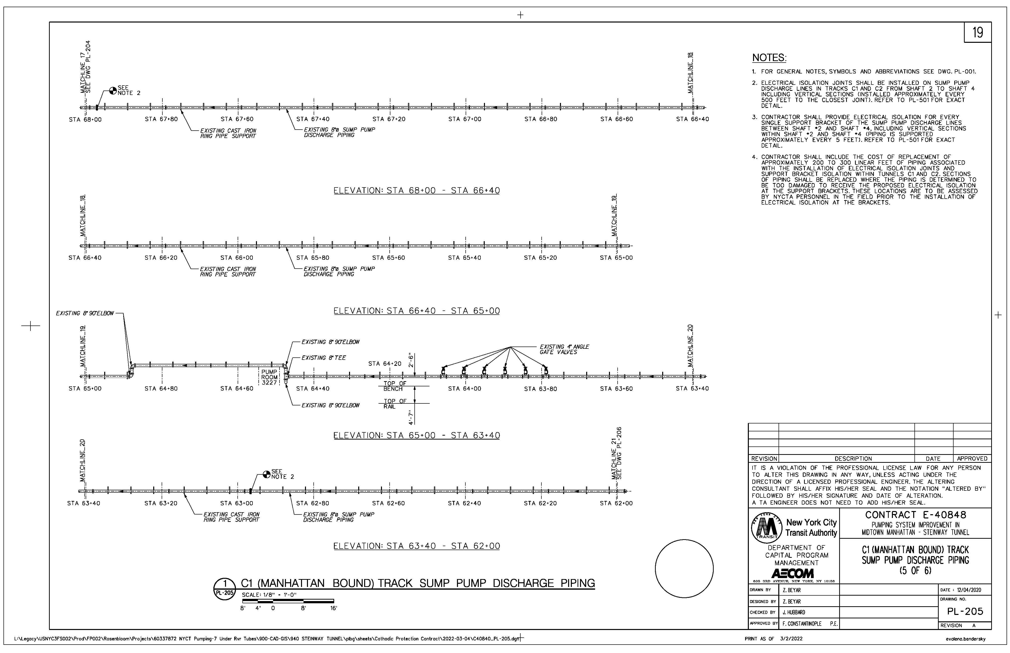
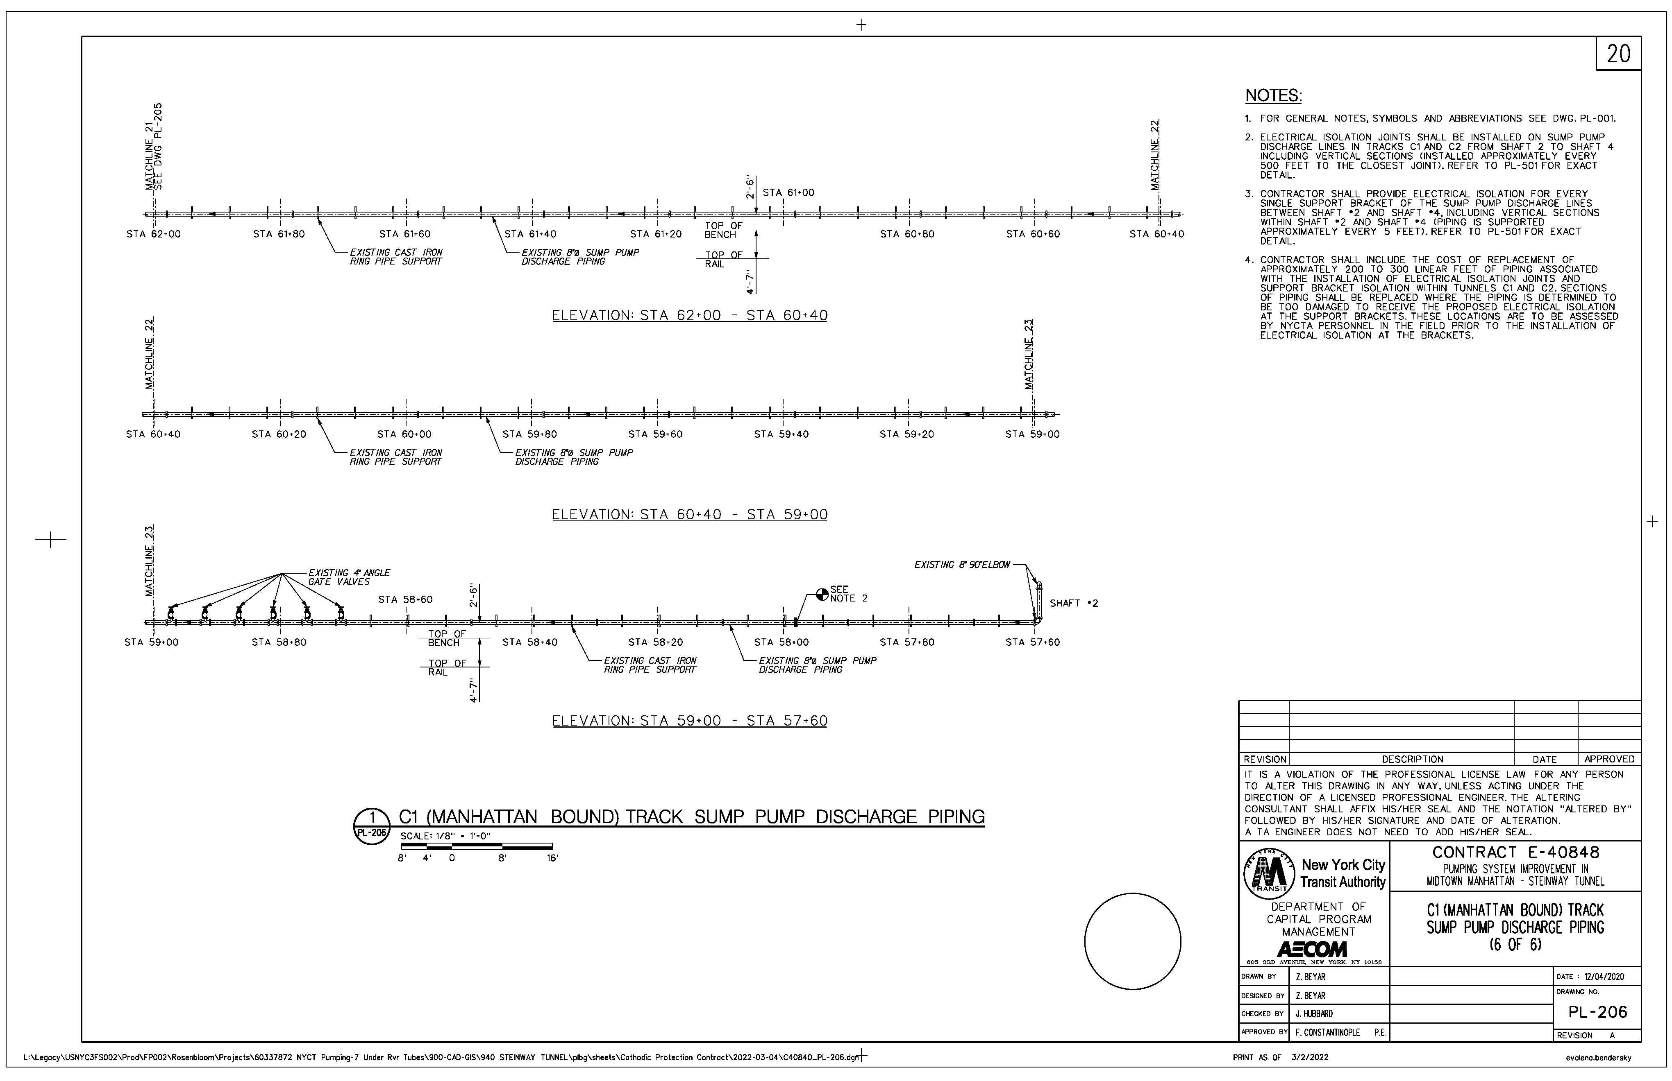
C1 track Manhattan

Slide 12
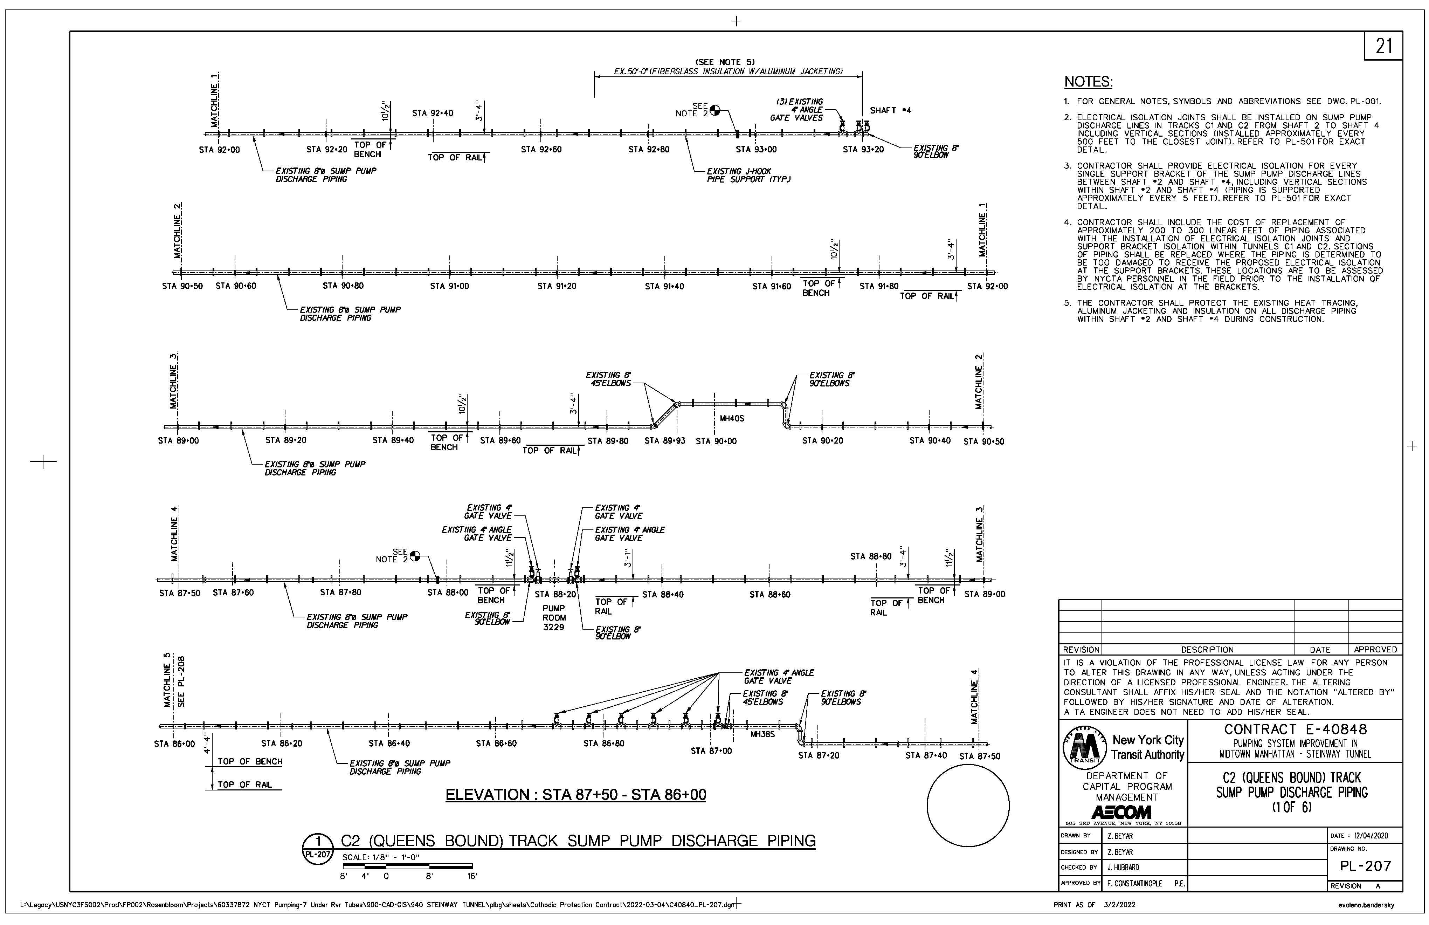
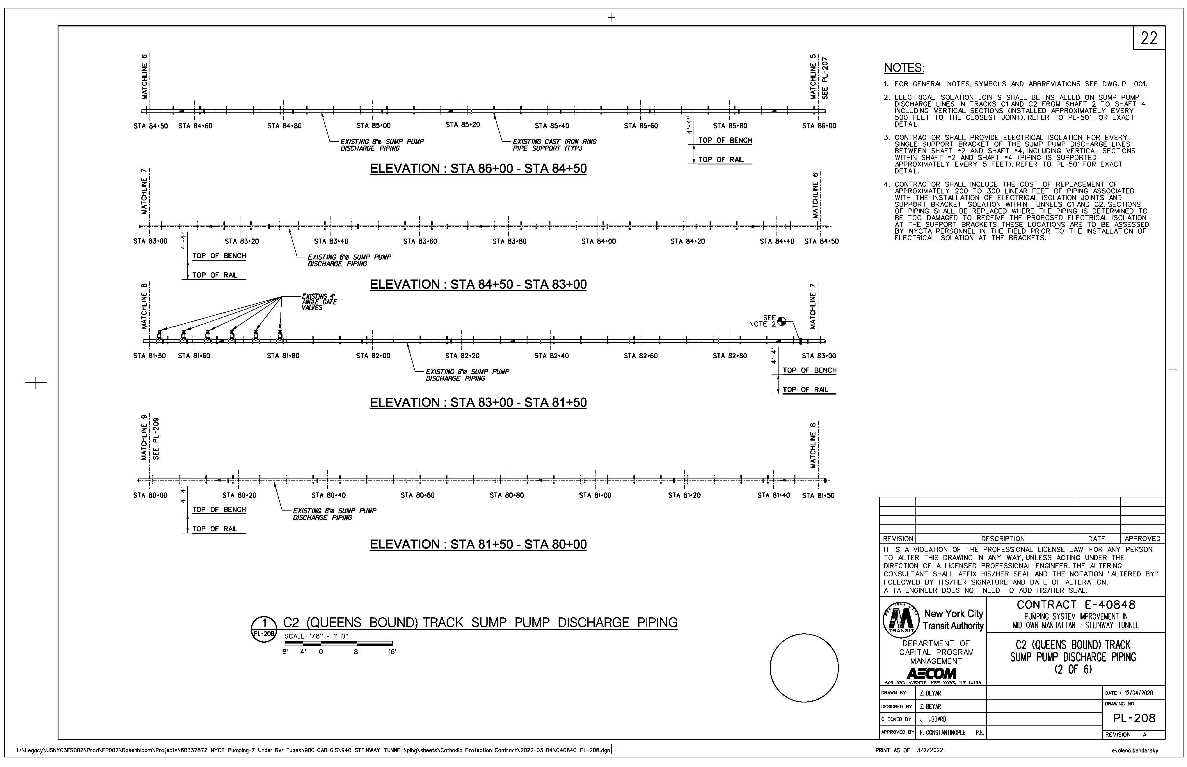
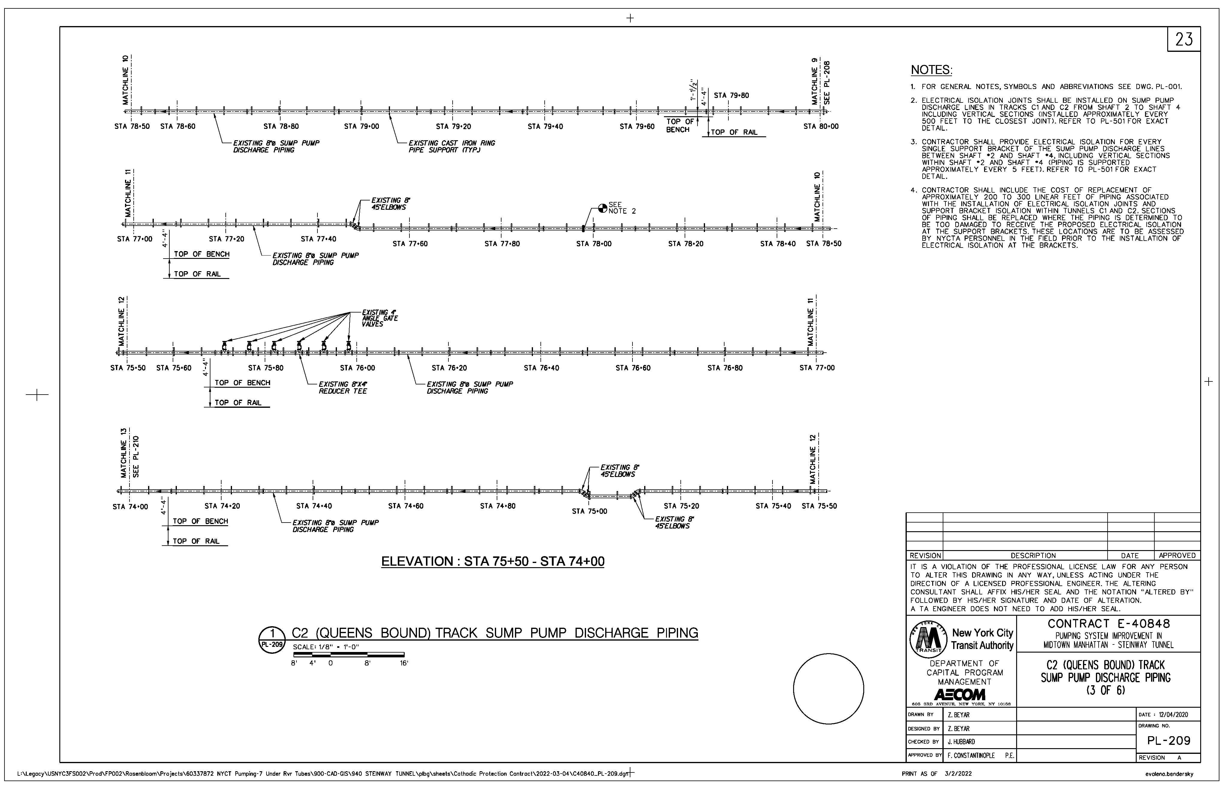
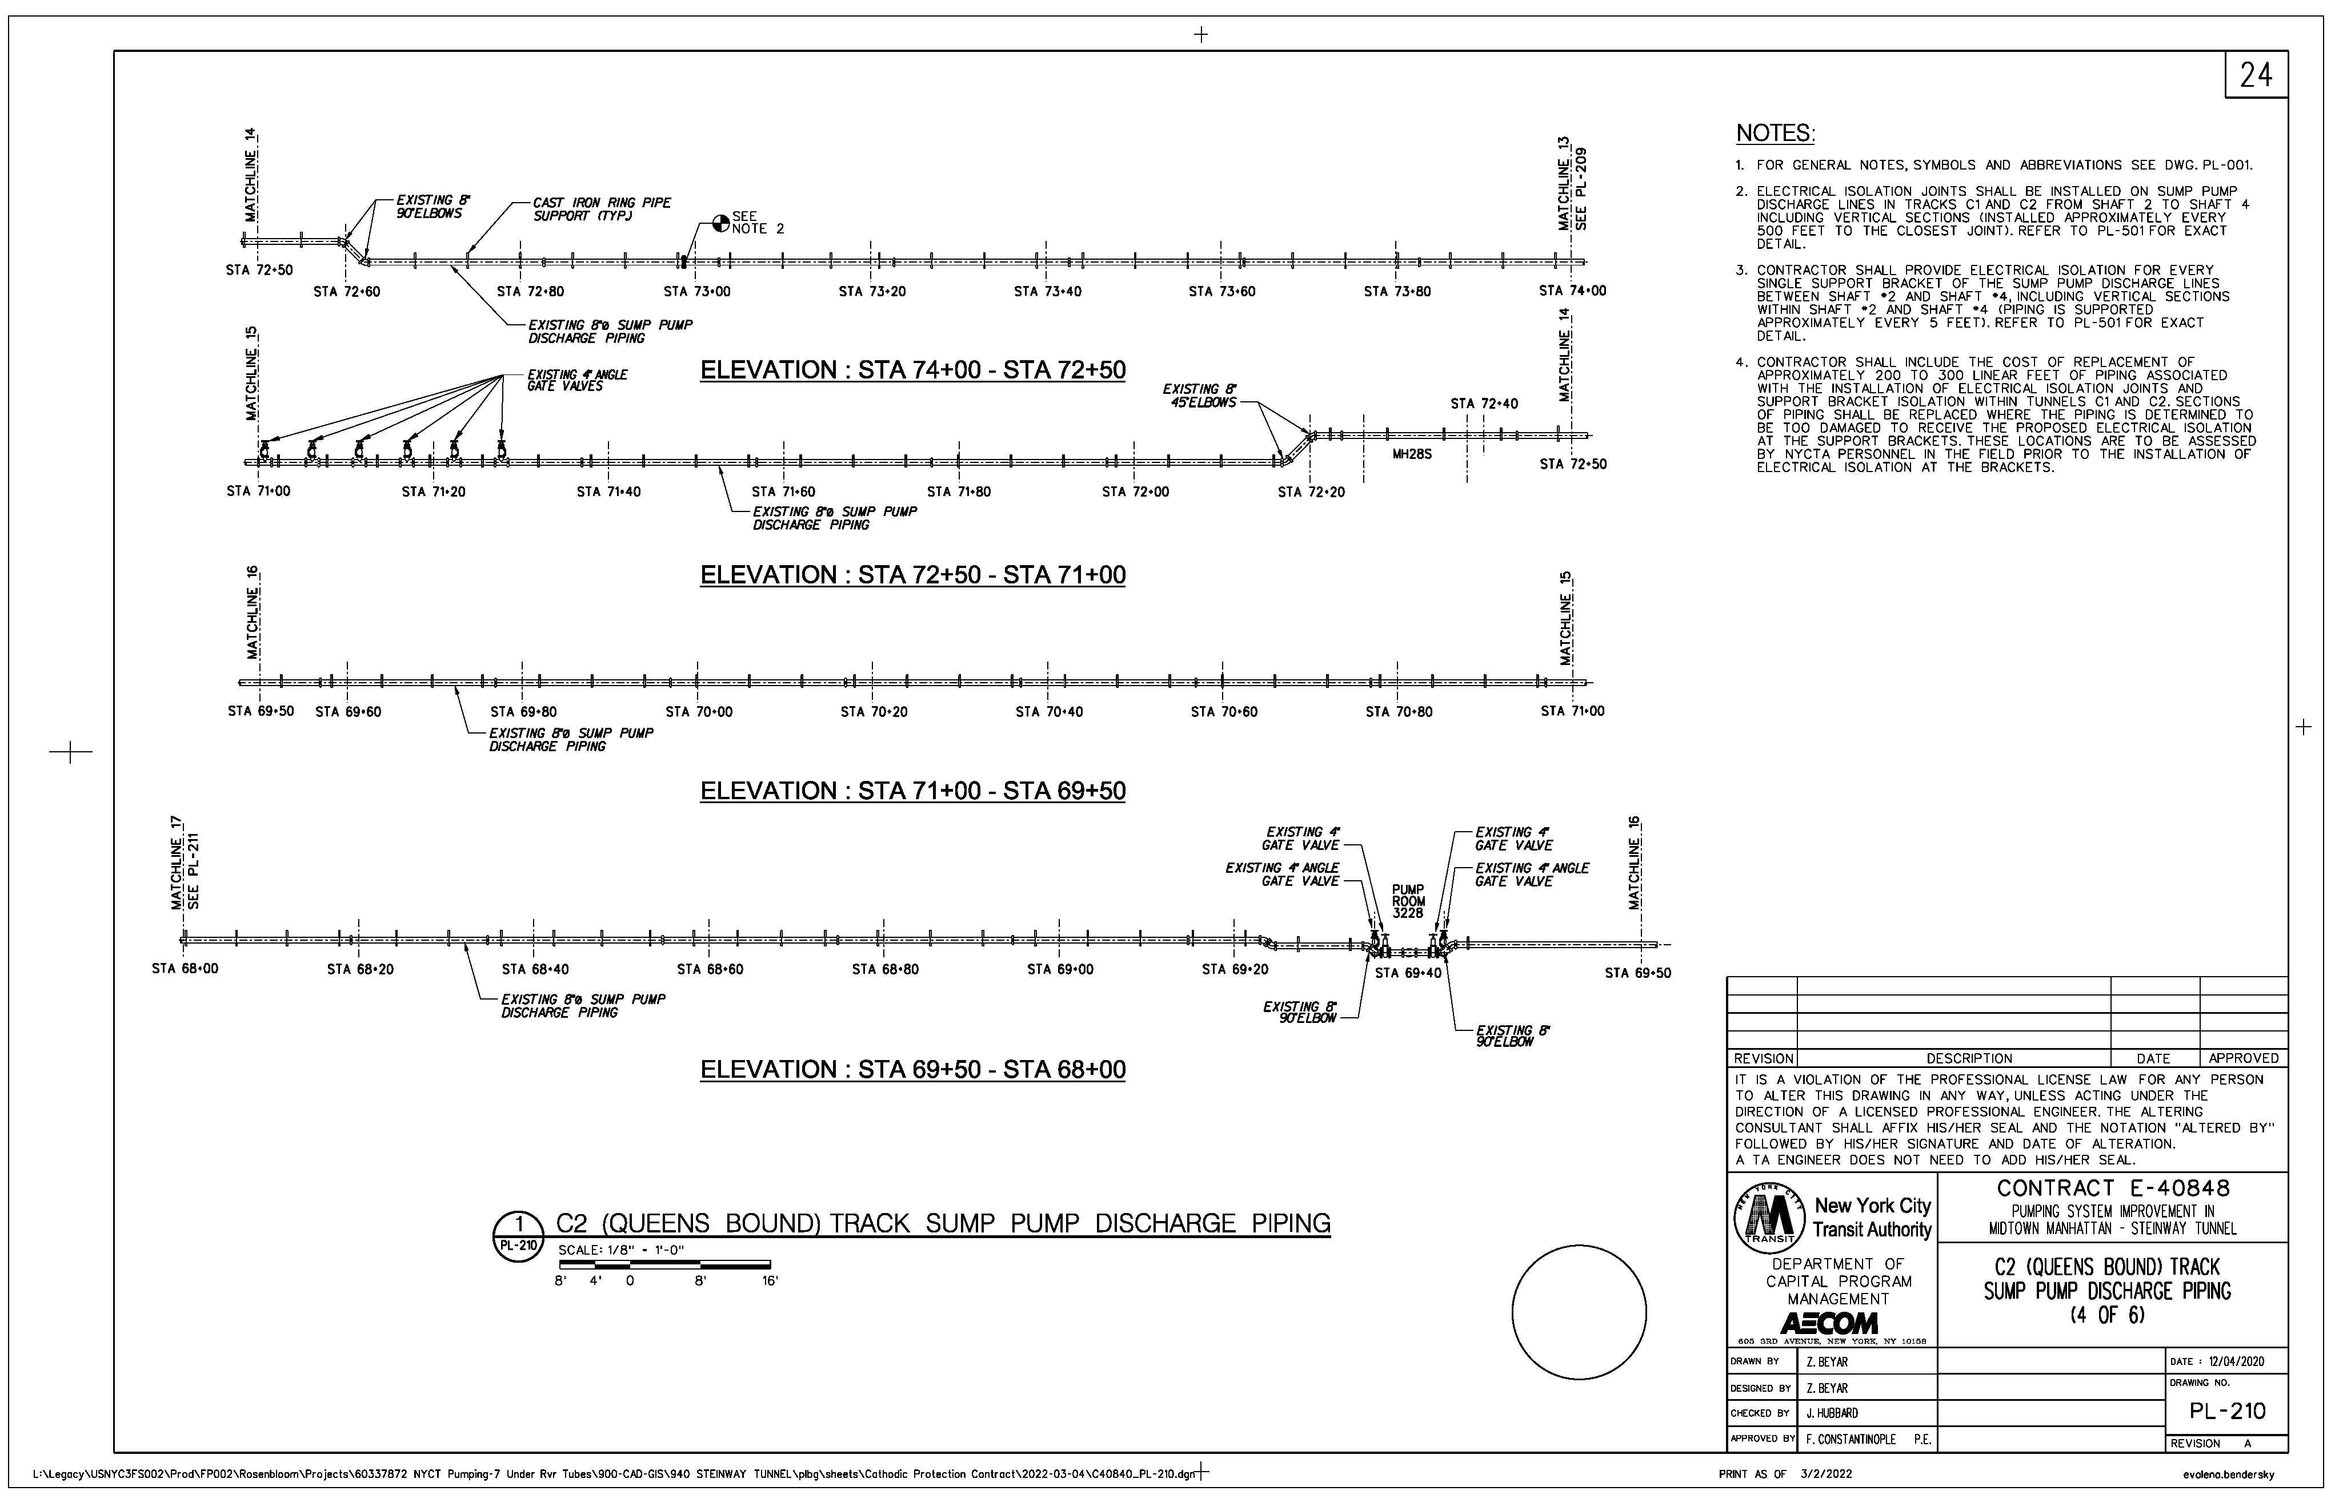
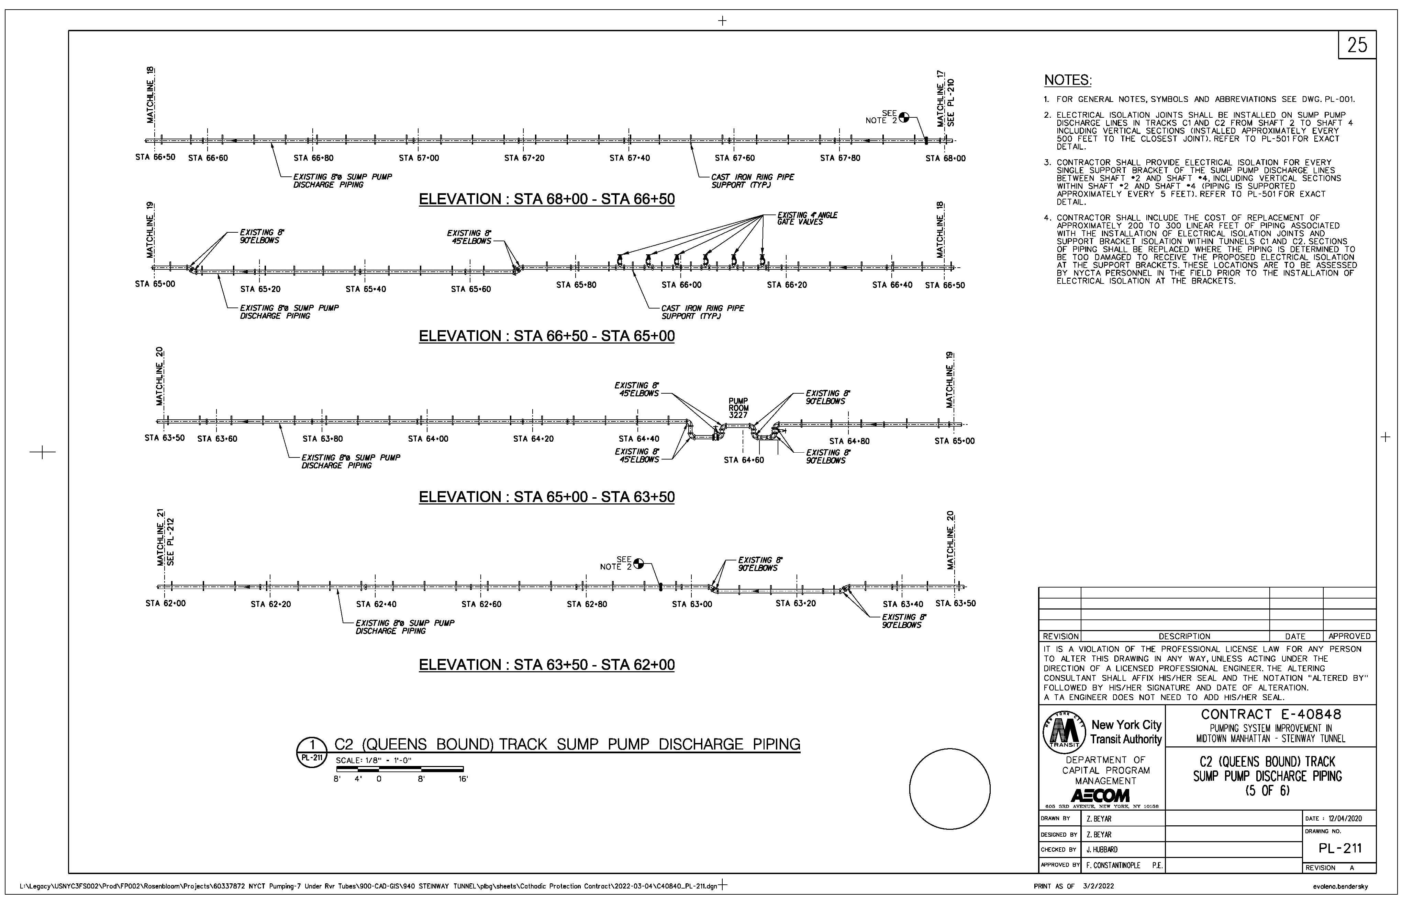
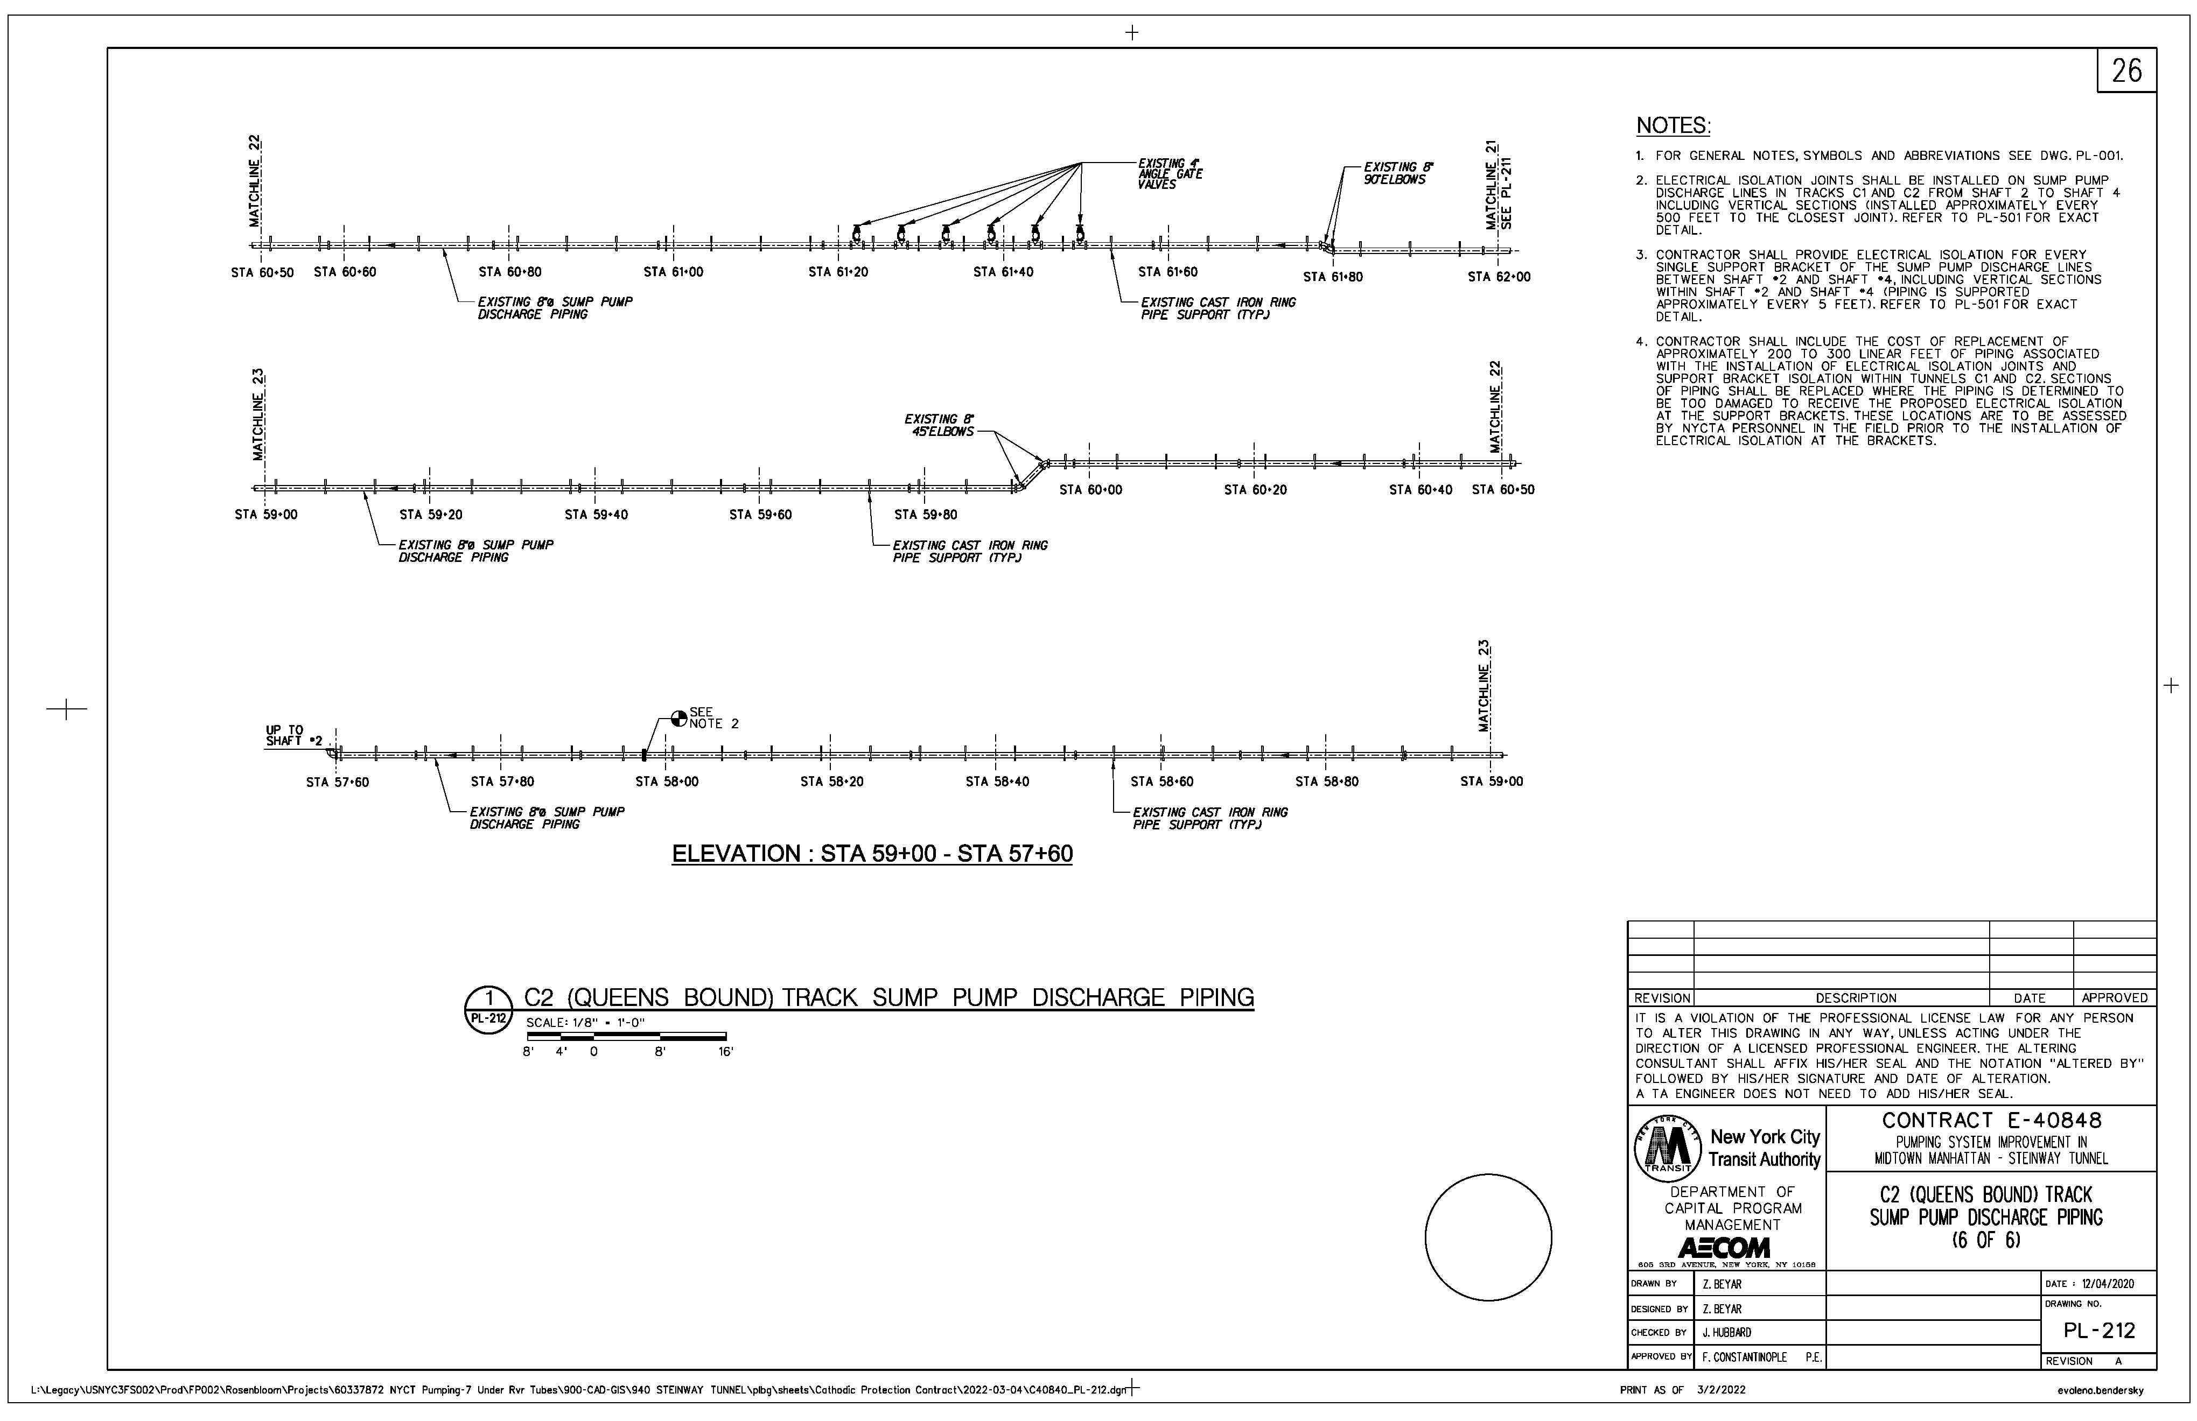
C2 Track Queens

Slide 13
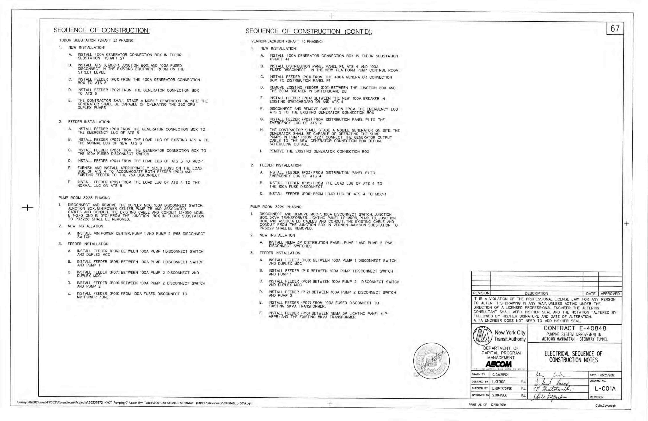
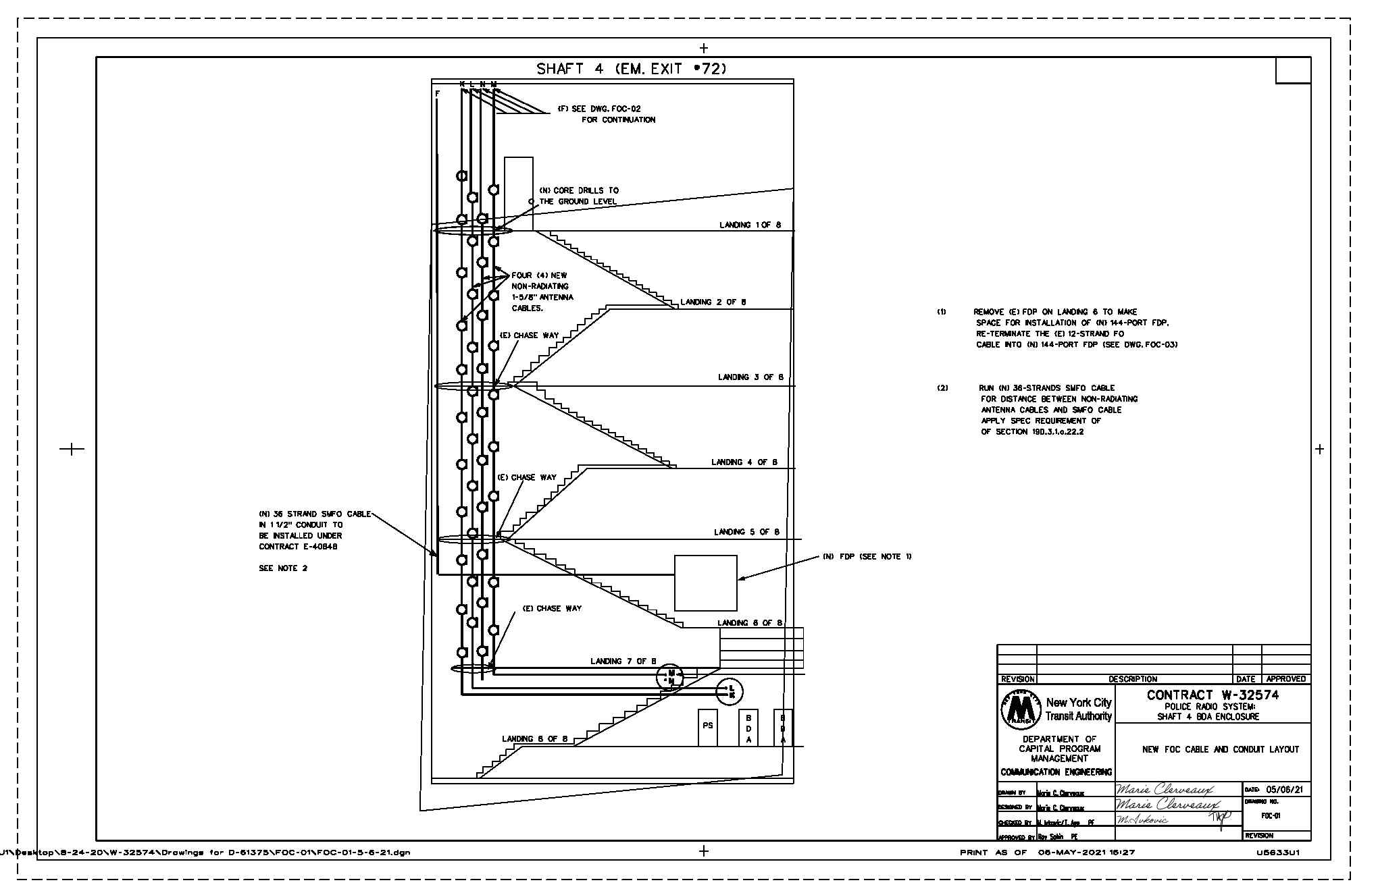
Shaft 4, Shaft 2.

Slide 14
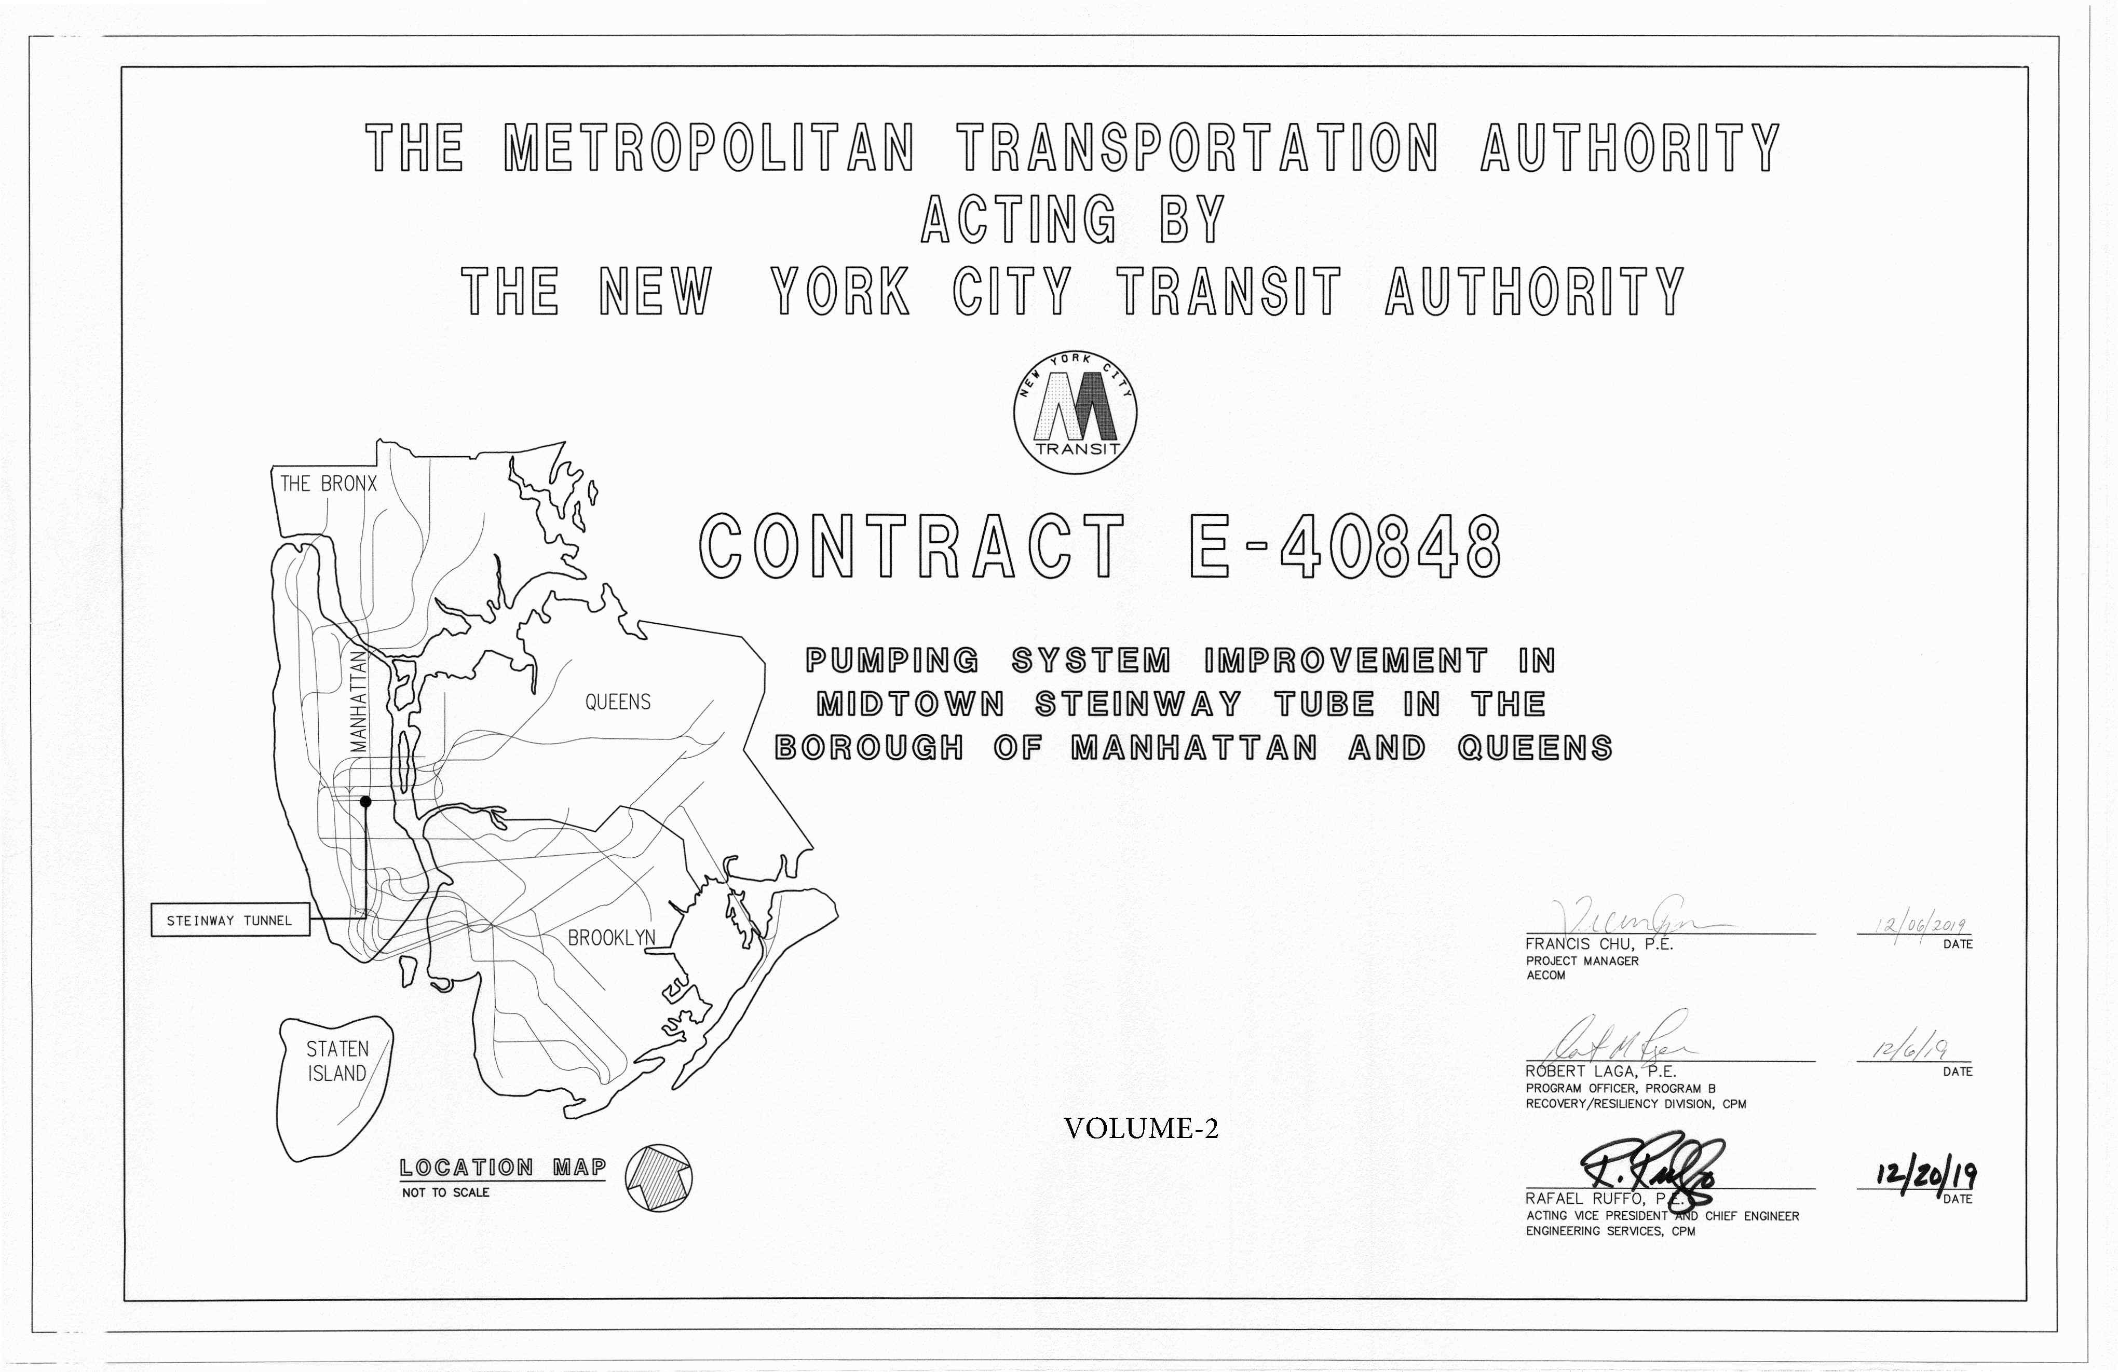
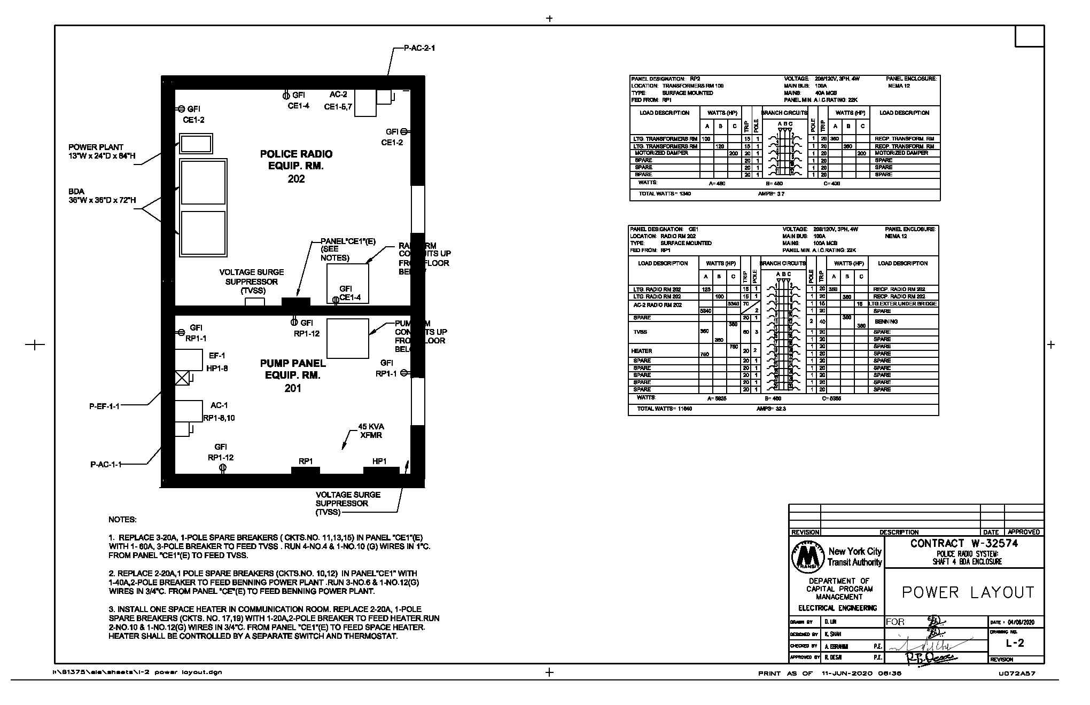
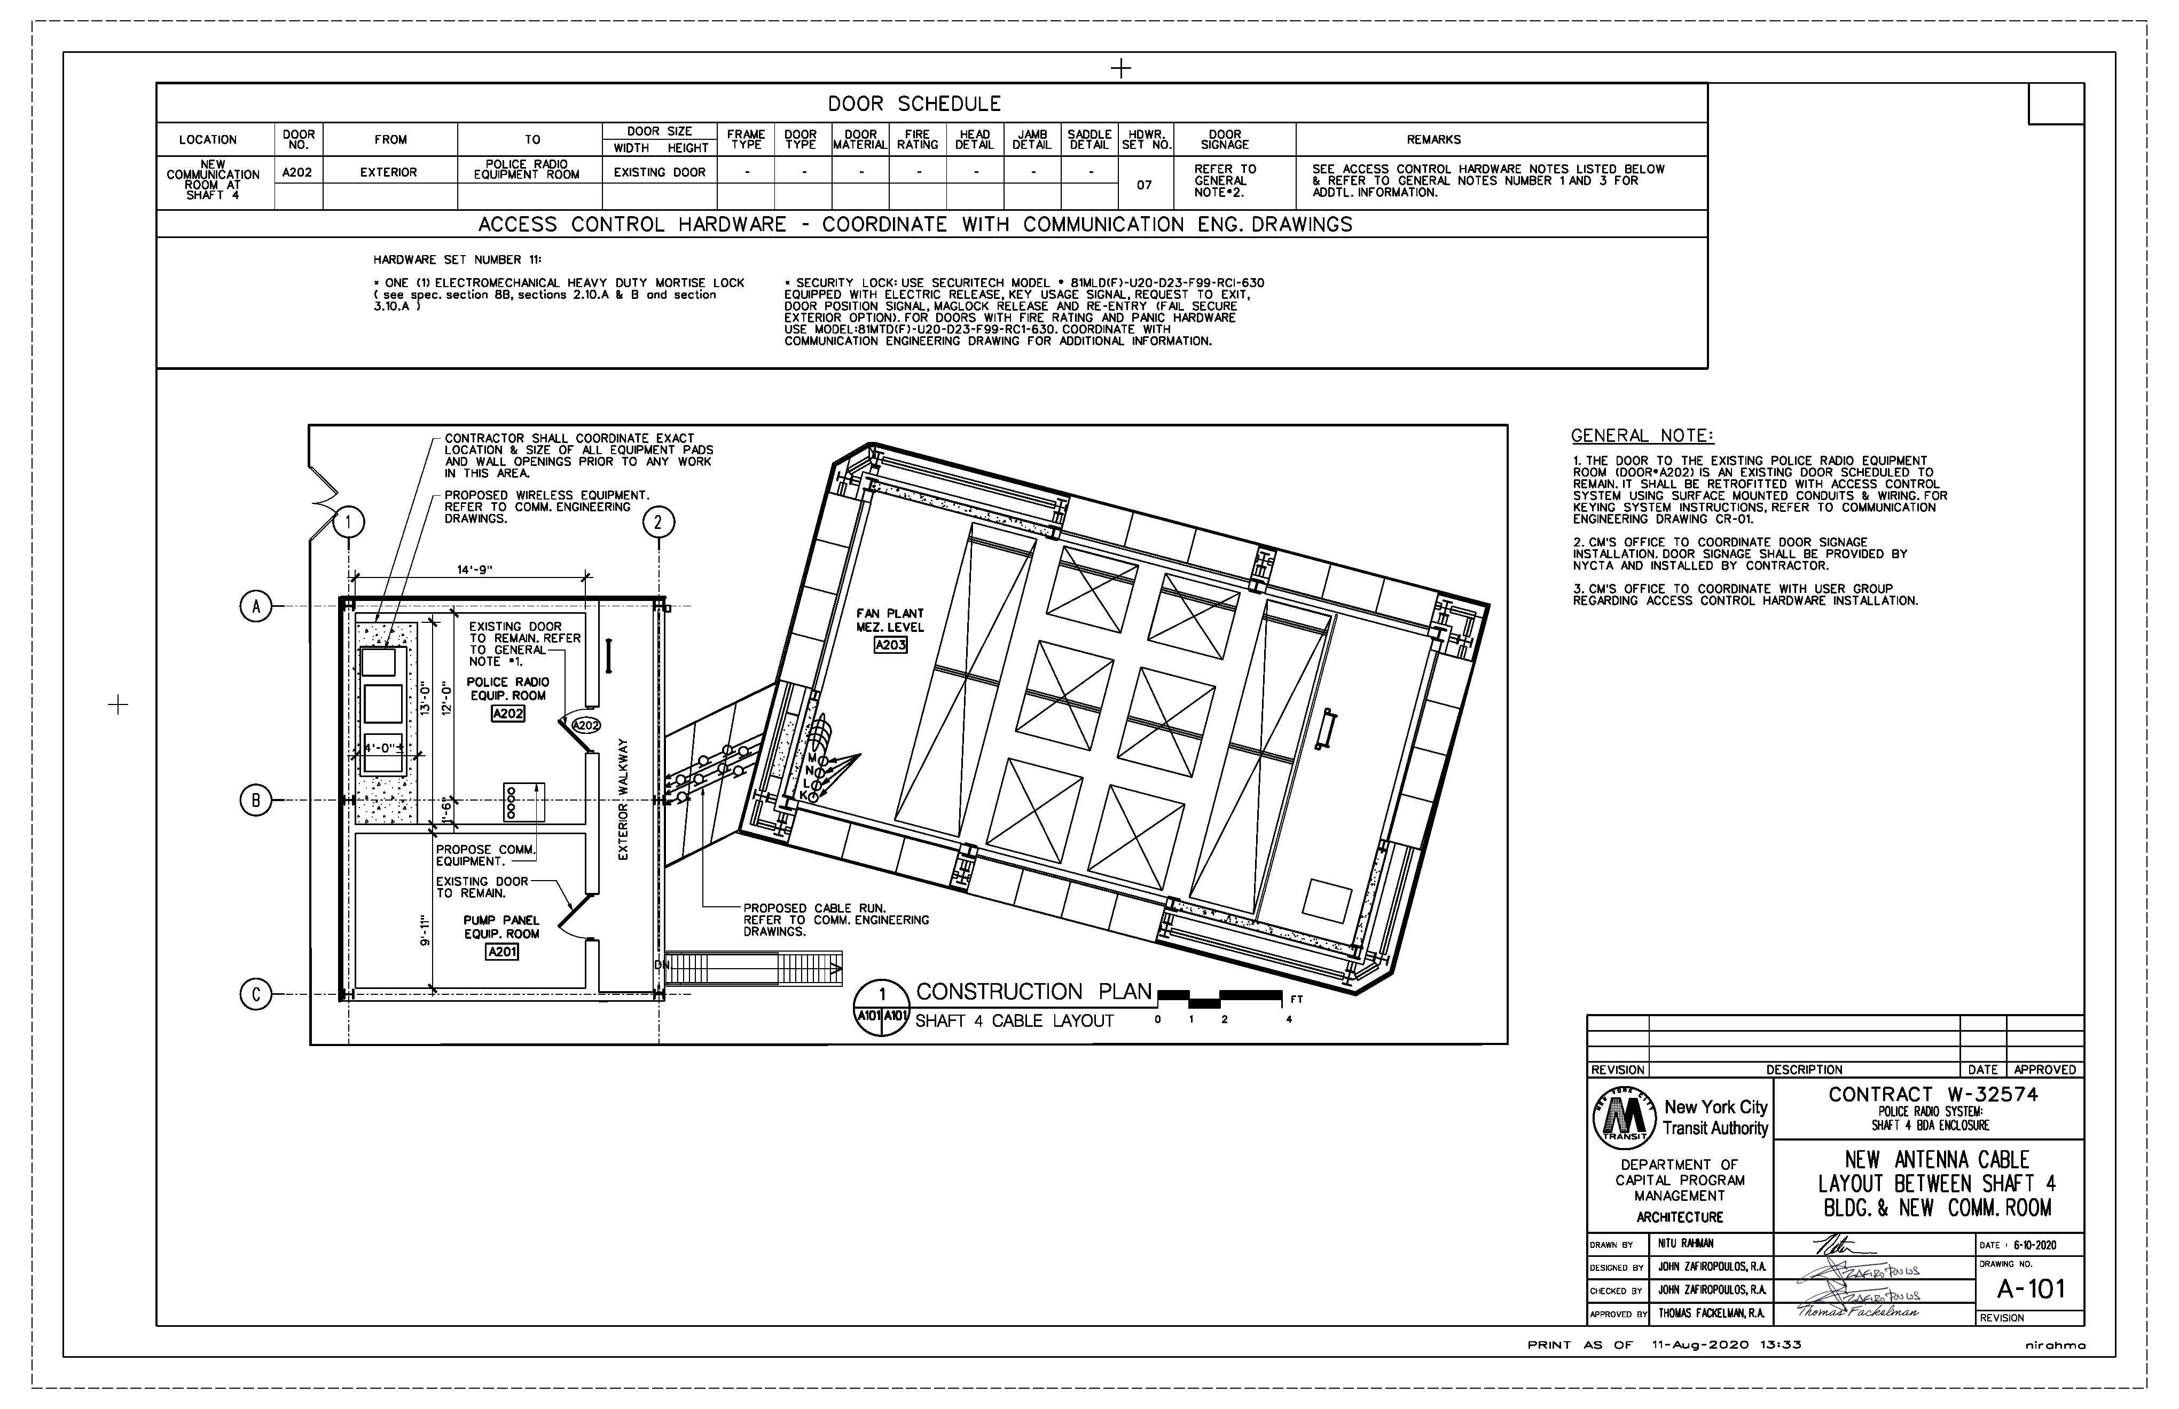
(Contract W-32574)
Police radio systems: Shaft 4 BDA enclosure..
Start date : 27-Jun-2023
Finish date : 21-Nov-2024
(Contract E-40848) consists of :
Concrete Work
Door Hardware
Electrical work
Signal Work
Communication Work

Slide 15
Police radio and antenna equipment installation and replacement
Type of work | Duration | Start | Finish | Budgeted Total Cost
Concrete Work | 20 | 27-Jun-23 | 25-Jul-23 | $20,000.00
Door Hardware | 60 | 28-Aug-23 | 22-Nov-23 | $36,000.00
Electrical work | 100 | 24-Nov-23 | 17-Apr-24 | $140,140.00
Signal Work | 30 | 18-Apr-24 | 30-May-24 | $40,000.00
Communication Work | 120 | 31-May-24 | 21-Nov-24 | $793,700.00

Slide 16
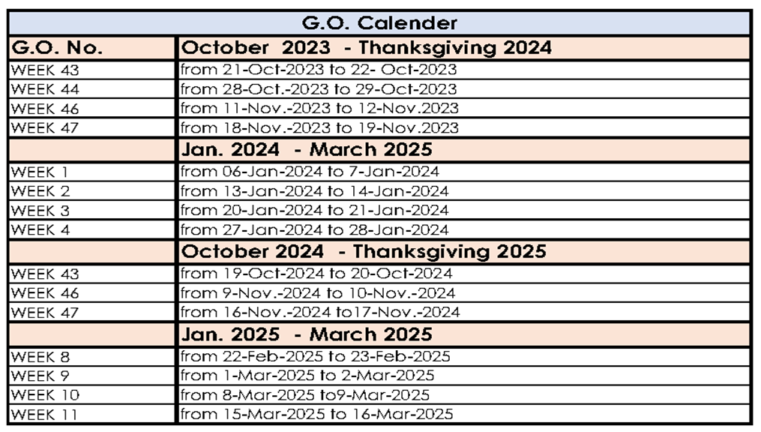
3. Constraints
NYC Transit’s Operations Planning (OP) has planned out a series of weekend shutdowns for 2023 and the first month of 2024 based on the overall needs and SOW for contracts along the #7 line. In order to accommodate all the sports events, holiday embargoes as well as each other’s construction needs, all contractors along the #7 Line have been encouraged to share these GOs to carry out their respective work. With the understanding that individual contracts will have their unique need(s).
The followings are the planned GOs by OP so far:
The year 2023: Weeks 43,44,46 &47
The year 2024: weeks 1,2,3,4,43,46,47
The year 2025: weeks 8,9,10,11

Slide 17
4. Resources
Resources distribution
Description |  | Jun-23 | Jul-23 | Aug-23 | Sep-23 | Oct-23 | Nov-23 | Dec-23 | Jan-24 | Feb-24 | Mar-24 | Apr-24 | May-24 | Jun-24 | Jul-24 | Aug-24 | Sep-24 | Oct-24 | Nov-24 | Dec-24 | Jan-25 | Feb-25 | Mar-25
Total | Early | 4 | 23 | 10 | 25 | 85 | 51 | 32 | 154 | 77 | 58 | 59 | 85 | 47 | 55 | 35 | 33 | 93 | 172 | 17 |  |  | 13
 | Late |  |  | 8 | 23 | 95 | 53 | 35 | 132 | 50 | 43 | 33 | 39 | 40 | 65 | 62 | 57 | 114 | 201 | 66 |  |  | 13
Carpenter | Early |  |  |  |  | 1 | 1 |  |  |  | 4 | 2 | 2 | 0 | 6 | 2 | 3 | 1
 | Late |  |  |  |  | 1 | 1 |  |  |  | 3 | 2 | 2 |  | 5 | 3 | 2 | 2
Communication technecian | Early |  |  |  |  |  |  |  |  |  | 2 | 4 | 6 | 3 | 3 | 3 | 3 | 3 | 4
 | Late |  |  |  |  |  |  |  |  |  |  |  | 2 | 2 | 3 | 3 | 4 | 6 | 5 | 4
Communication technecian GO | Early |  |  |  |  |  |  |  |  |  |  |  |  |  |  |  |  |  | 16
 | Late |  |  |  |  |  |  |  |  |  |  |  |  |  |  |  |  |  | 16
Electrician | Early |  |  | 1 | 5 | 5 | 5 | 5 | 7 | 9 | 5 | 3 |  |  |  |  |  |  | 9 | 11
 | Late |  |  |  | 2 | 5 | 5 | 5 | 5 | 8 | 8 | 6 | 2 |  |  |  |  |  | 9 | 11
Electrician GO | Early |  |  |  |  | 3 |  |  | 7 |  |  |  |  |  |  |  |  | 5 | 5
 | Late |  |  |  |  | 3 |  |  | 7 |  |  |  |  |  |  |  |  | 5 | 5
Fire Alarm technician | Early |  |  |  |  |  |  |  |  |  |  |  | 2 | 0
 | Late |  |  |  |  |  |  |  |  |  |  |  |  |  |  |  |  |  | 1 | 1
Flex Gate installer | Early |  |  |  |  |  |  |  |  |  |  |  |  |  |  |  |  |  |  |  |  |  | 0
 | Late |  |  |  |  |  |  |  |  |  |  |  |  |  |  |  |  |  |  |  |  |  | 0
Labor GO | Early |  |  |  |  | 28 | 2 |  | 53 |  |  |  |  |  |  |  |  | 36 | 68
 | Late |  |  |  |  | 28 | 2 |  | 53 |  |  |  |  |  |  |  |  | 36 | 68
Labour | Early | 4 | 20 | 7 | 20 | 44 | 41 | 25 | 81 | 63 | 46 | 46 | 75 | 44 | 45 | 26 | 26 | 48 | 70 | 4 |  |  | 12
 | Late |  |  | 8 | 21 | 48 | 42 | 28 | 63 | 43 | 32 | 22 | 32 | 38 | 55 | 48 | 46 | 66 | 97 | 48 |  |  | 12
Mechanic | Early |  |  |  |  |  |  |  | 3 | 5 | 2
 | Late |  |  |  |  |  |  |  |  |  |  |  |  |  | 2 | 6 | 3
Mechanic GO | Early |  |  |  |  | 4 | 2 |  | 1
 | Late |  |  |  |  | 4 | 2 |  | 1
Rigger | Early |  |  |  |  |  |  |  |  |  |  |  |  | 0 | 1
 | Late |  |  |  |  |  |  |  |  |  |  |  |  |  | 2
Steel fixer | Early |  | 3 | 2 |  | 1 | 2 | 2 | 3 |  |  | 4 | 1 |  |  | 3 | 2 |  |  |  |  |  | 1
 | Late |  |  |  | 0 | 6 | 2 | 2 | 3 |  |  | 3 | 2 |  |  | 3 | 3 |  |  |  |  |  | 1
WFD-006 installer | Early |  |  |  |  |  |  |  |  |  |  |  |  |  |  |  |  |  | 1 | 2
 | Late |  |  |  |  |  |  |  |  |  |  |  |  |  |  |  |  |  | 0 | 2

Slide 18
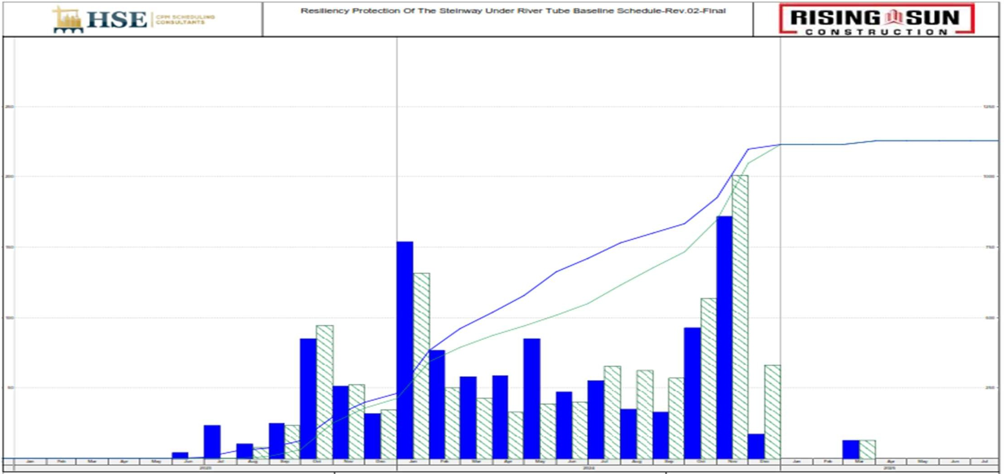
Resources
Resources Profile

Slide 19
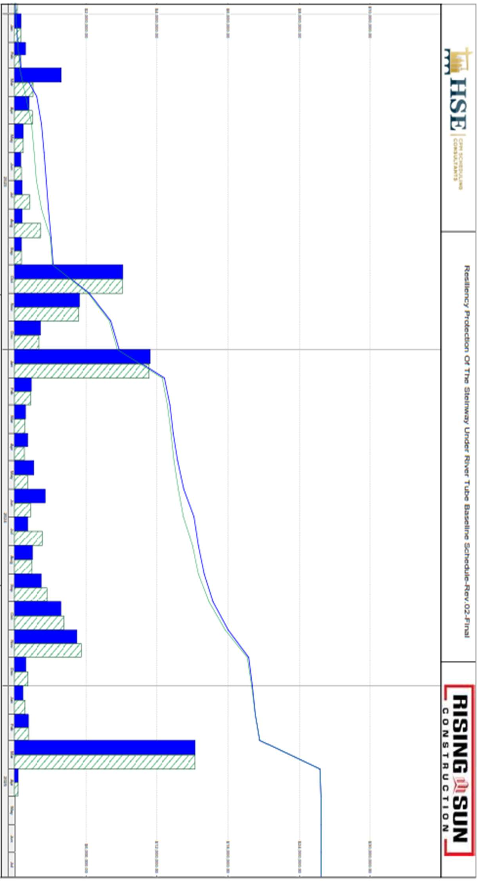
5. S-curve

