Slide 1
PALM COAST WWTP FLORIDA
REHABILITATION

Slide 2
SITE LOCATION IN FLORIDA

Slide 3
SCOPE OF WORK
EXPLORATORY WORK
OXIDATION DITCHES
ELECTRICAL IMPROVEMENTS
BY PASS
BIOFILTER HEAD WORKS

Slide 4
SITE

Slide 5
EXPLORATORY WORK FOR PIPING

Slide 6
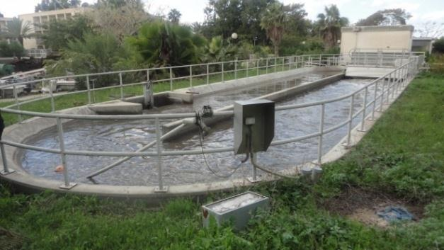
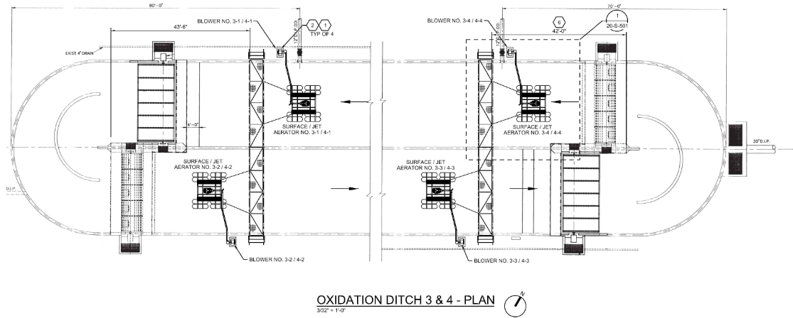
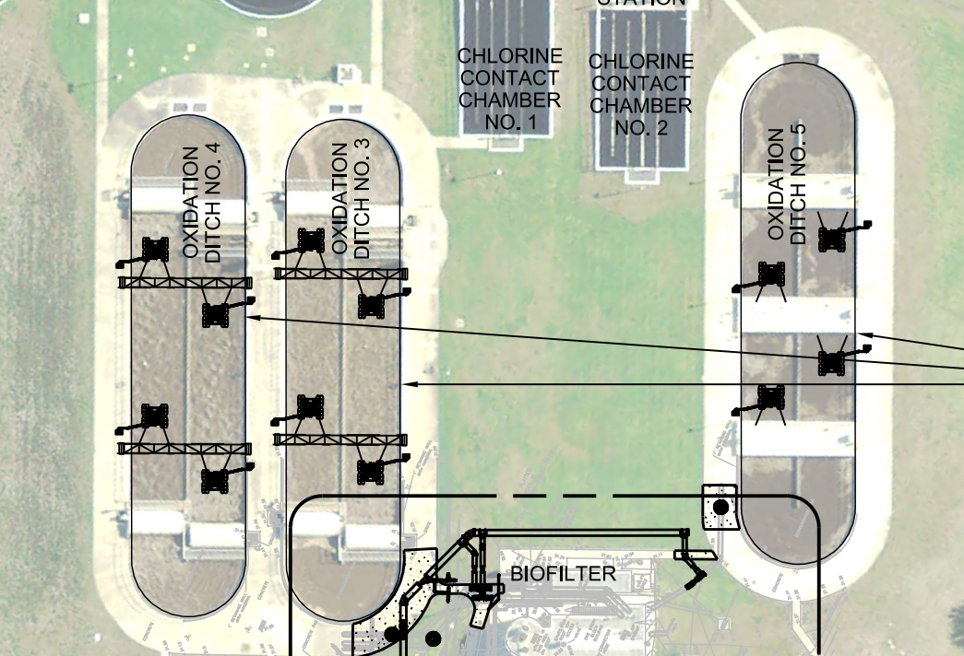
3 OXIDATION DITCHES

Slide 7
3 OXIDATION DITCHES (MECHANICAL POWER PLAN)

Slide 8
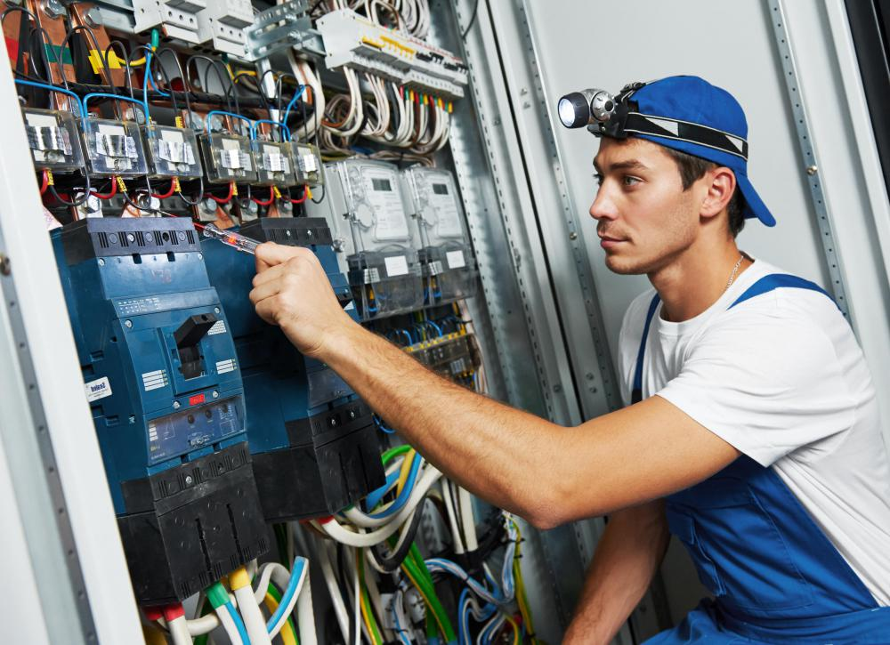
ELECTRICAL IMPROVEMENTS

Slide 9
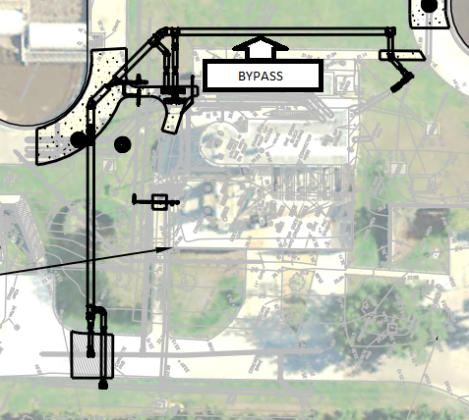
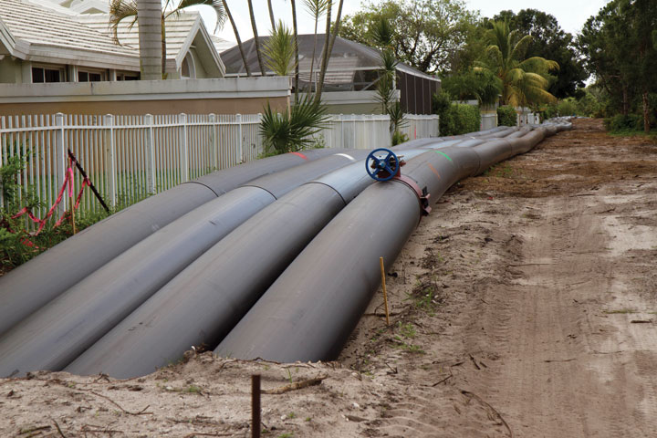
BYPASS

Slide 10
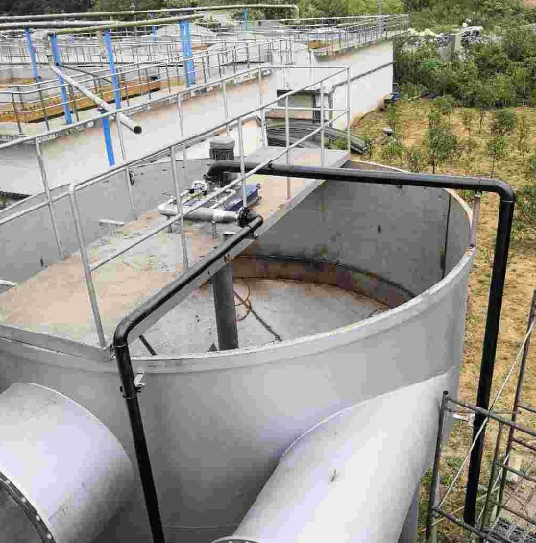
BIOFILTER

Slide 11
WORK SEQUENCE
OXIDATION DITCHES
ELECTRICAL IMPROVEMENTS
BIOFILTER HEAD WORKS
BY PASS
EXPLORATORY WORK
concurrent
concurrent

Slide 12
THANK YOU

