Slide 1
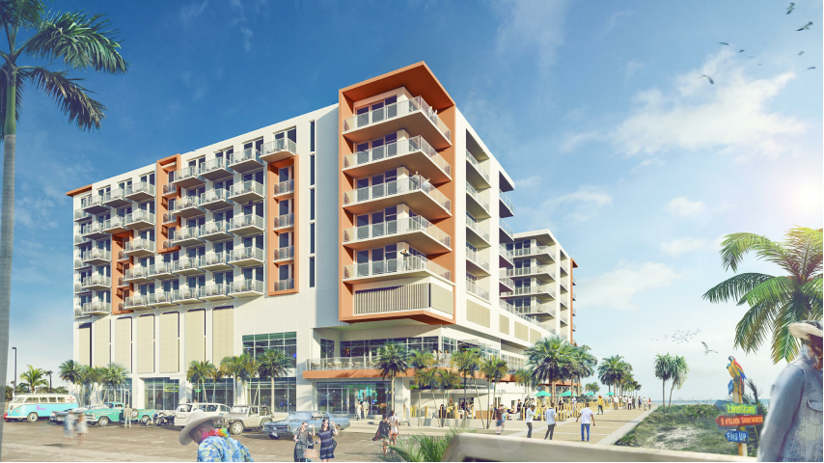
Introduction – Margaritaville Beach Hotel
Highlighting some areas on the drawings and isometric view using colors and writing the sequence or dates to simplify which building takes place first .
Critical Path Analysis
Structural Work Sequence
Façade Work Sequence
Landscape Sequencing
Project General Information :
Project Start (NTP) : Dec,01-2018
Project Finish :Sep,16-2020
Project Total Duration: (X) Working Days
Project Total Duration: (X) Calendar Days

Slide 2
Critical Path Analysis – Margaritaville Beach Hotel
Start : Jan,25-2019
Finish : May,08-2019
Duration : 66 days
Start : Dec,16-2019
Finish : May,18-2020
Duration : 97 days
Start : Dec,01-2018
Start : May,06-2019
Finish : Nov,26-2019
Duration : 121 days
NTP
North Facade /
[ Densglass Sheathing through Scaffolding Removal]
Superstructure / Area A – [ 1st Floor through Roof Floor]
(10) Days - Lag
Project Byout / Subcontractor award - Project Start
Foundation / Piles
Start : Dec,03-2018
Finish : Dec,31-2018
Duration : 18 days
Landscape (North Side)/
[ Clearing & Grading through Punch]
Final Inspection
Install Storm Tech
Start : Dec,03-2018
Finish : Dec,31-2018
Duration : 18 days
Start : May,19-2018
Finish : Jul,06-2018
Duration : 30 days
Start : Jul,07-2020
Finish : Aug,12-2020
Duration : 25 days
Finish : Sep,16-2018
Project Finish

Slide 3
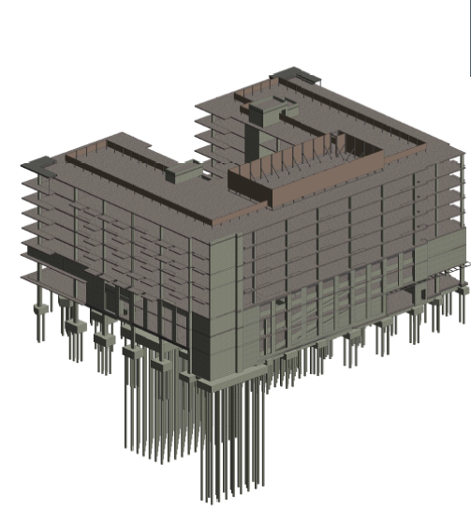
Structural Work (Sequence) – Margaritaville Beach Hotel
1st LVL – Verticals Only
2nd LVL
3rd LVL
4th LVL
5th LVL
6th LVL
7th LVL
8th LVL
Roof Slab
Start : Jan,25-2019
Finish : May,08-2019
Duration : 66 days
S.O.G Will start after Completion of 5th LVL Structural work
Start : Jan,25-2019
Finish : May,08-2019
Duration : 66 days

Slide 4
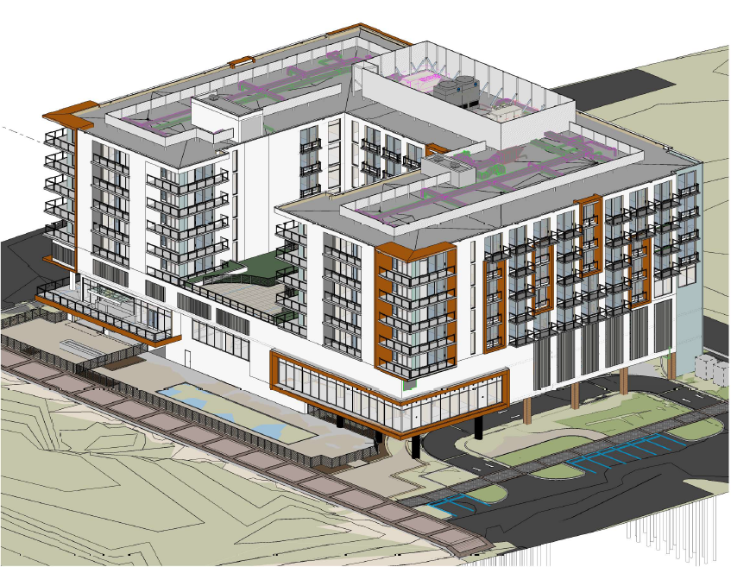
Facade Work (Sequence) – Margaritaville Beach Hotel
Once we finish structural work till roof then we go with West Façade after 30 days :
Start : Jan,17-2020
Finish : Jun,18-2020
Duration : 97 days
Once we finish structural work till roof then we go with South Façade after 20 days :
Start : Jan,02-2020
Finish : Jun,03-2020
Duration : 97 days
W
S
Once we finish structural work till roof then we go with North Façade after 10 days :
Start : Dec,16-2019
Finish : May,18-2020
Duration : 97 days
***Critical***
Once we finish structural work till roof then we go with East Façade :
Start : Nov,27-2019
Finish : May,01-2020
Duration : 97 days
Once we finish structural work till roof then we go with North Façade after 10 days :
Start : Dec,16-2019
Finish : May,18-2020
Duration : 97 days
N
E

Slide 5
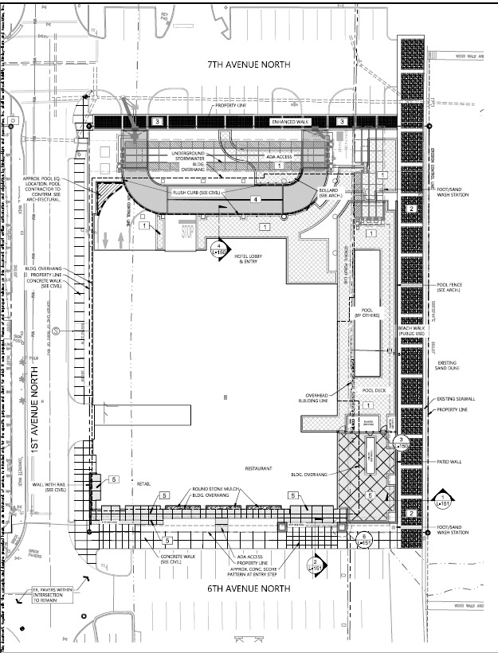
Landscape (Sequence) – Margaritaville Beach Hotel
Once we Remove Scaffolding of West Façade then we go through Landscape (West Side)
Start : Jun,19-2020
Finish : Jul,29-2020
Duration : 25 days
Once we Remove Scaffolding of South Façade then we go through Landscape (South Side)
Start : Jun,04-2020
Finish : Jul,13-2020
Duration : 25 days
W
S
Once we Remove Scaffolding of North Façade we go with Storm Tech (Start : May,19-2018
Finish : Jul,06-2018
Duration : 30 days) then we go through Landscape (North Side) starting with Storm Tech. with Lag 20 days
Start : Jul,07-2020
Finish : Aug,12-2020
Duration : 25 days
***Critical***
Once we Remove Scaffolding of North Façade we go with Storm Tech (Start : May,19-2018
Finish : Jul,06-2018
Duration : 30 days) then we go through Landscape (North Side) starting with Storm Tech. with Lag 20 days
Start : Jul,07-2020
Finish : Aug,12-2020
Duration : 25 days
Once we Remove Scaffolding of East Façade we go with tower crane removal & Scaffolding Removal (Start : April,30-2020
Finish : May,01-2020
Duration : 02 days) then we go through Landscape (East Side)
Start : May,04-2020
Finish : Jul,29-2020
Duration : 55 days
N
E

