Slide 1
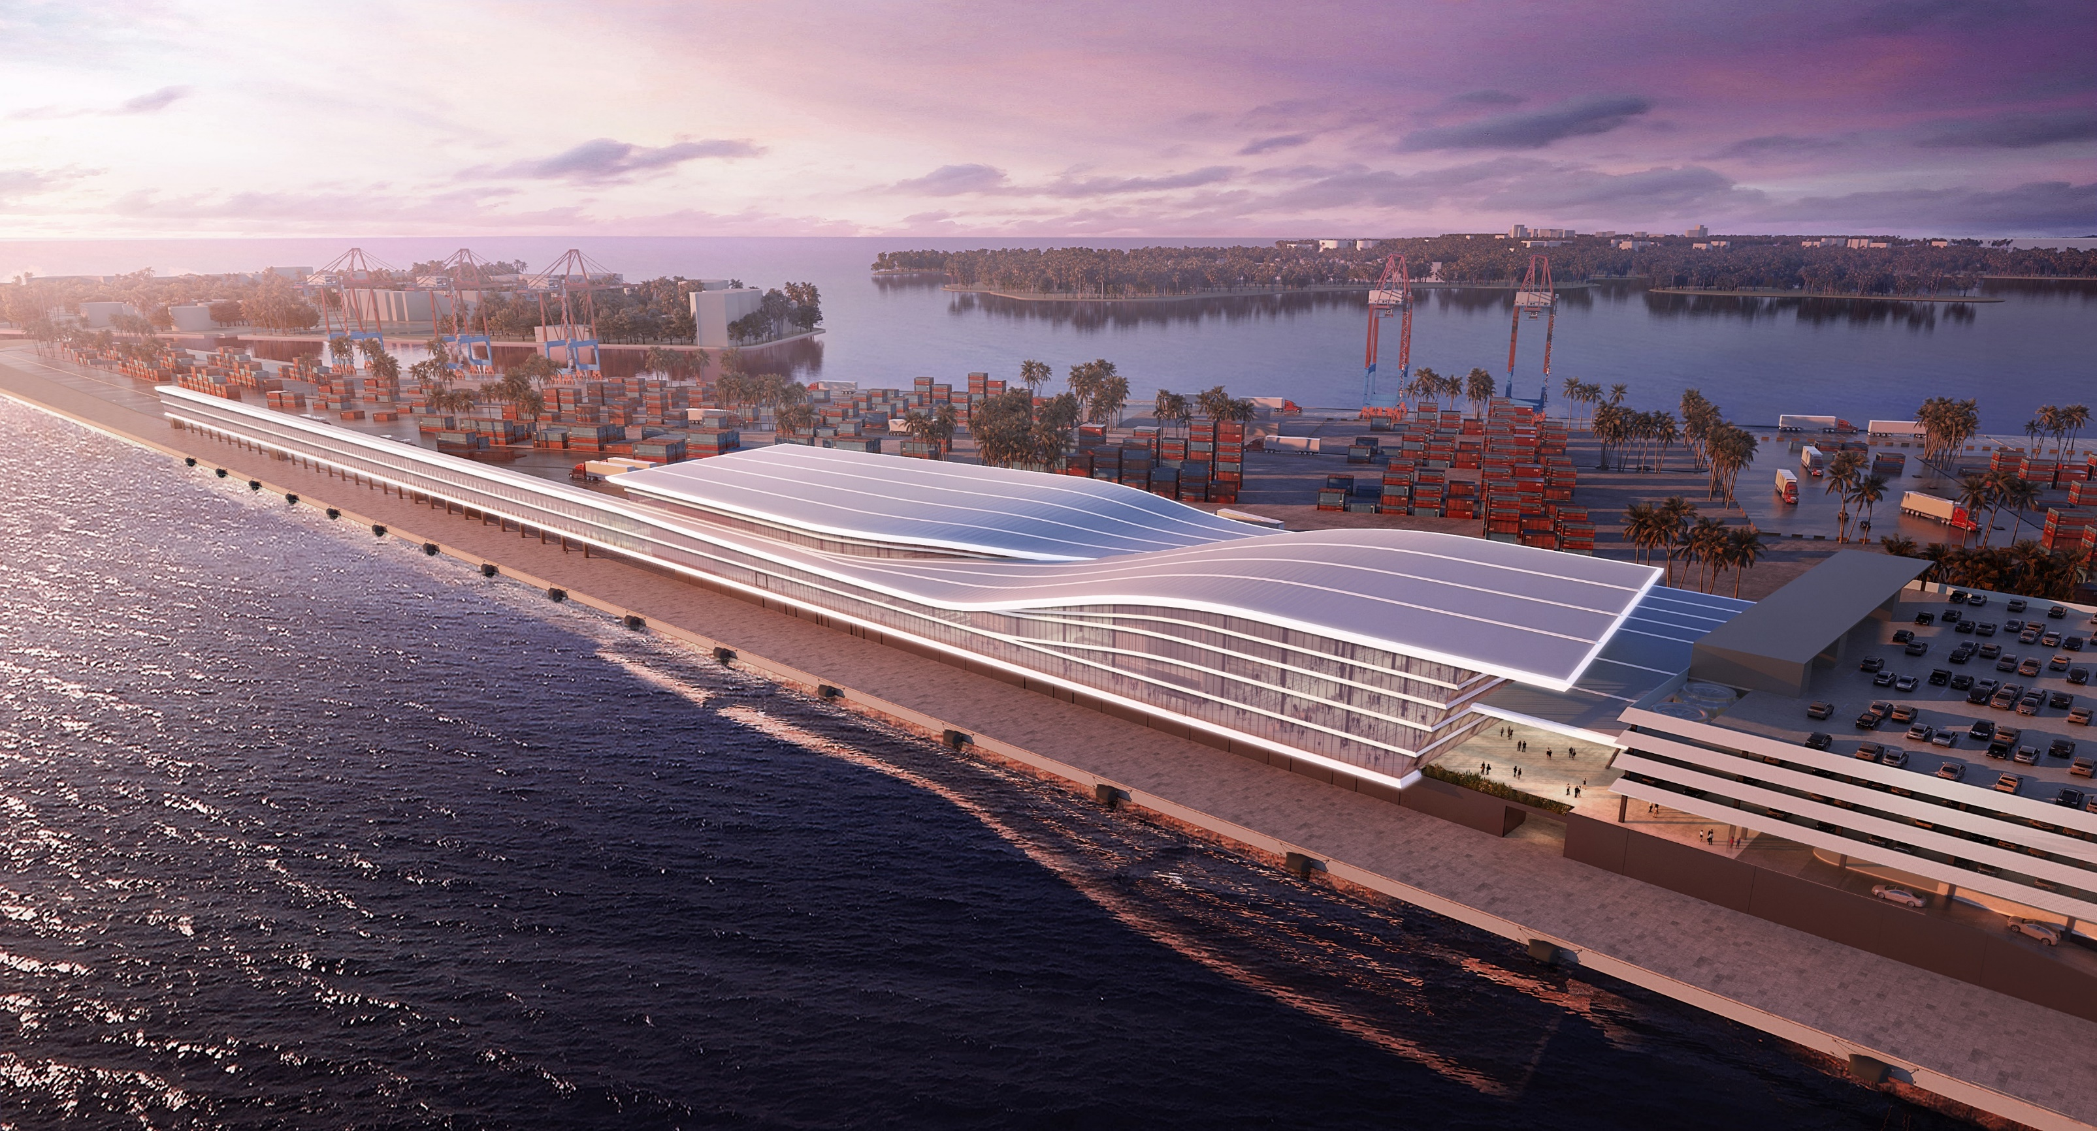
MIAMI CRUISE TERMINAL

Slide 2
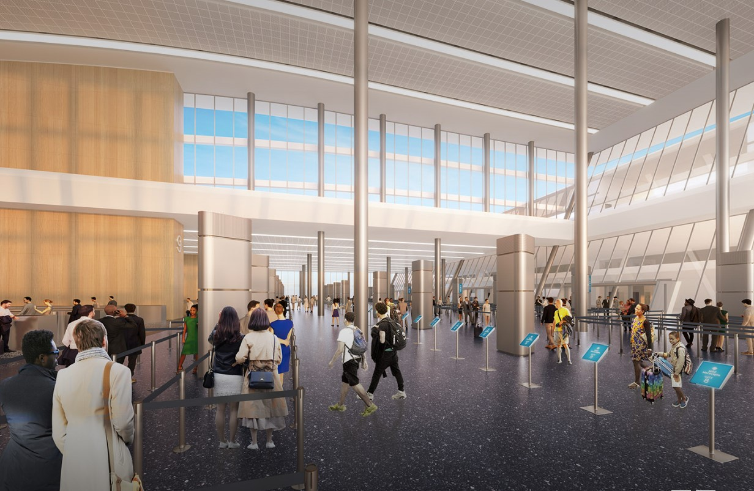
The terminal building will be the world’s largest cruise ship terminal with the capacity to service 3 ship berths and process 36,000 passengers daily.

Slide 3
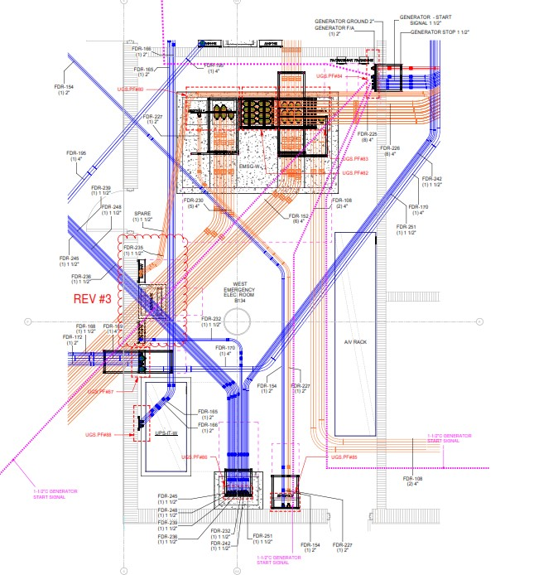
Project Scope
Electrical Work

Slide 4
Project Components
BMS
Electrical Rooms
Lighting
Cooling Tower / Chillers
Elevators
Escalators
Fire Alarm
Access Control
Security

Slide 5
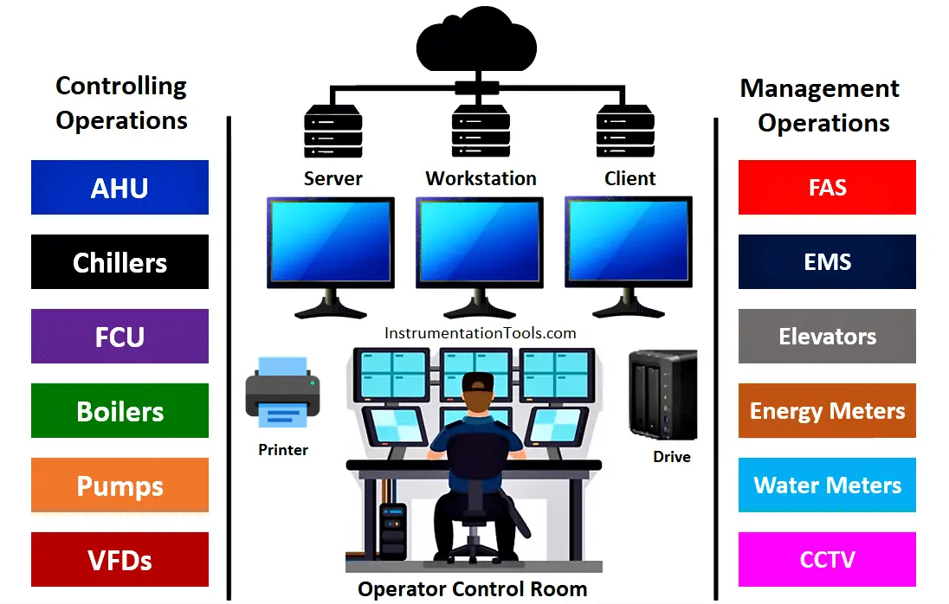
What is….
BMS (Building Management System): Is a system that manages and monitors all building systems, including the electrical system, HVAC system, renewable energy production, and electricity and gas meters.

Slide 6
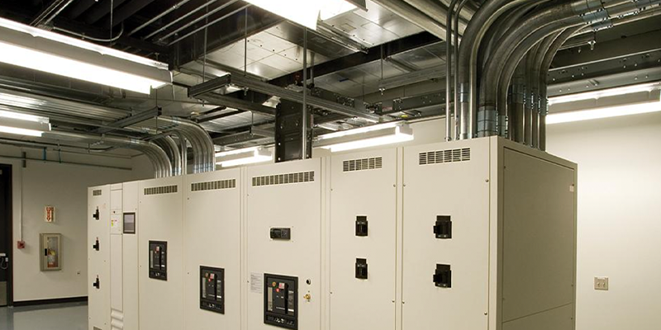
What is….
Electrical Room: Electrical distribution equipment, including electric switchboards, distribution boards, circuit breakers and disconnects, motor control centers, relays, transformers, busbars, fire alarm control panels, and distribution frames and switchgear fuse-switches…etc.
A space for safe and secure operation and maintenance of electrical equipment.

Slide 7
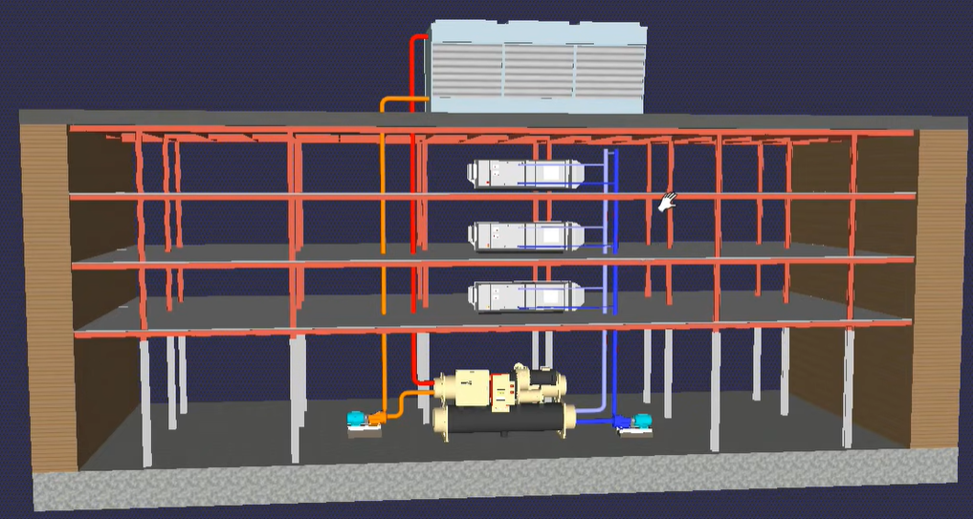
What is….
Cooling Tower: Designed to remove heat from a building by spraying water down through the tower to exchange heat into the inside of the building.

Slide 8
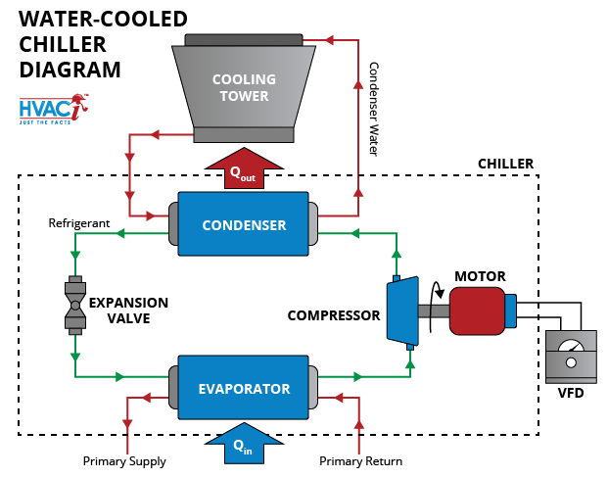
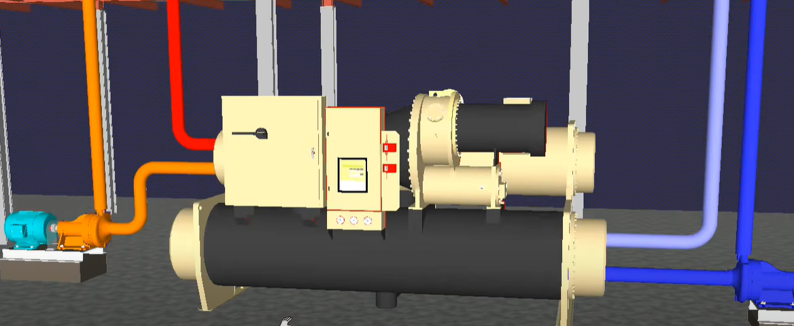
What is….
Chiller: In most process cooling applications, a pumping system circulates cool water or a water/glycol solution from the chiller to the process. This cool fluid removes heat from the process and the warm fluid returns to the chiller.

Slide 9
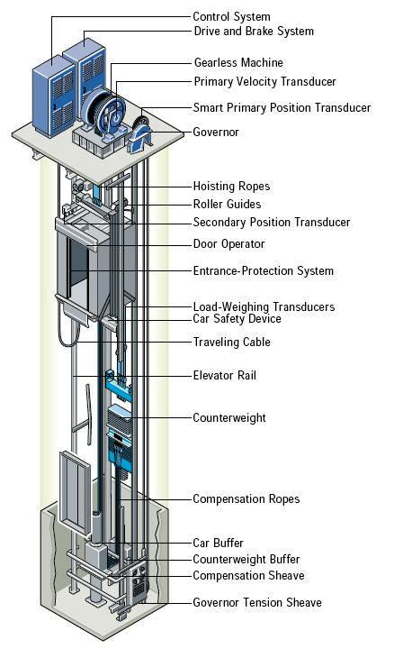
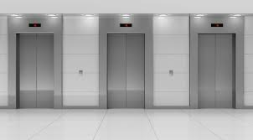
Elevators

Slide 10
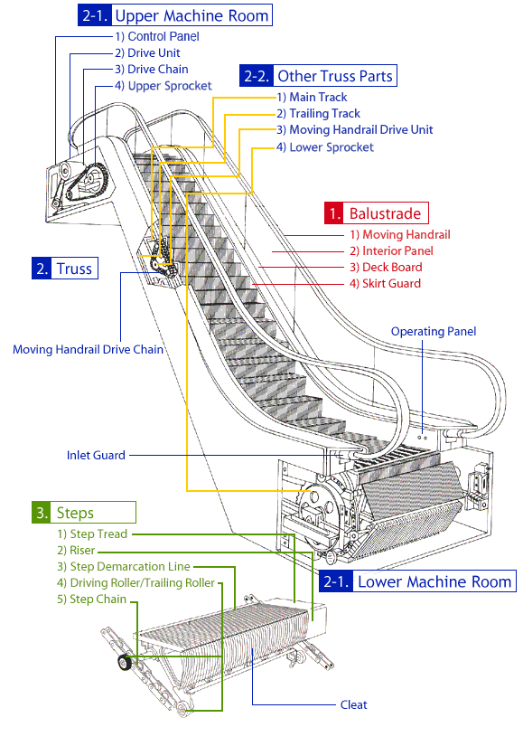
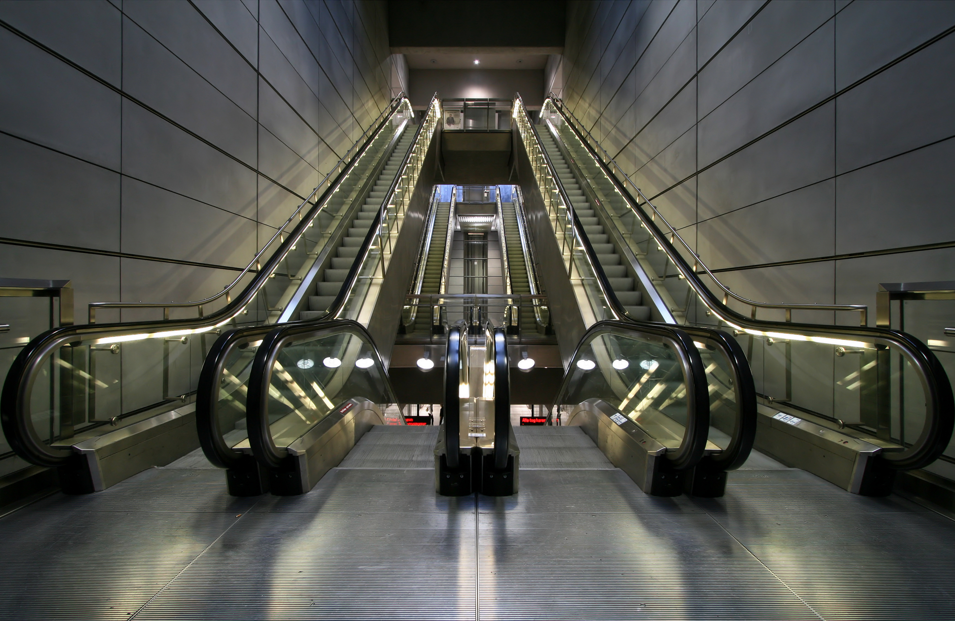
Escalators

Slide 11
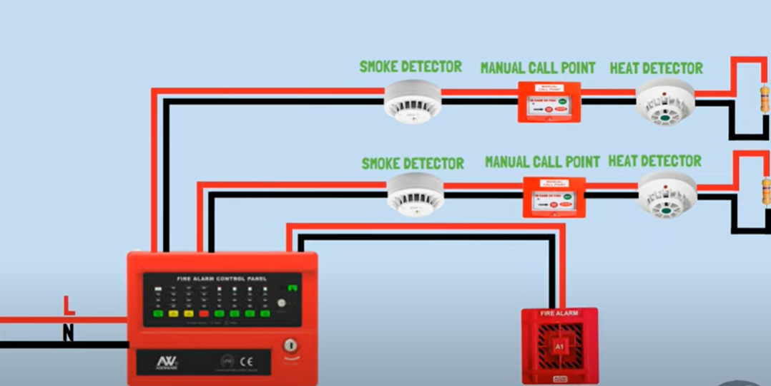
Fire Alarm

Slide 12
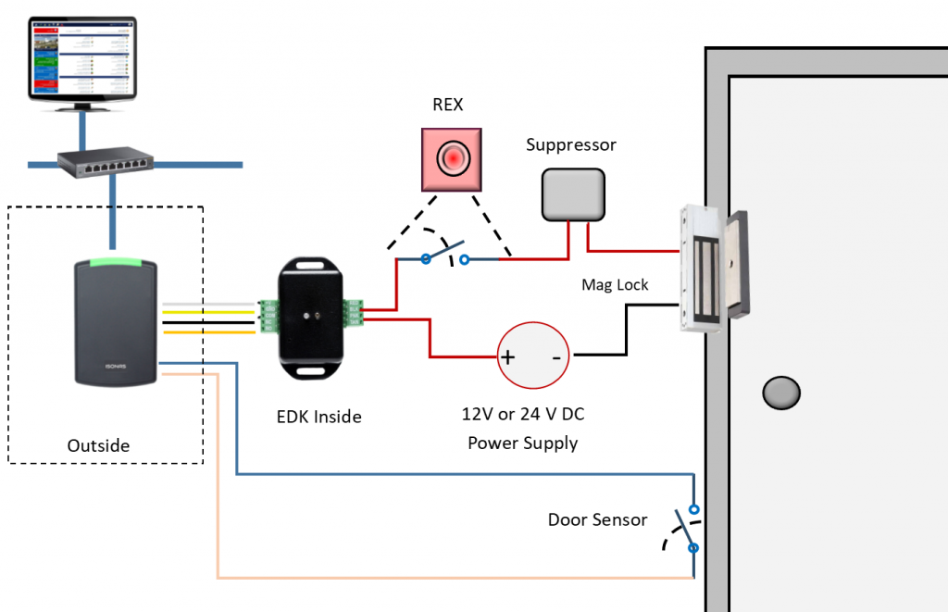
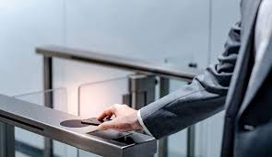
Access Control

Slide 13
Security / CCTV

Slide 14
THANK YOU

