Slide 1
Bart Fire alarm replacement
By : Fady Sedeek

Slide 2
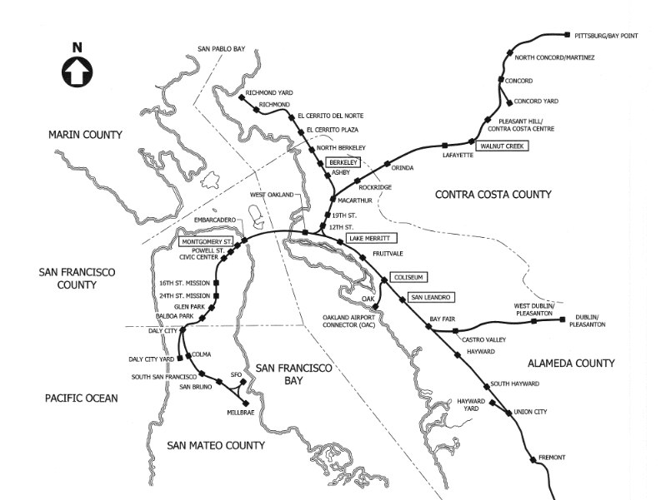
Main Contractor.
Location: San Francisco

Slide 3
SCOPE OF WORK

Slide 4
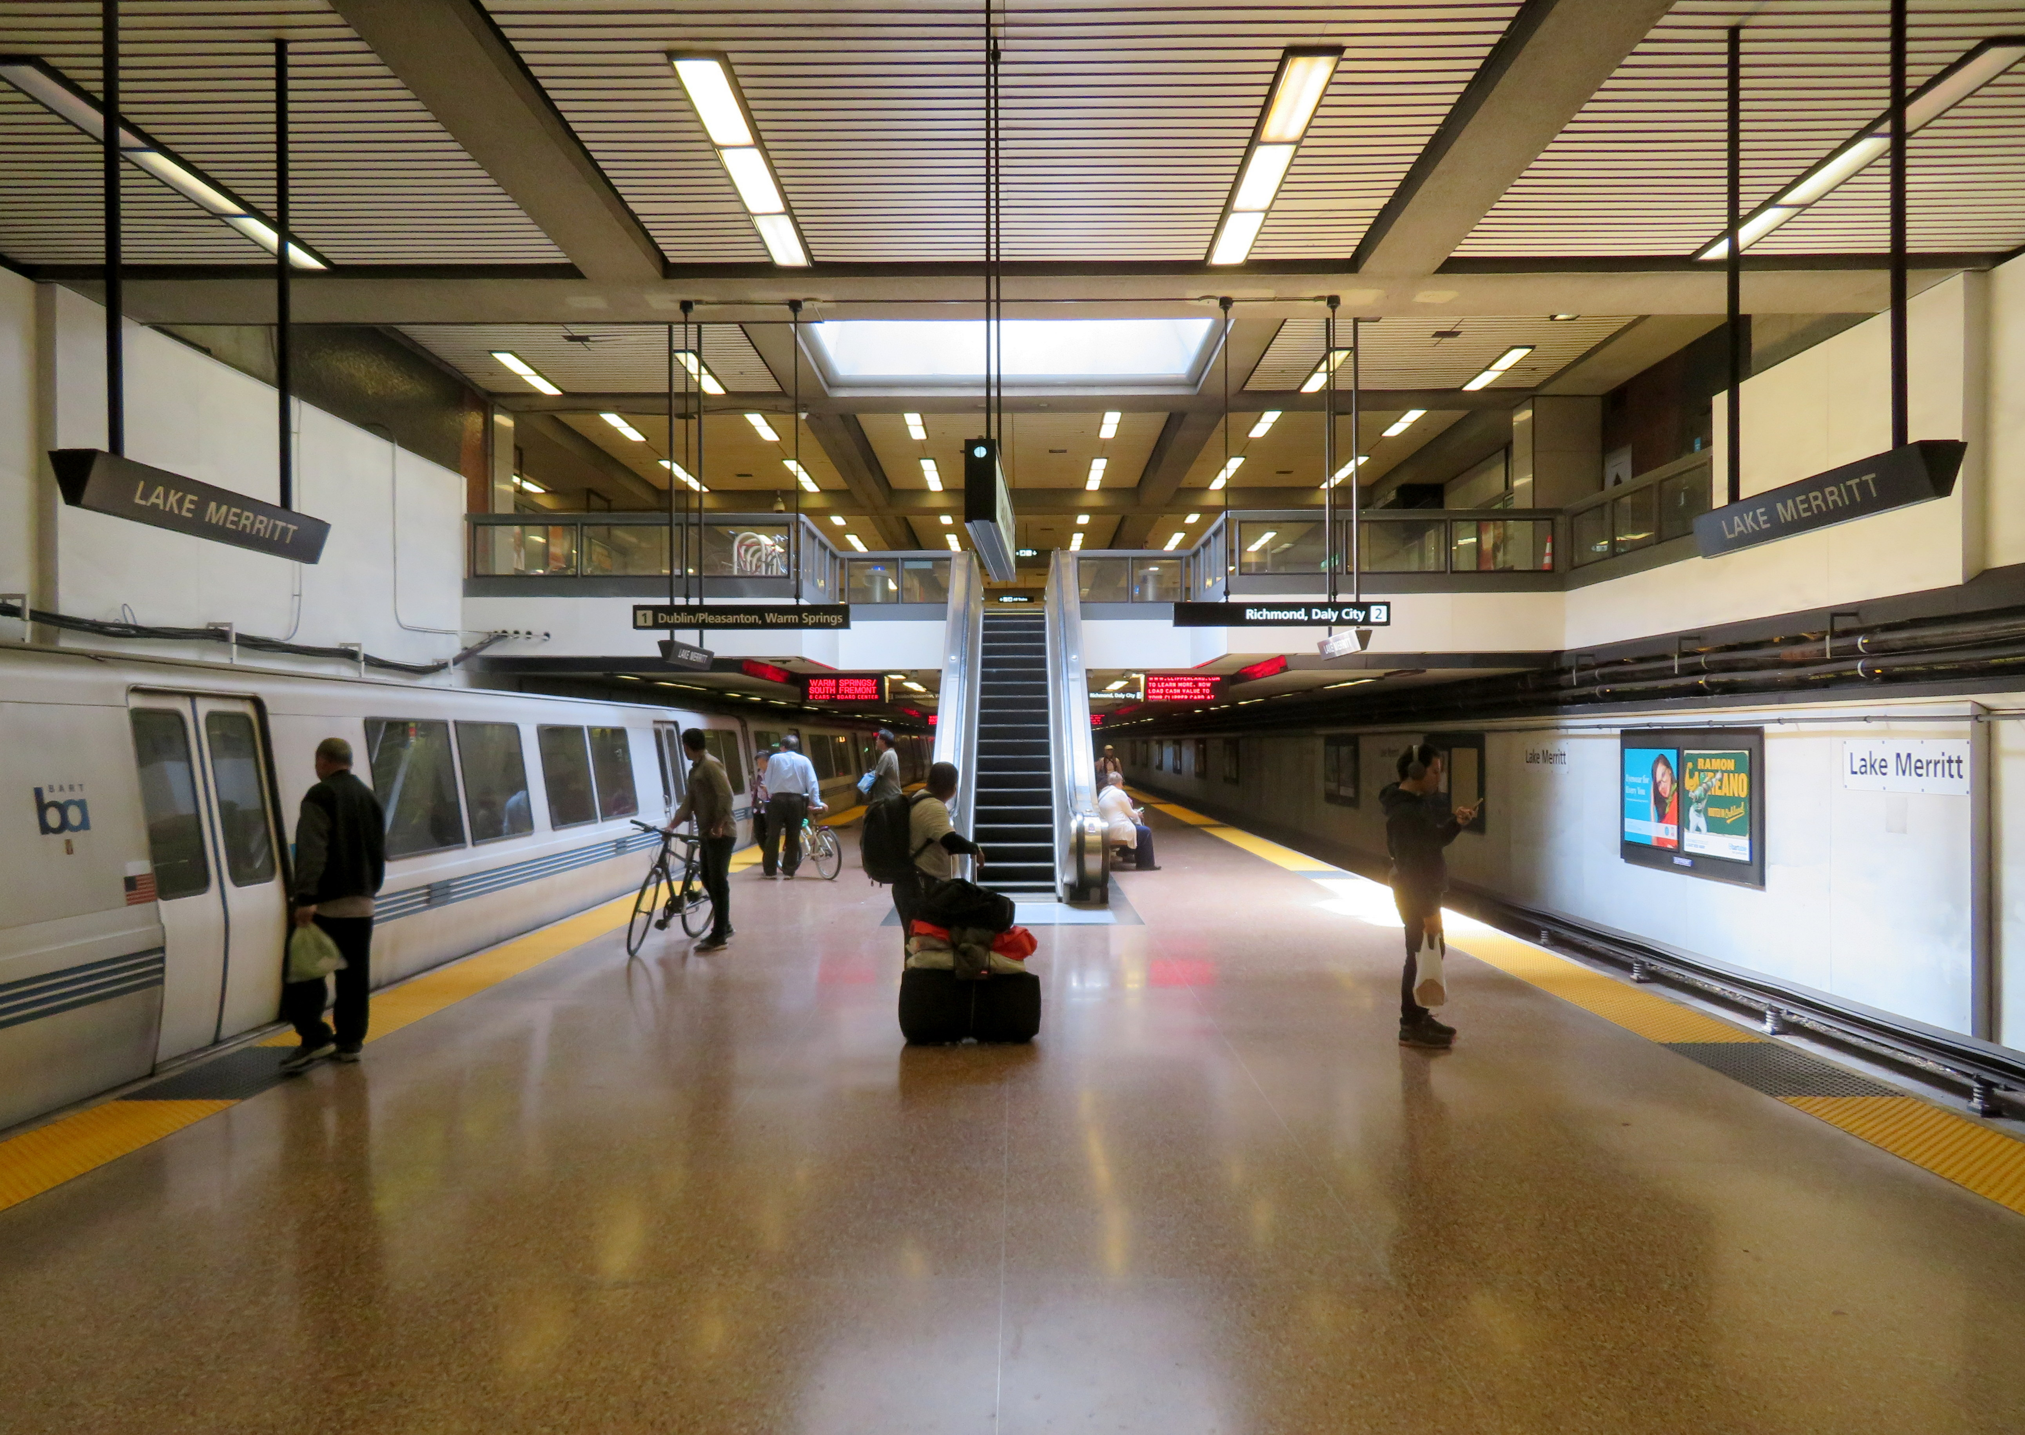
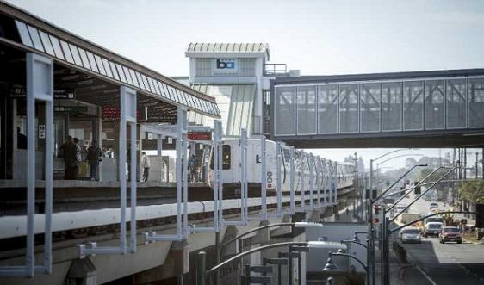
A10 - LAKE MERRITT STATION
A30 – COLISEUMS STATION

Slide 5
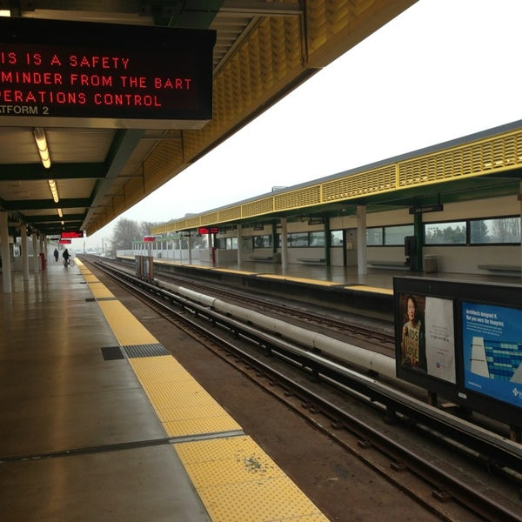
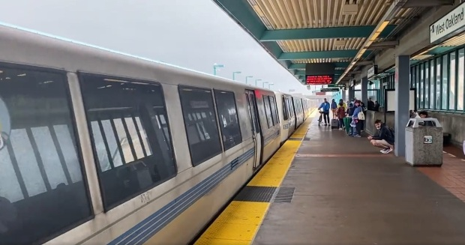
A40 – SAN LEANDRO STATION
C40 -WALNUT CREEK STATION

Slide 6
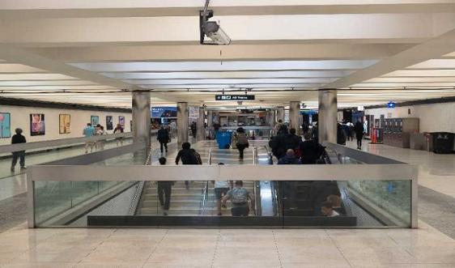
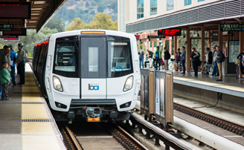
M20 – MONTOGOMERY STATION
R20 – BERKELEY STATION

Slide 7
Fire Alarm System components.
Control Panel
Detectors
Pull Station or Call Point
Notification appliances
Pipes and Cables.

Slide 8
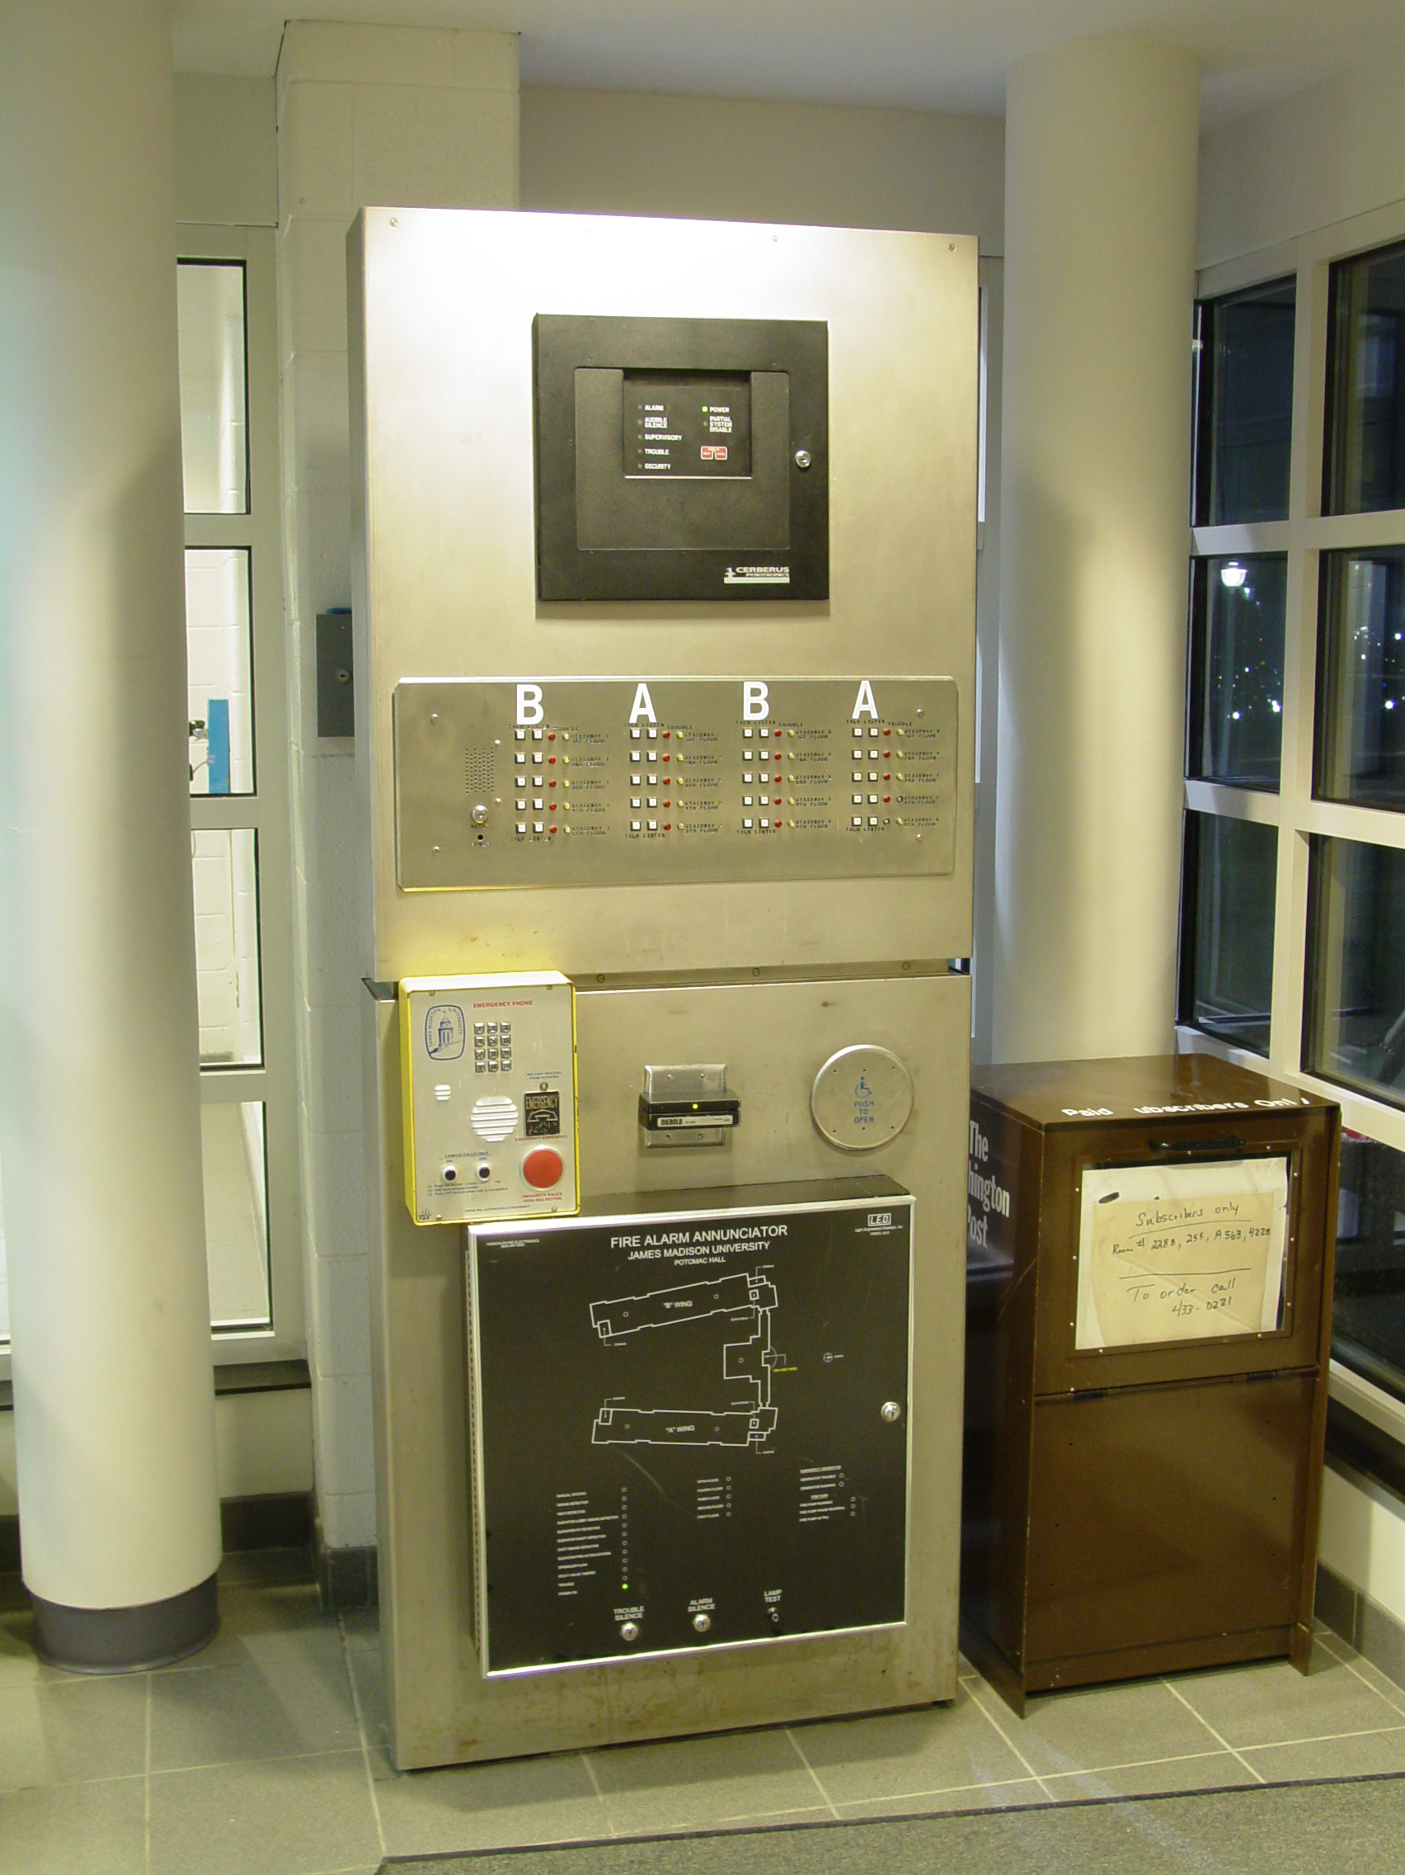
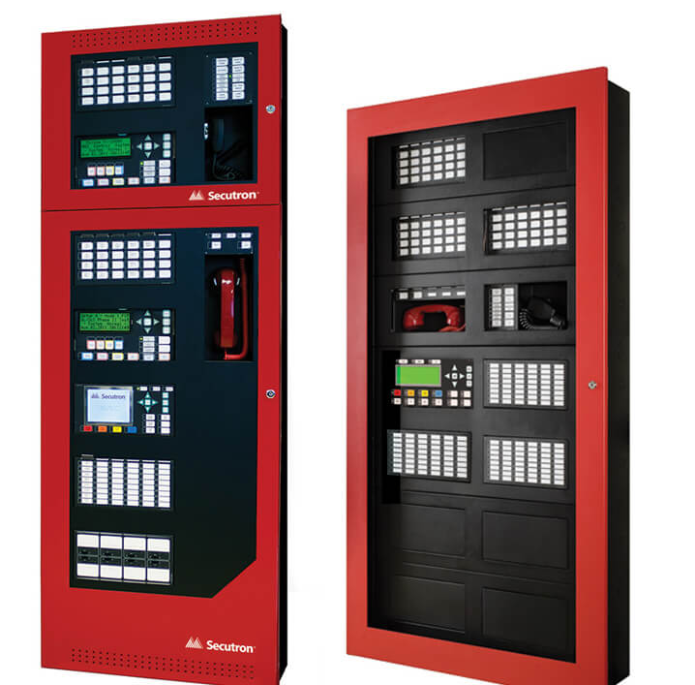
Control Panel

Slide 9
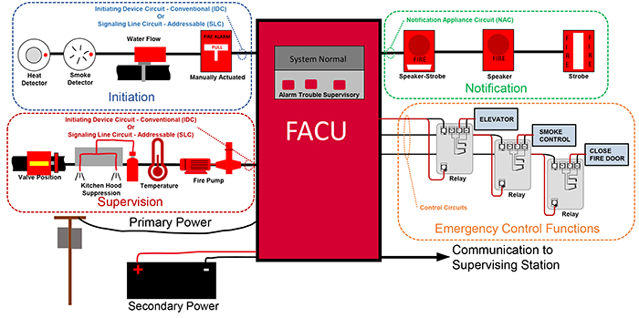
Control Panel
The Fire Alarm Control Panel (FACP) monitors and controls all functions of the fire alarm system. It receives input from initiation devices like a manual pull station or smoke detector, and controls output for notification devices like a horn or strobe, which notify facility staff and other people in the building that the fire alarm system has detected a fire, smoky condition or system problem.

Slide 10
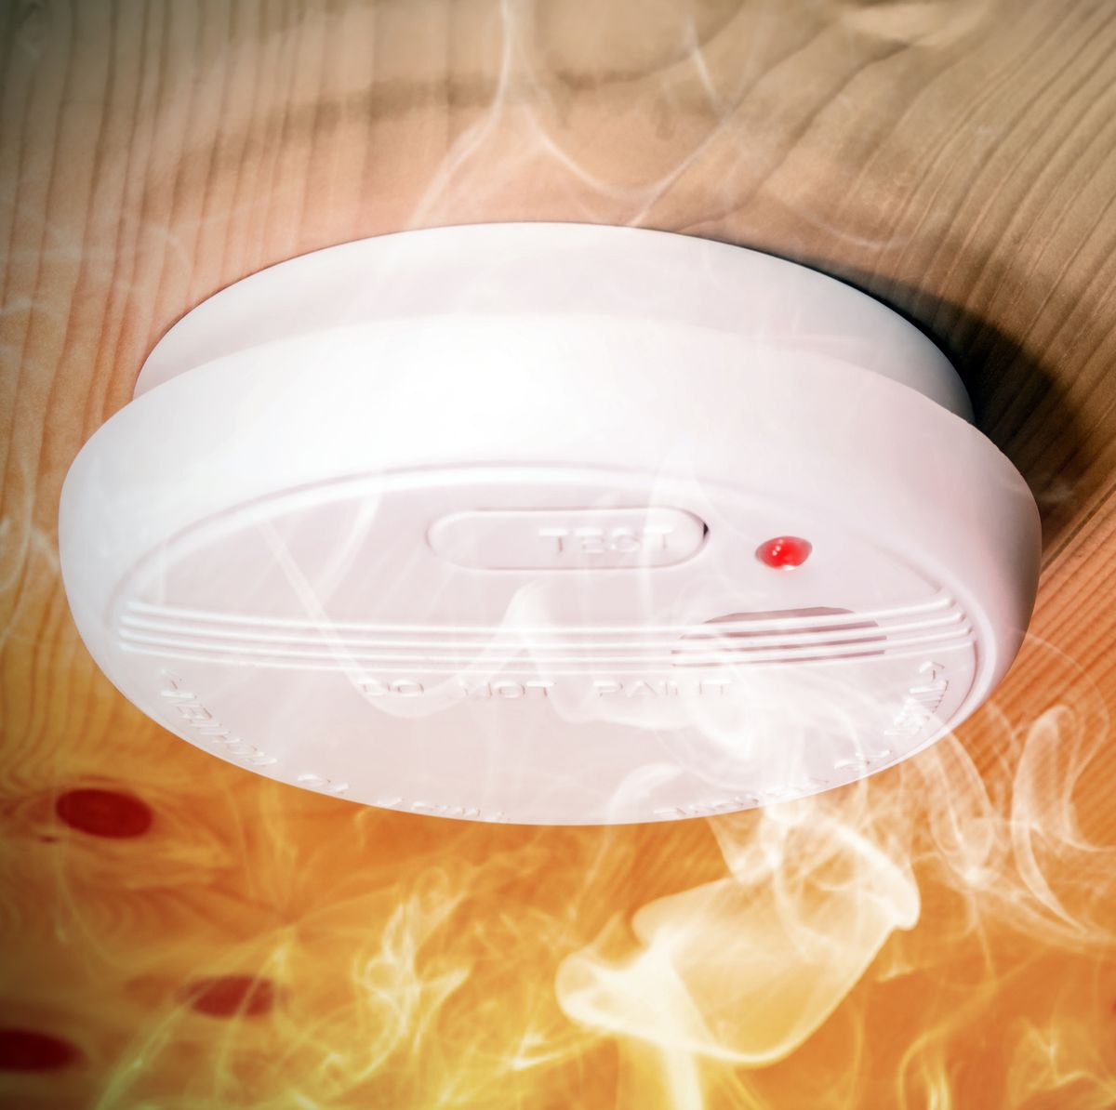
Detector
Heat Detector
Smoke Detector

Slide 11
Detector

Slide 12
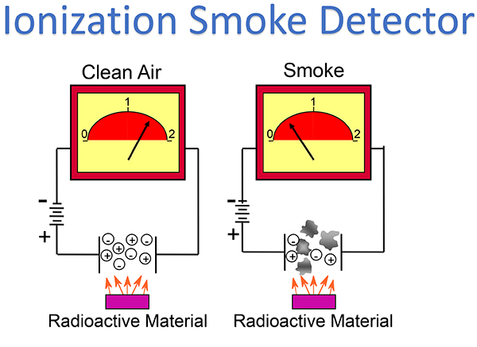
Detector

Slide 13
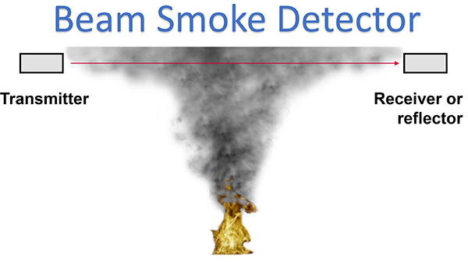
Detector

Slide 14
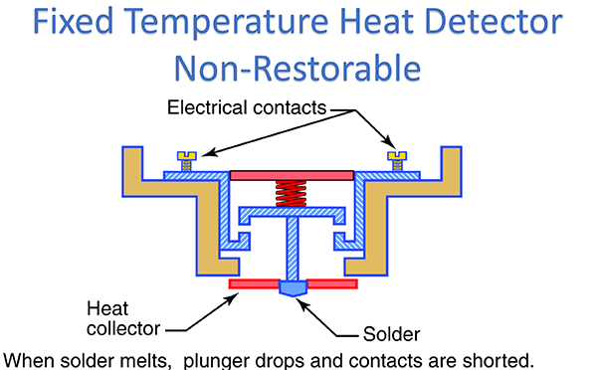
Detector

Slide 15
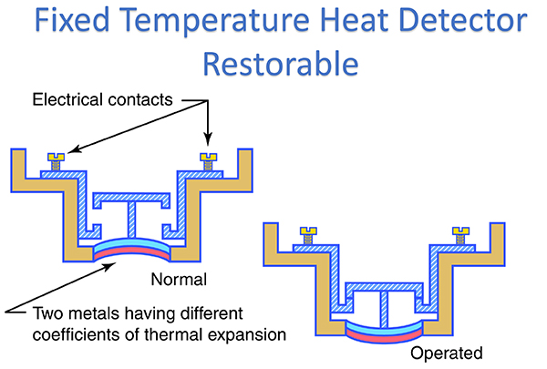
Detector

Slide 16
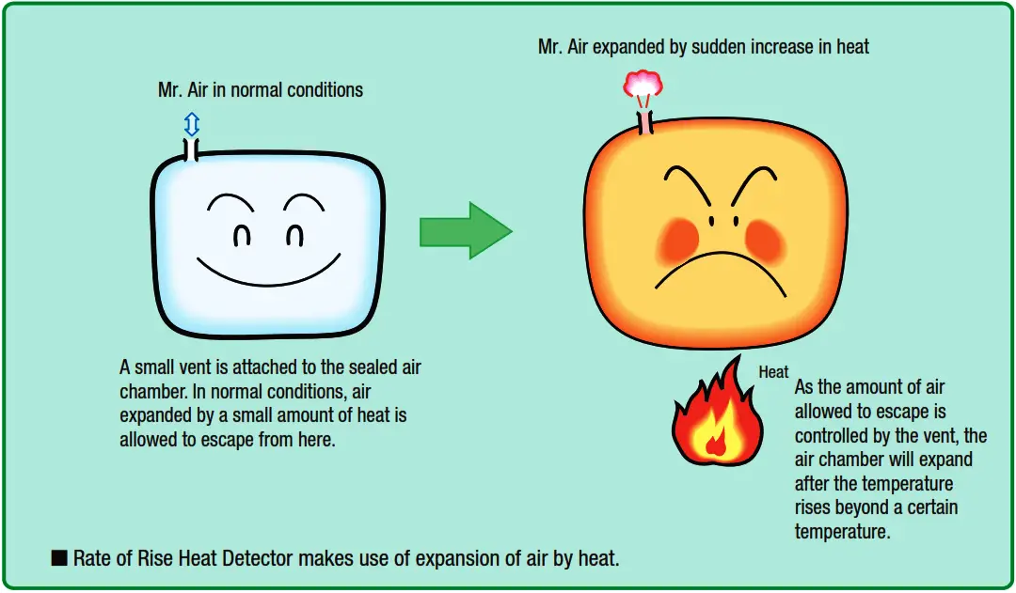
Detector
Rate Of Rise Heat Detector

Slide 17
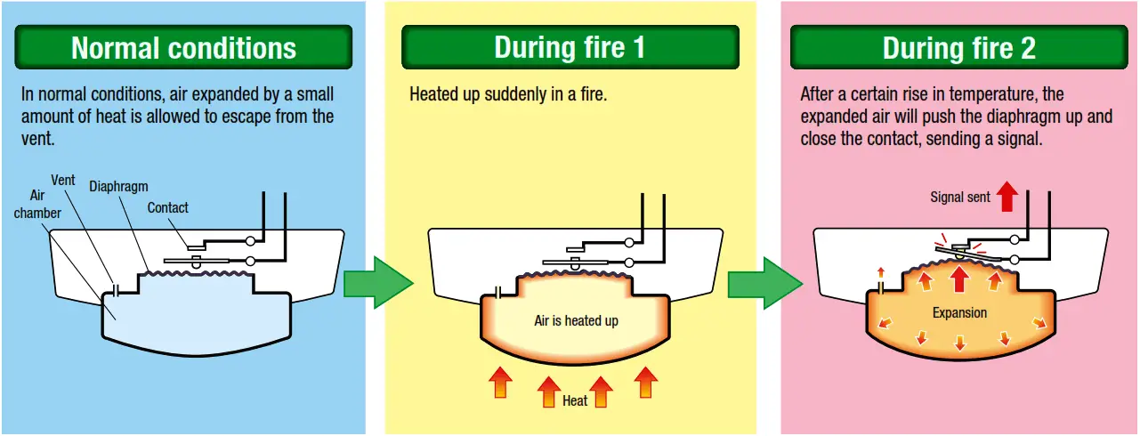
Detector
Rate Of Rise Heat Detector

Slide 18
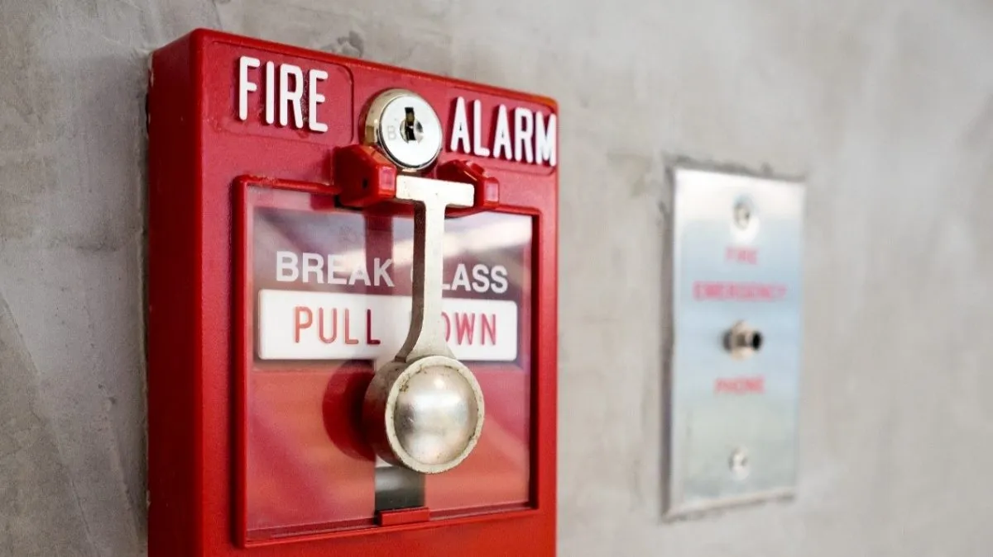
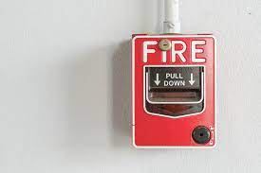
Pull Station or Call Point
Manual fire alarm activation requires human intervention, as distinct from automatic fire alarm activation such as that provided through the use of heat detectors and smoke detectors. It is, however, possible for call points/pull stations to be used in conjunction with automatic detection as part of an overall fire detection and alarm system.

Slide 19
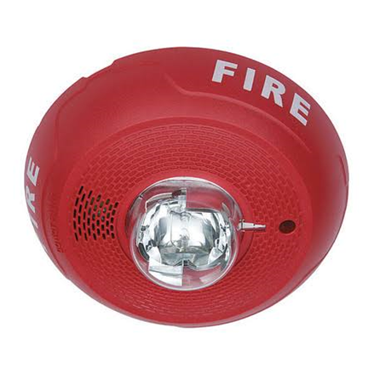
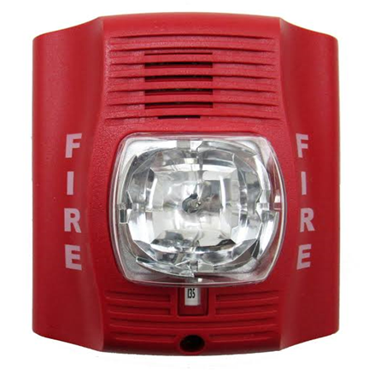
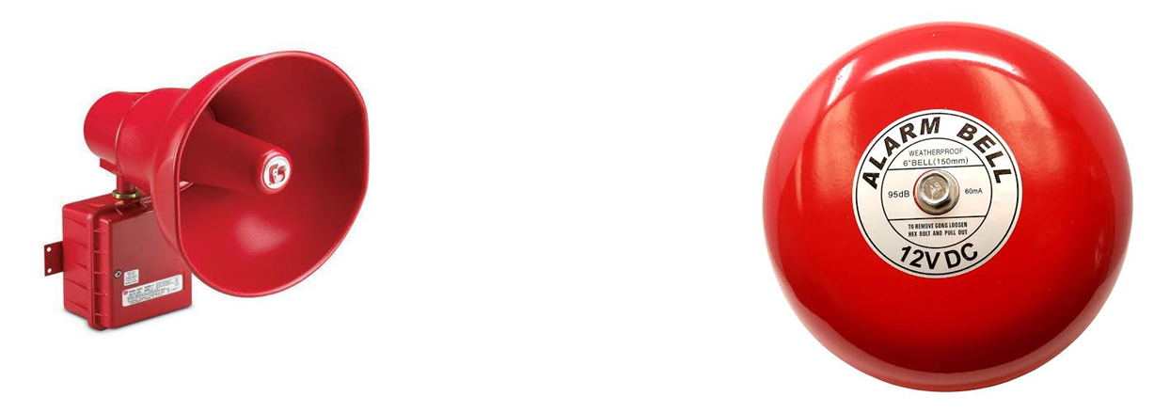
Notification appliances

Slide 20
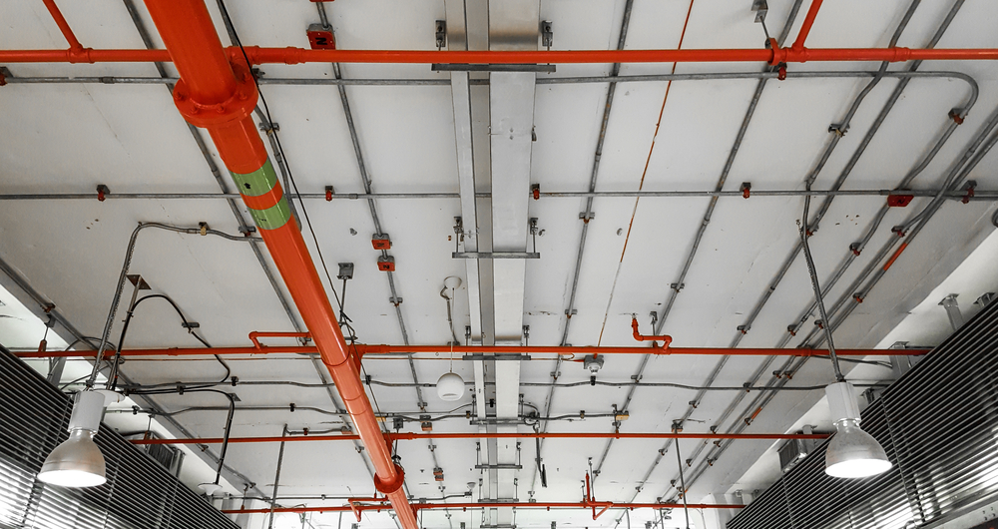
Pipes and Cables

Slide 21
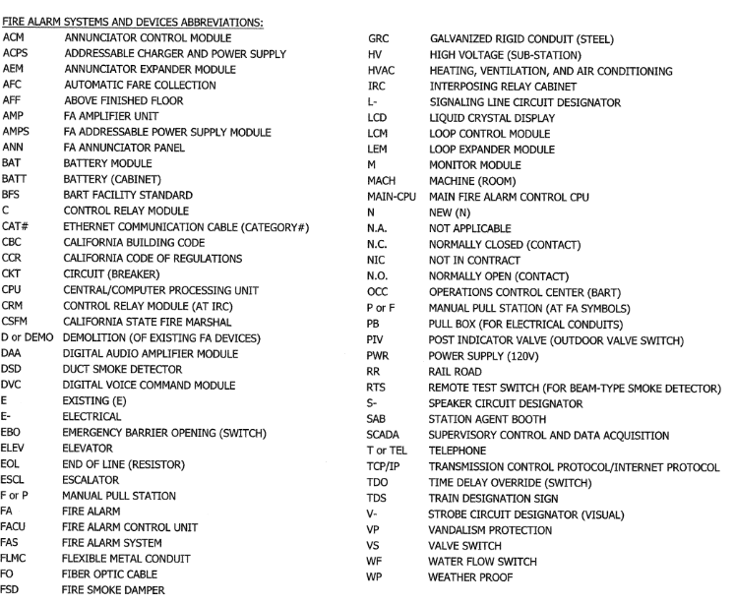
Drawings

Slide 22
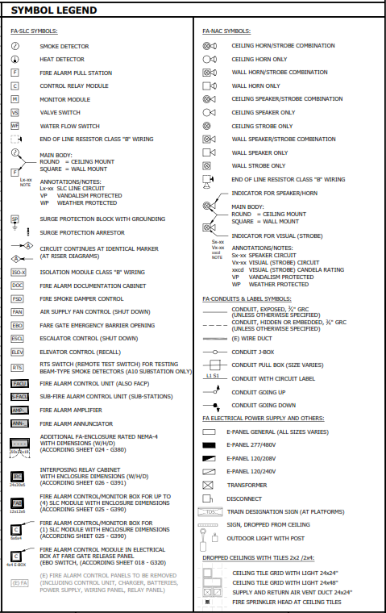
Drawings

Slide 23
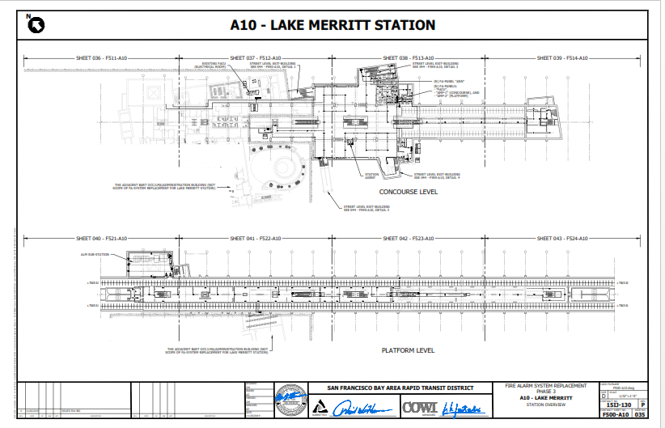
Drawings

Slide 24
Drawings

Slide 25
Construction Sequence
Ceiling
Wall
1. Rough-in (Conduits and Boxes)
1. Rough-in (Conduits and Boxes)
2. Trim out ( Pull Wire)
2. Plaster.
3. Ceiling Rough-in(Accessories and studs)
3. Trim out ( Pull Wire)
4. Ceiling Paint
4. Wall Finishes
5. Fire Alarm Devices
5. Fire Alarm Devices
6. FACU
6. FACU
7. Programming & Testing.
7. Programming & Testing.

Slide 26
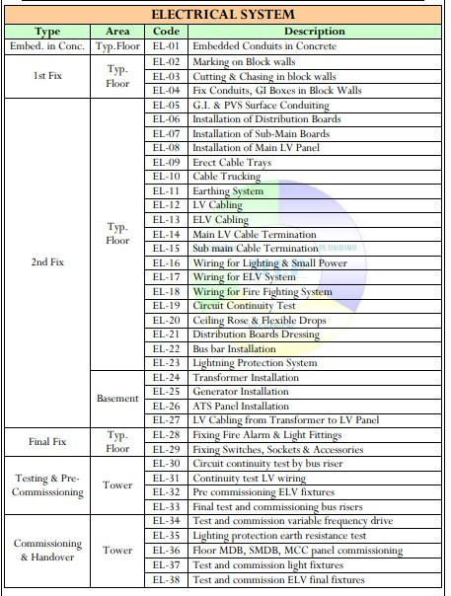
Electrical systems breakdown

Slide 27
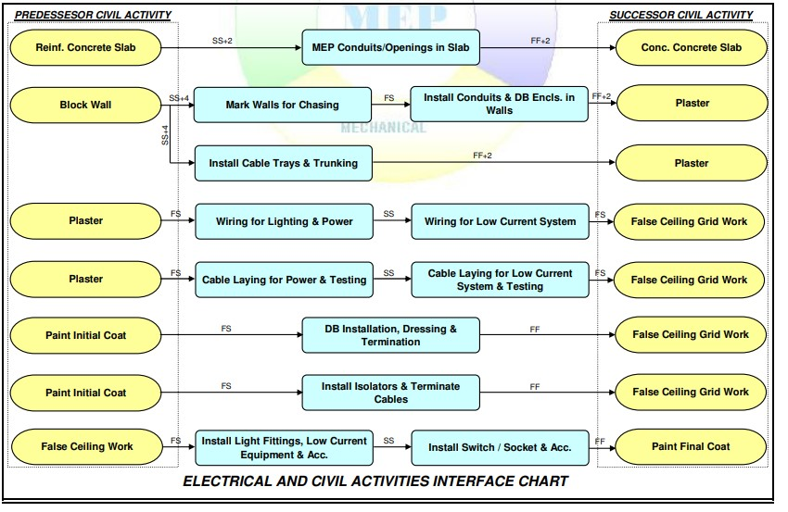
Electrical systems diagram

Slide 28
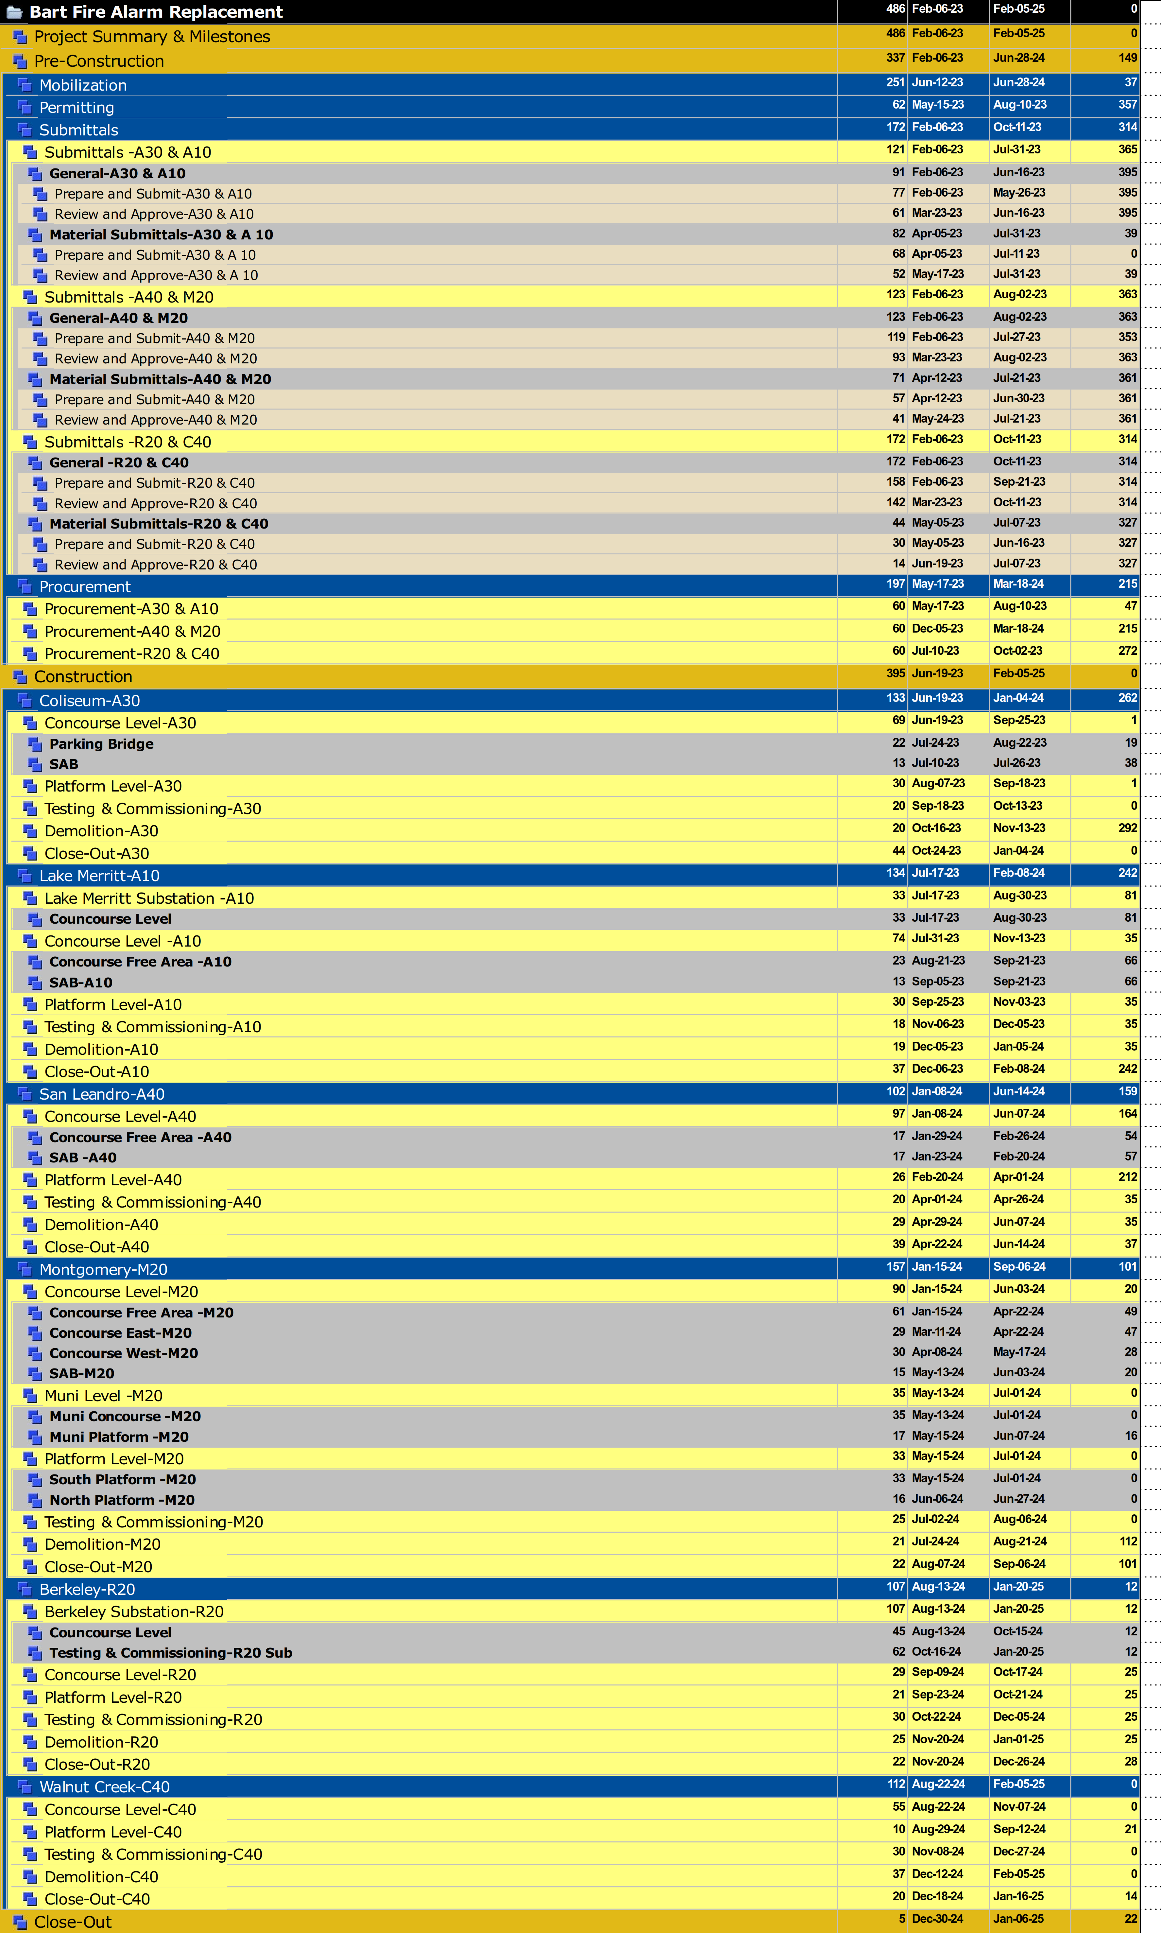
Bart Project WBS

Slide 29
Thank you

